Slide 1
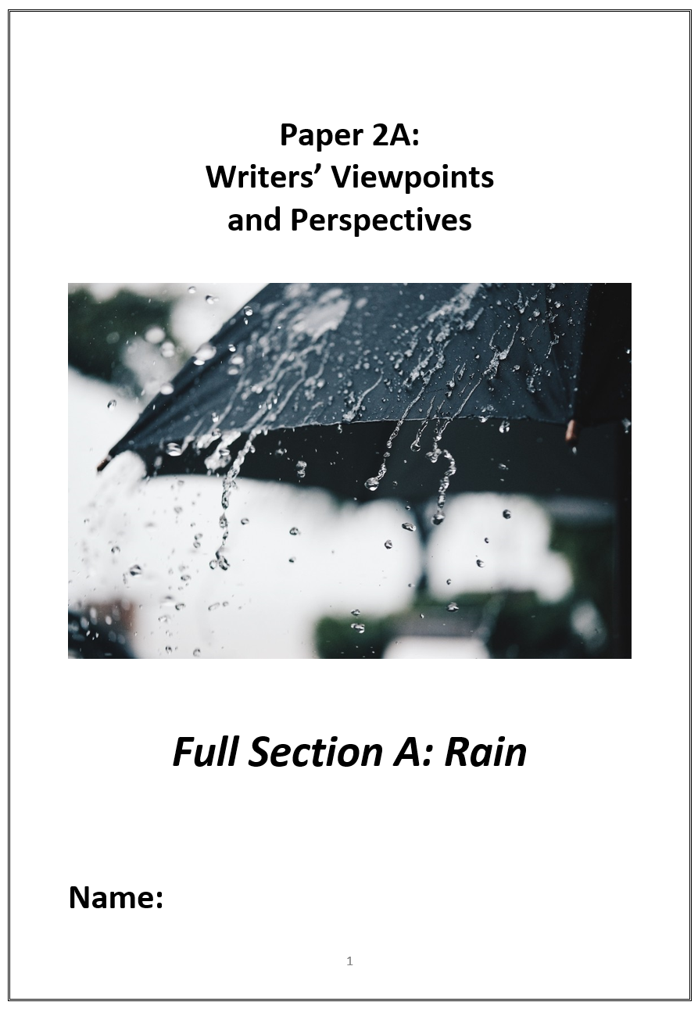
We are going to read two texts:
Text 1: Jottings about London (1883)
Text 2: Rain by Melissa Harrison (2016)

Slide 2
You will be asked four questions
Each question will tell you to look at a part of the text and will give you line numbers
You should answer using only the part of the text from those lines
The questions get more difficult as they go
The later questions are worth more marks, so even if they’re difficult, you should always write something

Slide 3
SOURCE A: Jottings about London by Edmondo de Amicis (1883)
He who has not seen London in the rain, has not seen the real London; and I had this ‘pleasure’ the morning I went to see the Tunnel under the Thames. Then I understood how, in such weather, one can be seized with the temptation to give one's self a pistol shot. The houses drip as if sweating; the water seems not only to descend from the heavens, but also to ooze from the walls and ground; the sombre colours of the buildings turn yet gloomier and take on an oily look; the beginnings of the streets seem like entrances to grottos; everything seems foul, used up, mouldy, and sinister; the eye knows not where to look without meeting something disagreeable; one feels shudderings, which have the effect of a sudden attack of misfortune; one feels an irksome sense of weariness, a disgust with everything: an inexpressible wish to go out like a lamp from this weary world.

Slide 4
SOURCE B: Rain by Melissa Harrison (2016)
What does rain mean to you? We love to grumble about it, yet we invent dozens of terms to describe it and swap them gleefully; it trickles through our literature from Geoffrey Chaucer to Alice Oswald, and there are websites and apps that mimic its sound, soothing us while we work or sleep Rain is what makes the English countryside so green and pleasant; it’s also what swells rivers, ﬂoods farms and villages and drives people out of their homes.
Because it's something that sends most of us scurrying indoors, few people witness what actually happens out in the landscape on a wet afternoon. Clouds gather and rain falls, changing how the English countryside looks, smells and sounds, and the way the living things in it behave. And the falling rain alters the landscape itself, dissolving ancient rocks, deepening river channels and moving soil from place to place. Rain is co-author of our living countryside; it is also a part of our deep internal landscape. which is why we become fretful and uneasy when it‘s too long withheld. Fear it as we might, complain about it as we may, rain is as essential to our sense of identity as it is to our soil. And there’s something else that rain gives us; something deeper and more mysterious, to do with memory, and nostalgia, and a pleasurable kind of melancholy. Perhaps there have simply been too many novels with storm-drenched emotional climaxes and too many ﬁlms in which sad protagonists look out through rain- streaked windows, but it seems to me that rain is a mirror of one of our key emotional states: not a negative one at all, but deeply necessary — just as necessary as joy.

Slide 5
Paper 2
Question 1
This question is the easiest. It will ask you to pick out FOUR things from the text.
You need to shade in the circle of the statements you think are TRUE.
DO:
Box off the lines the question refers to
Underline each relevant detail from the extract as you find it
Shade in the circle of the statements you think are TRUE

Slide 7
Paper 2
Question 2
This question asks you to read both texts.
The question always asks you to summarise the differences or similarities between the two texts.
DO:
Underline relevant words and phrases from the extract as you find them
Use WHAT and HOW to write up your answer, using quotation marks around your evidence
Make sure you use synthesizing words such as ‘however’ or ‘similarly’ to compare the texts

Slide 8
Q2: Write a summary of the differences in the way that the two writers describe rain.

Slide 9
WHAT
One thing we learn…
The writer says… …which suggests…
HOW
LINK
WHAT
One thing we learn…
The writer describes…
This suggests…
HOW
Note! These all show differences.
To make sure you synthesize, you will need to use linking words such as ‘whereas’, ‘unlike’, ‘but’, ‘however’, ‘on the other hand’…

Slide 10
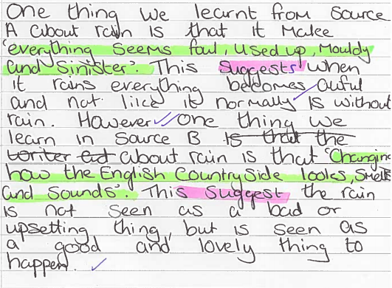

Slide 11
One thing we learn about rain in ‘Jottings about London’ is that it makes you want to shoot yourself. The writer says, ‘one can be seized with the temptation to give one’s self a pistol shot’ which suggests that rain is depressing. However, in ‘Rain’ by Melissa Harrison, we learn that rain is happy and enlightening. The writer says, ‘apps that mimic its sounds, soothing us’. This means that rain is used to help us relax even though we run away from it.

Slide 12
WHAT
One thing we learn…
The writer says… …which suggests…
HOW
LINK
WHAT
One thing we learn…
The writer describes…
This suggests…
HOW
Note! These all show differences.
To make sure you synthesize, you will need to use linking words such as ‘whereas’, ‘unlike’, ‘but’, ‘however’, ‘on the other hand’…

Slide 13
Paper 2
Question 3
This question asks you to read one of the texts again.
The question is always about what language the writer has used.
DO:
Underline interesting words and phrases from the extract as you find them
Use WHAT, HOW, WHY to write up your answer, using quotation marks around your evidence

Slide 14
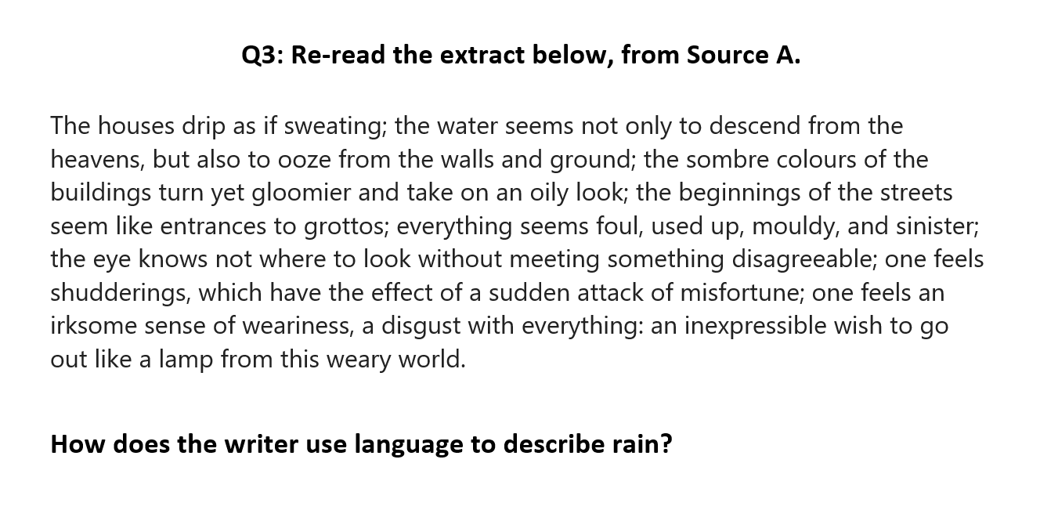
WHY
HOW
WHAT
Dig in to one word – what does it suggest?
Pull back: what is the writer trying to say about London?
Most obvious idea here.
‘QUOTATION’

Slide 15
Paper 2
Question 4
This question asks you to read both texts.
The question always asks you to summarise the differences or similarities in the viewpoints of the writers.
What are the writer’s thinking, feeling, imagining and experiencing? What do they do to present these thoughts, feelings and experiences? How do they write to ensure they get these ideas across to their reader?

Slide 16
Paper 2
Question 4
This question asks you to read both texts.
The question always asks you to summarise the differences or similarities in the viewpoints of the writers.
DO:
Underline interesting words and phrases from the extract as you find them
Use WHAT, HOW, WHY to write up your answer, using quotation marks around your evidence
Make sure you include an idea about what the writer thinks or feels
Make sure you use synthesizing words such as ‘however’ or ‘similarly’ to compare the texts

Slide 17
Q4 For this question, you need to refer to the whole of Source A, together with Source B.
Compare how the two writers convey their different views on rain.
[16 marks]
HOW
WHY
WHAT
Dig in to words – what do they suggest about the rain?
What does (s)he think about the rain?
What does this literally tell us?

Slide 18
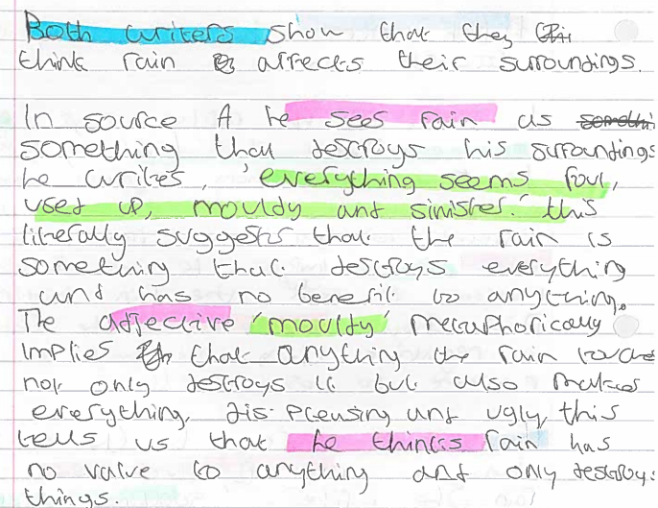

Slide 19
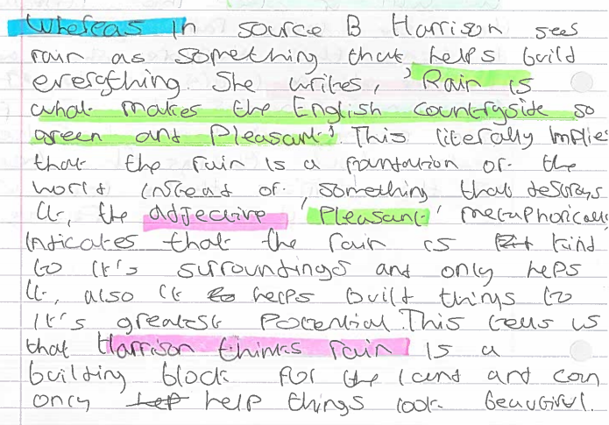

Slide 20
Q4 For this question, you need to refer to the whole of Source A, together with Source B.
Compare how the two writers convey their different views on rain.
[16 marks]
HOW
WHY
WHAT
Dig in to words – what do they suggest about the rain?
What does (s)he think about the rain?
What does this literally tell us?

