Slide 1
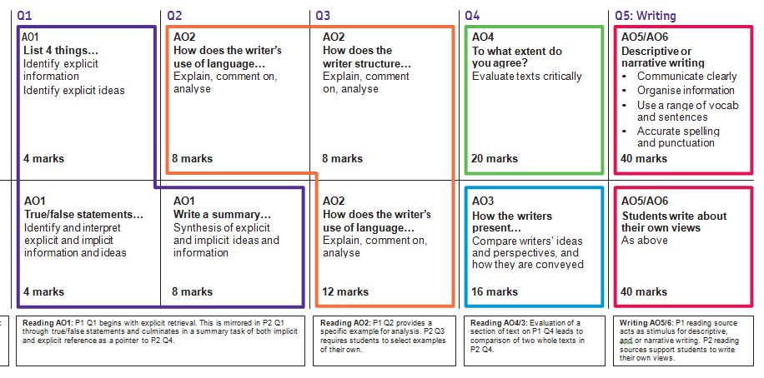

PAPER 1
PAPER 2

Slide 2

English Language Paper 1
Explorations in creative reading and writing

Slide 3
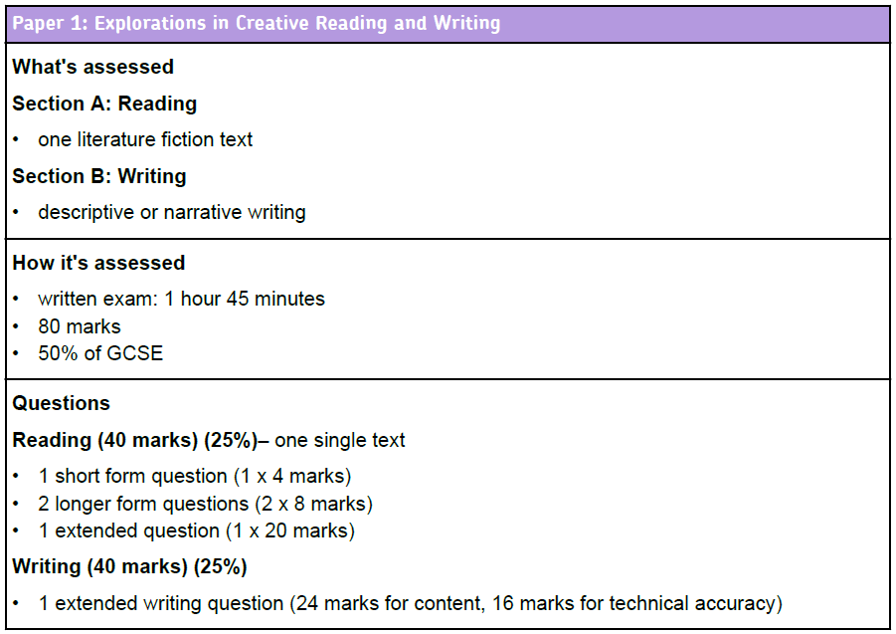
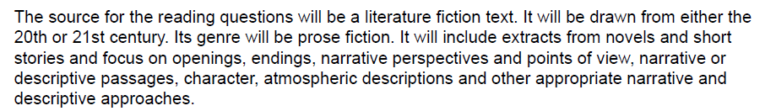

Slide 4

Paper 1
Question 1
‘The few who offered incorrect points either selected from the wrong lines or misinterpreted the text at a basic level.’
said…
Q1: Read lines 3-8.
List four things from this part of the text that people believe about Billy Tapper.
[4 marks]
The first question is designed to ease you into the exam. The question will specify which lines you need to read. It will ask you to pick out FOUR things from the text.

Slide 5
An example
When he first saw the crow, he took no notice. There had been several crows. This one glided down into the corn on its enormous, ragged black wings. He began to be aware of it when it rose up suddenly, circled overhead, and then dived, to land not very far away from him. Kingshaw could see the feathers on his head, shining black in between the butter-coloured corn-stalks. Then it rose, and circled, and came down again, this time not quite landing, but flapping about his head, beating its wings and making a sound like flat leather pieces being slapped together. It was the largest crow he had ever seen. As it came down for the third time, he looked up and noticed its beak, opening in a screech. The inside of its mouth was scarlet, it had small glinting eyes.
King of the Castle, Susan Hill
List four things about the crow’s behaviour that Kingshaw finds frightening.

Slide 6
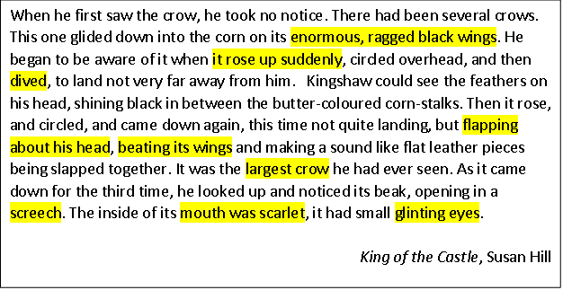
An example
List four things about the crow’s behaviour that Kingshaw finds frightening.
It was very large
It had enormous ragged black wings
It rose up suddenly
It flapped about his head
It beat its wings noisily
It kept diving towards him
It screeched
Its mouth was scarlet inside
It had glinting eyes
Some information is paraphrased and some is directly quoted – you can do either.

Slide 7
Let’s practise…
I DO NOT REMEMBER our arrival at my grandfather’s farm sometime before daybreak, after a drive of nearly twenty miles with heavy work-horses. When I awoke, it was afternoon. I was lying in a little room, scarcely larger than the bed that held me, and the window-shade at my head was flapping softly in a warm wind. A tall woman, with wrinkled brown skin and black hair, stood looking down at me; I knew that she must be my grandmother. She had been crying, I could see, but when I opened my eyes she smiled, peered at me anxiously, and sat down on the foot of my bed.
My Antonia by Willa Cather
List four things we learn about the grandmother from this part of the text .

Slide 8
Another go…
The snow was falling, and the Cat's fur was stiffly pointed with it, but he was imperturbable. He sat crouched, ready for the death-spring, as he had sat for hours. It was night—but that made no difference—all times were as one to the Cat when he was in wait for prey. Then, too, he was under no constraint of human will, for he was living alone that winter. Nowhere in the world was any voice calling him; on no hearth was there a waiting dish. He was quite free except for his own desires. The Cat was very hungry—almost famished, in fact.
*imperturbable: calm; self-controlled
The Cat by Mary E Wilkins Freeman
List four things we learn about the cat from this part of the text .

Slide 9
Paper 1
Question 1
‘The few who offered incorrect points either selected from the wrong lines or misinterpreted the text at a basic level.’
said…
Q1: Read lines 3-8.
List four things from this part of the text that people believe about Billy Tapper.
[4 marks]
The first question is designed to ease you into the exam. The question will specify which lines you need to read. It will ask you to pick out FOUR things from the text.

Slide 10

Give yourself a mark for each:
People believed he had been a music teacher at a boys’ grammar school.
Bill was the head of a girls’ school in Scotland, or down south, or in Hull, somewhere, anywhere.
They thought but that the drink had sent him mad was universally accepted.
They thought he was eccentric or had eccentricities.
People believed he lived in a cave.
People believed he had killed someone in Whitehaven with a hammer.
People believed he had a daughter somewhere.
People believed he thought that collecting certain combinations of stones and shells made him invisible.

Slide 11
Paper 1
Question 2
‘Students who performed less well on this question often identified and labelled language features but failed to comment on the effect on the reader or explain a reason behind the writer’s choices.’
said…
Look at lines 9-15. How does the writer use language to describe Billy Tapper?
[8 marks]
In this question, you need to comment on language devices and their effect. You need to consider WHY the writer has used these devices. If you are struggling to find devices, you must comment on single words. You must remember to use the correct subject terminology.
The question will always ask you how the writer has used language to achieve something. The question will ask you to look at a specific area of the text.

Slide 12
Learning Objective: Q2: explain, comment on and analyse how writers use language…
Level 4 Perceptive, Detailed 7-8 marks | Shows detailed and perceptive understanding of language: • Analyses the effects of the writer’s choices of language • Selects a judicious range of quotations • Uses a range of subject terminology appropriately
Level 3 Clear, relevant 5-6 marks | Shows clear understanding of language: • Clearly explains the effects of the writer’s choices of language • Selects relevant quotations • Uses a subject terminology accurately
Level 2 Some, attempts 3-4 marks | Shows some understanding of language: • Attempts to comment on the effect of language • Selects some relevant quotations • Uses some subject terminology, not always appropriately
Level 1 Simple, limited 1-2 marks | Shows simple awareness of language: • Offers simple comment on the effects of language • Simple references or textual details • Simple mention of subject terminology
Grade 4

Slide 13
Paper 1
Question 2
Look at lines 9-15. How does the writer use language to describe Billy Tapper?
[8 marks]
DO:
Box off the lines the question refers to
Underline interesting words and phrases from the extract as you find them
Use WHAT, HOW, WHY to write up your answer, using quotation marks around your evidence

Slide 14
1. What does the verb ‘shattered’ suggest?
2. What does the image ‘twisted deep down into his skull’ convey?
I wasn’t sure how much of it was true, but it didn’t matter. Once you’d seen Billy Tapper, anything they said about him seemed possible. I’d never seen a man be so unkind to his own body. His fingers and his palms were shattered with filth. Every crease and line was brown. Either side of his broken nose his eyes were twisted deep down into his skull. His hair crawled past his ears and down his neck which had turned sea-coloured with dozens of tattoos. There was something faintly heroic about his refusal to wash, I thought, when my brother and I were so regularly scrubbed and towelled by Mummer. He slumped on the bench, with an empty bottle of something evil lying on its side on the floor.
3. What method is ‘crawled’? What does it signify about Billy’s hair?
4. How does the phrase ‘sea-coloured’ position the reader to respond to Billy’s tattoos?
5. What effect does ‘faintly heroic’ have on the reader’s impression of Billy?
6. What does the verb ‘slumped’ imply?

Slide 15
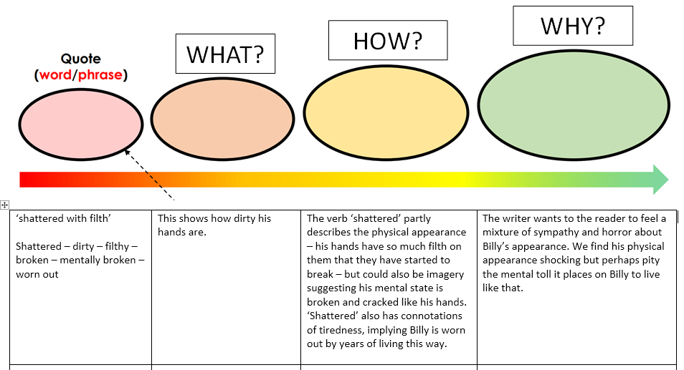
Rainbow word analysis
Terminology:
describes imagery
suggesting connotations
implying reader

Slide 16


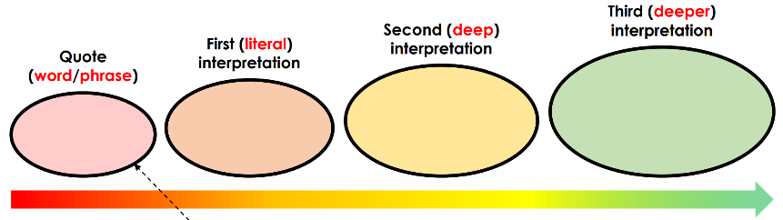
Question 2:
Question 2: Look in detail from lines 8 to 17
How does the writer use language to describe Billy Tapper?
You could include the writer’s choice of:
Words and phrases
Language features and techniques
Sentence forms
[8 marks]
I wasn’t sure how much of it was true, but it didn’t matter. Once you’d seen Billy Tapper, anything they said about him seemed possible. I’d never seen a man be so unkind to his own body. His fingers and his palms were shattered with filth. Every crease and line was brown. Either side of his broken nose his eyes were twisted deep down into his skull. His hair crawled past his ears and down his neck which had turned sea-coloured with dozens of tattoos. There was something faintly heroic about his refusal to wash, I thought, when my brother and I were so regularly scrubbed and towelled by Mummer. He slumped on the bench, with an empty bottle of something evil lying on its side on the floor.
10
minutes

Slide 17
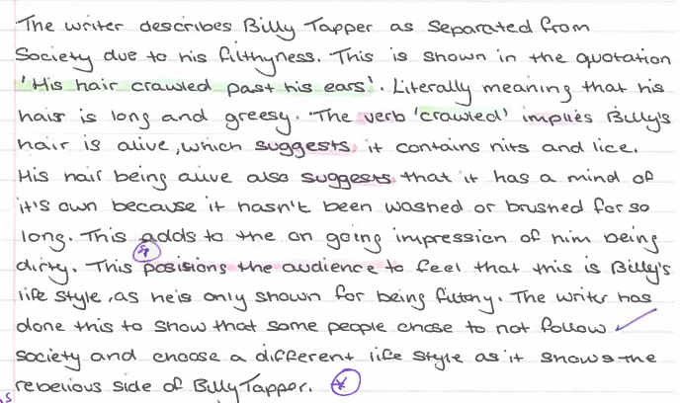

Slide 18
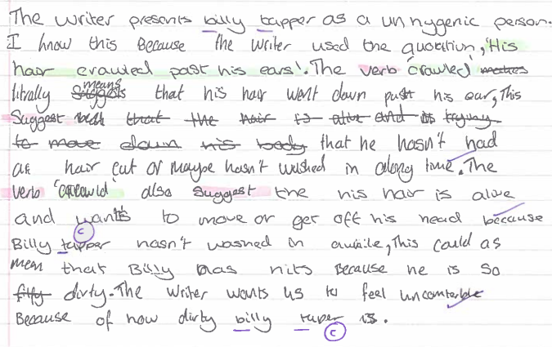

Slide 19
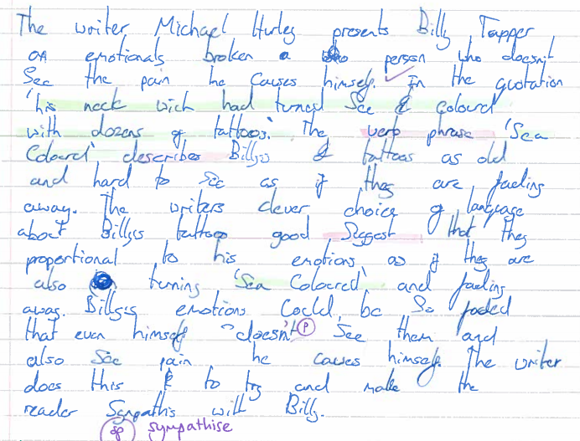

Slide 20
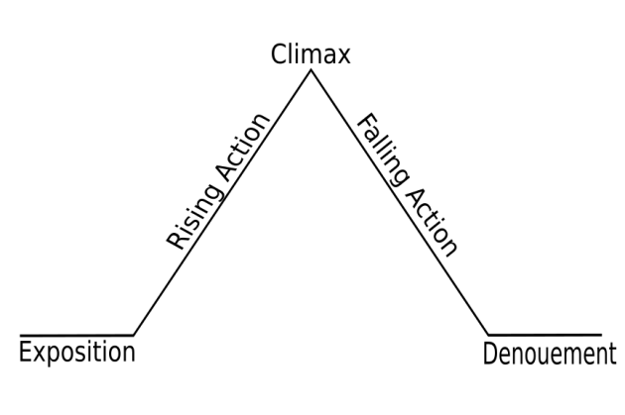
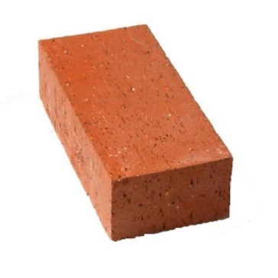
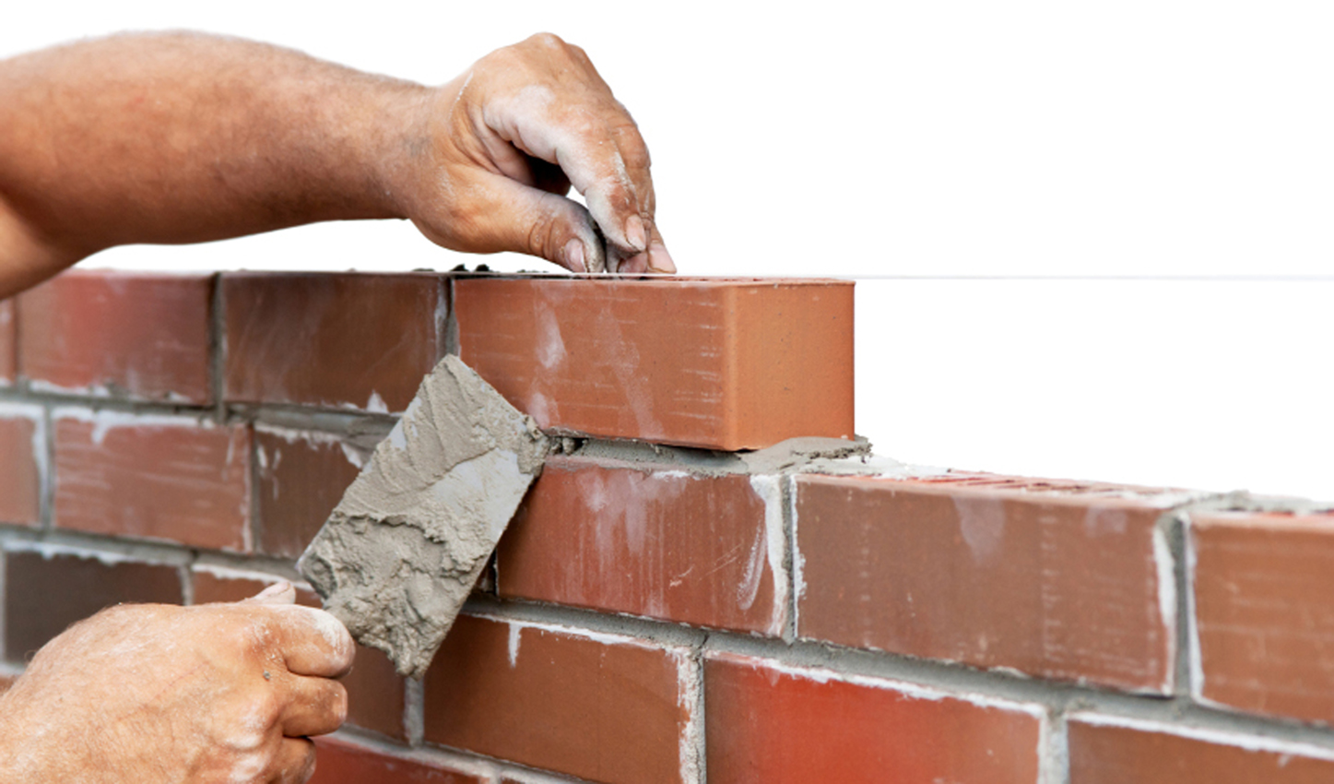
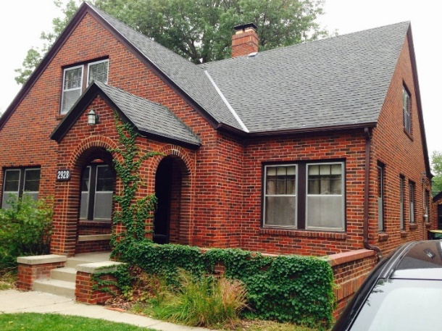
Paper 1
Question 3
In your GCSE exam, you will be answering the following question:
How has the writer structured the text to interest you as a reader?
STRUCTURE
Text structure refers to how the information within a written text is organized.

Slide 21
What is structure?
Structure

Slide 22
The turning point and most exciting part of the story. Creates strong emotions, e.g. fear.
The events of the plot that build tension, all leading to the climax.
Shifts in focus keep the momentum going.
Unravelling of the conflict.
A resolution.
A catharsis (release of tension and anxiety).
Introduction: setting; characters; events before the main plot; back stories etc.

Slide 23
Why does the writer zoom in to describe him in detail. What does this reveal about him?
Why does he shift to dialogue? Does this change/develop our opinion?
Who else’s impression of Billy does the writer shift to?
Why does this come where it does in the text? Does this change/develop our opinion?
Why does it end with his inner thoughts? What are we left thinking?
It is unlikely you will get any falling action in your exam text.
Why has the writer started with a detailed list of things that people believe on Billy Tapper?
What does this make us think about his character?
What atmosphere does it create?
It is unlikely you will get any denouement in your exam text.

Slide 24
Look through the example answer you have on your sheet.
Label where the structural features are identified
Any short quotations used to anchor the answer
Structural terminology, e.g. shift, zoom in, rising action
WHAT the writer has done (and WHERE)
WHY the writer has done it there/the effect on the reader (i.e. why it is interesting)

Slide 25
Overall, the writer interests us by slowly revealing information about Billy’s character. We begin with myths about Billy and then shift to hearing him speak and finally see various character’s thoughts and reactions to him.
The writer begins by stating ‘Billy was the local drunk’ Everyone knew him’. These two blunt sentences at the start act as exposition and immediately allow the reader to see his low status and poor reputation in the community. He then switches to a list of myths about him e.g. ‘he lives in a cave’. By placing these at the start he creates a sense of mystery surrounding Billy’s character. This is interesting as we question what he is like as a person.
The writer then switches focus to zoom in on Billy Tapper in detail for example, ‘his twisted eyes.’ This gives us an enhanced insight into his character and following on from the myths allows us to see he is actually human. The shift to dialogue again adds to the ever developing picture of Billy; his short speech and mythical stories (‘fell off a roof’) could support the mysterious picture painted in the opening paragraphs. However, his dialogue, 'have you got a spare fag?‘, brings the reader's view of him crashing back down to earth. It is clear that Billy is just the 'local drunk' mentioned at the start. This is interesting as our view of him changes in a short space of time.
At the climax of the extract, the writer provides us with the character’s inner thoughts on Billy alongside his mother's condemnation of him. Unlike the mystery at the start, we see how his mother ‘tutted’ and they decided ‘Billy was going to die soon’. Placing this at the end brings the reader back to normality; we see the harsh reality of Billy’s lifestyle. We are forced to feel sympathy for this man who, whist a legend in the village, faces impending doom, interesting us in him.

Slide 26
Paragraph 1
The land seemed almost as dark as the water, for there was no moon. All that separated sea
from shore was a long, straight stretch of beach - so white that it shone. From a house behind the grass-splotched dunes, lights cast yellow glimmers on the sand. The front door to the house opened, and a man and a woman stepped out onto the wooden porch. They stood for a moment staring at the sea, embraced quickly, and scampered down the few steps onto the sand. The man was drunk, and he stumbled on the bottom step. The woman laughed and took his hand, and together they ran to the beach.
“First a swim,” said the woman, “to clear your head.”
“You go ahead. I’ll wait for you here.”
Structure: How is the writer guiding us through the story? Look for structural techniques.

Slide 27
Paragraph 2
The woman rose and walked to where the gentle surf washed over her ankles. The water was colder than the night air, for it was only mid-June. The woman called back, “You’re sure you don’t want to come?” But there was no answer from the sleeping man. She backed up a few steps, then ran at the water. At first her strides were long and graceful, but then a small wave crashed into her knees. She faltered, regained her footing, and flung herself over the next waisthigh wave. The water was only up to her hips, so she stood, pushed the hair out of her eyes, and
continued walking until the water covered her shoulders. There she began to swim – with the
jerky, head-above-water stroke of the untutored.
Structure: How is the writer guiding us through the story? Look for structural techniques.

Slide 28
Paragraph 3
A hundred yards offshore, the fish sensed a change in the sea’s rhythm. It did not see the woman, nor yet did it smell her. Running within the length of its body were a series of thin canals, filled with mucus and dotted with nerve endings, and these nerves detected vibrations and signalled the brain. The fish turned toward shore.
Structure: How is the writer guiding us through the story? Look for structural techniques.

Slide 29
Paragraph 4
The woman continued to swim away from the beach, stopping now and then to check her position by the lights shining from the house. The tide was slack, so she had not moved up or down the beach. But she was tiring, so she rested for a moment, treading water, and then started
for shore.
Structure: How is the writer guiding us through the story? Look for structural techniques.

Slide 30
Paragraph 5
The vibrations were stronger now, and the fish recognized prey. The sweeps of its tail
quickened, thrusting the giant body forward with a speed that agitated the tiny phosphorescent animals in the water and caused them to glow, casting a mantle of sparks over the fish.
Structure: How is the writer guiding us through the story? Look for structural techniques.

Slide 31
Paragraph 6
The fish closed on the woman and hurtled past, a dozen feet to the side and six feet below the surface. The woman felt only a wave of pressure that seemed to lift her up in the water and ease her down again. She stopped swimming and held her breath.
Structure: How is the writer guiding us through the story? Look for structural techniques.

Slide 32
Paragraph 7
Feeling nothing further, she resumed her lurching stroke.
Structure: How is the writer guiding us through the story? Look for structural techniques.

Slide 33
Paragraph 8
The fish smelled her now, and the vibrations – erratic and sharp – signalled distress. The fish began to circle close to the surface. Its dorsal fin broke water, and its tail, thrashing back and forth, cut the glassy surface with a hiss. A series of tremors shook its body.
Structure: How is the writer guiding us through the story? Look for structural techniques.

Slide 34
Paragraph 9
For the first time, the woman felt fear, though she did not know why. Adrenaline shot through her trunk and her limbs, generating a tingling heat and urging her to swim faster. She guessed that she was fifty yards from shore. She could see the line of white foam where the waves broke
on the beach. She saw the lights in the house, and for a comforting moment she thought she saw someone pass by one of the windows.
Structure: How is the writer guiding us through the story? Look for structural techniques.

Slide 35
Paragraph 10
The fish was about forty feet from the woman, off to the side, when it turned suddenly to the left, dropped entirely below the surface, and, with two quick thrusts of its tail, was upon her.
Structure: How is the writer guiding us through the story? Look for structural techniques.

Slide 36
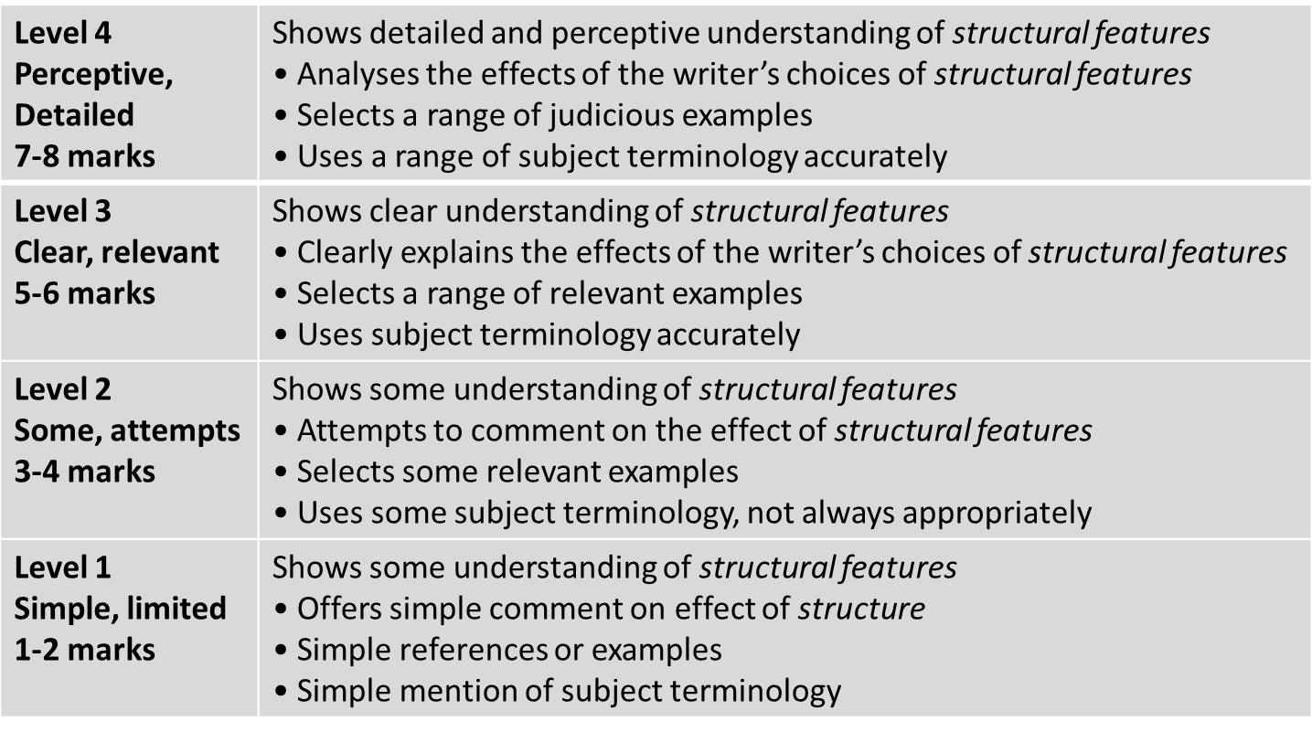
Learning Objective: Q3: explain, comment on and analyse how writers use structure…
Grade 4

Slide 37
Explain what the author focuses our attention on at the beginning of the extract. Use these words in your explanation: exposition setting character and explain how this opening would arouse the reader’s interest.
Now explain the perspective shift from the shark to the woman and back again. Use these words in your explanation: perspective shift suspense How does the reader respond to these shifts?
Now explain how the episode ends and why it is interesting to the reader. Use these words in your explanation: climax tension escalates
The writer begins by introducing…
He focuses on…
This arouses the reader’s interest by…
The writer then shifts to… and back to…
This perspective shift creates an impression of…
The reader will feel…
The episode ends with…
This creates the effect that…
This is interesting to the reader because…

Slide 38
Paper 1
Question 3
This question asks you about the whole text.
The question is always about the structure of the text. STRUCTURE simply means the order of the things the writer describes in the text.
DO:
Look at the beginning, middle and end of the text
Look for a place where the focus shifts (changes)
Make notes on the text as you find structural features
Write about WHAT the writer has done and WHY

Slide 39
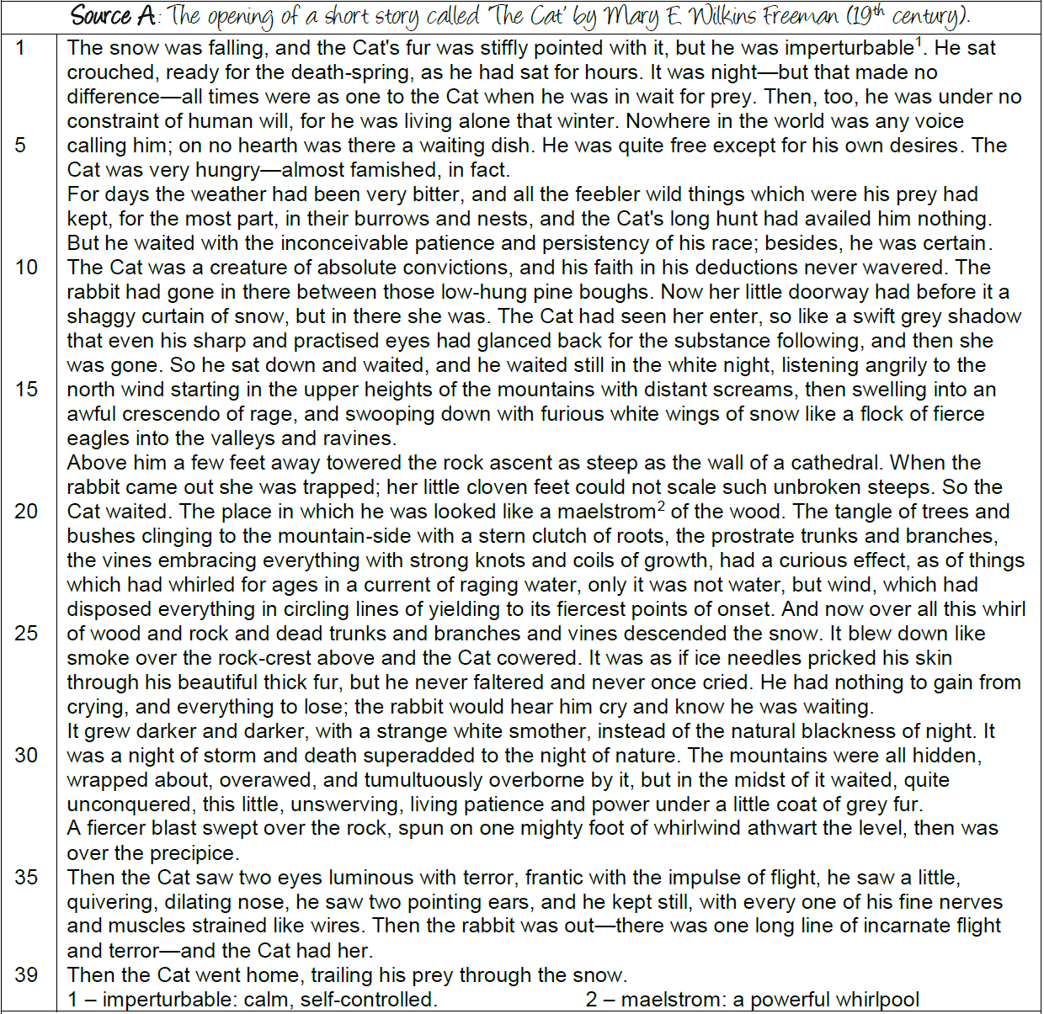
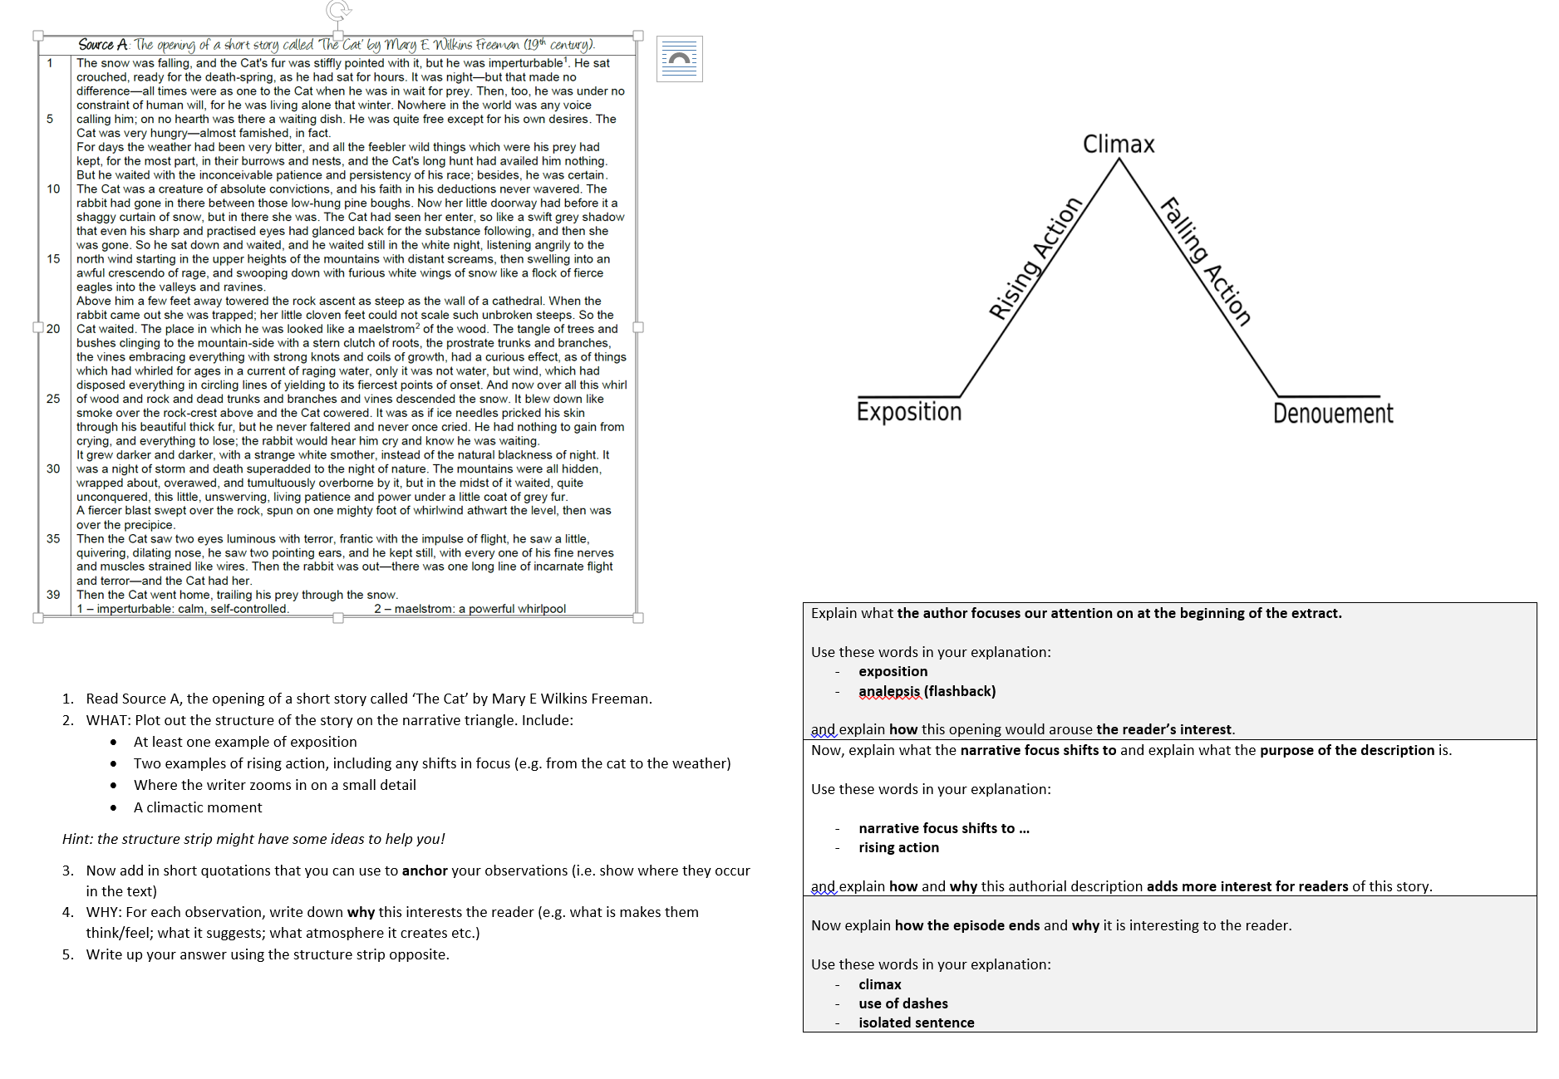

Slide 40
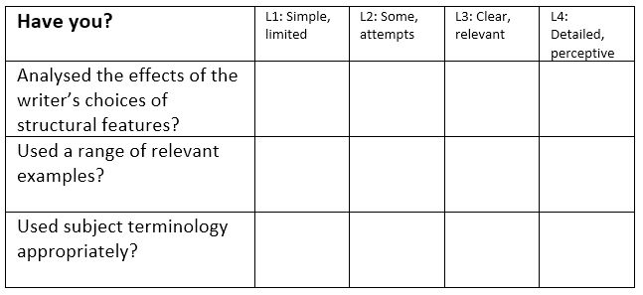
?
STRENGTHS | WEAKNESSES | NEXT STEPS
Clear and relevant points. Explained effects of structure. Range of evidence included. Subject terminology used. | Limited range of points. Only one or two points made. No comment/analysis on the effect of structure. Subject terminology not used accurately. | Show a detailed understanding of structure. Analyse the effect of structure. Include a range of precise evidence. Use a range of subject terminology.

Slide 41
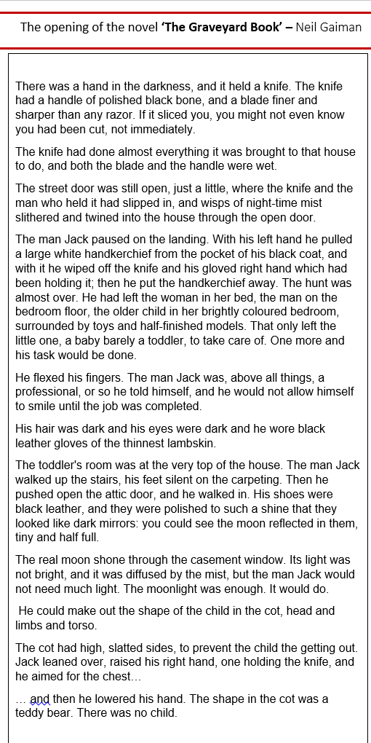
Q2: Use the full extract for this question. How does the writer use language to create an impression of the man Jack?
Highlight words or phrases that suggest anything about the man Jack. WHAT do they suggest? HOW do they do it? WHY this way?
Q3: Use the full extract for this question. How does the writer structure the text to interest you as a reader?
Plot out the narrative of the text on a triangle. WHAT does it focus on? WHY is this interesting?

Slide 42
Key Assessment:
COMPLETE ALL QUESTIONS
Q1: Re-read the first two paragraphs. List four things we learn about the knife from this part of the text.
Q2: Use the full extract for this question. How does the writer use language to create an impression of the man Jack?
Q3: Use the full extract for this question. How does the writer structure the text to interest you as a reader?

Slide 43
Q2: Use the full extract for this question. How does the writer use language to create an impression of the man Jack?
The writer presents the man Jack as…
The word/phrase/[T] ‘…’ literally means that…
The word/phrase/[T]‘…’ could suggest…
The writer describes the man Jack this way to make us feel…
Q3: Use the full extract for this question. How does the writer structure the text to interest you as a reader?
The writer begins by introducing…
He focuses on…
This arouses the reader’s interest by…
The writer then shifts to…
This perspective shift creates an impression of…
The reader will feel…
The episode ends with…
This creates the effect that…
This is interesting to the reader because…

Slide 44

A student who picked up this novel said ‘This front cover lacks imagination, creativity and life. It is as dull as dishwater and the illustrator needs sacking! ’
To what extent do you agree with this statement?
EXT: What skills do you think this question is testing?

Slide 45
Paper 1
Question 4
This question asks you about the second half of the text.
The question always asks you to EVALUATE.
Evaluate means explain how well the writer has done something.
DO:
Box off the lines the question refers to
Start by agreeing with the statement in the question
Underline interesting words and phrases from the extract that agree with the statement
Write about WHAT the writer has done, HOW it works and WHY it is successful, using adverbs

Slide 46
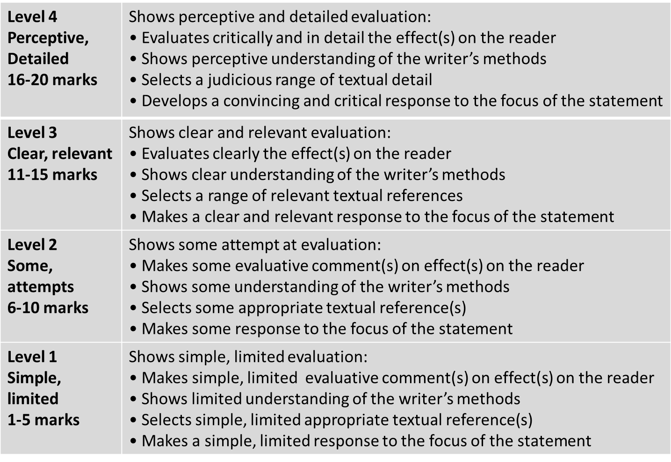
Learning Objective: Q4: evaluate the effects of the writer’s methods…
Grade 4

Slide 47
What is critical evaluation?
When we read an extract, we form ideas about what effect the writer is trying to achieve.
We know the writer is trying to keep us interested.
What do I think about the characters and events?
How does the writer make me think or feel these things?
How well does he or she do it?
Notes:
You are being asked your opinion; however, the text has been chosen because it is a skilful piece.
Don’t be too negative.
The examiner wants to see that you can recognise the effects used.
They also want to see you explain how well the effects have been achieved.

Slide 48

The Prime of Miss Jean Brodie by Muriel Spark
Focus this part of your answer on the lines 22 to 37.
A student, having read this section of the text said: “In this text, school is presented as a challenging place for the pupils.”
To what extent do you agree?
In your response, you could:
write about your own impression of the school
evaluate how the writer has created these impressions
support your opinions with quotations from the text
[20 marks]
‘“Stupid as ever,” said Miss Brodie.’
Let’s share
our ideas.

Slide 49
YOUR TASK: DIG DEEPER
Let‘s look for evidence that proves the statement correct.
‘More is vulgar’ – ‘Vulgar’ is an adjective. How does it show us that the school is a challenging place for pupils?
Dialogue is a structural feature. How is it used here to show the school is a challenging place?
‘One should have an innate sense of these things.’ – What does the adjective ‘innate’ imply about the school being a challenging place?
‘Nobody answered’ is an isolated line. How does this structural technique show us the school is a challenging place?
Why does the writer zoom in on Miss Brodie’s ‘cover up’ lesson? How does this show the school is a challenging place?
Choose a number!
1
2
3
4
5
6
7
8
‘Answer in a complete sentence please’. – The verb ‘answer’ is an imperative. How does this help prove the school is challenging?
‘Mary did not know’ is a line isolated by itself. How does this structural technique show us the school is a challenging place?
Miss Brodie uses the adjective ‘stupid’ to describe Mary when she does not know an answer. What can we infer about how the girls are treated if they do not know an answer?

Slide 50
Paper 1
Question 4
The key skill for Question 4 is evaluation, both of the ideas in the source in relation to the given statement, and also the methods used by the writer to convey these ideas. However, the biggest error made by students was that many of them failed to address methods; they dealt with the ‘what’ but not the ‘how’, which limited how far they could move into a given level.
said…
Remember, this is a 20 mark question. This means that this question alone is worth 25% of your paper.
To judge or determine the significance, worth, or quality of; assess.
In other words, you are evaluating the significance of your evidence. HOW does the evidence help present the school as a challenging place?
Evaluation

Slide 51
Advice: remember to use evaluate words such as ‘successfully’.
Remember to use your evaluative statements when you respond to the question.
The writer successfully depicts…
The writer effectively conveys…
The use of _____ works well because…
The writer deliberately/purposefully chose to use…
The use of _____ has great impact because…

Slide 52
Learning Objective: Q4: evaluate the effects of the writer’s methods…
Having read this section of the text, one pupil wrote, ‘In this text, school is presented as a challenging place for the pupils.” To what extent do you agree?
I agree with the idea that the school is presented as a challenging place for pupils. This is demonstrated through Miss Brodie’s interaction with one of the pupils when she says ‘stupid as ever’ in response to a student who does not know the answer to a question. The adjective ‘stupid’ is not what the reader would expect a teacher to say. It implies she is incredibly harsh on those who are in her class which makes the school challenging. Furthermore, ‘as ever’ would suggest this is not the first time this insult has been used towards a pupil which makes the reader question how else she treats the students. It is clear she is strict and expects students to conform to her high expectations.

Slide 53
Learning Objective: Q4: evaluate the effects of the writer’s methods…
Having read this section of the text, one pupil wrote, ‘In this text, school is presented as a challenging place for the pupils.” To what extent do you agree?
I agree with the idea that the school is presented as a challenging place for pupils. This is demonstrated through Muriel Spark’s use of structure in a one sentence paragraph, ‘Mary did not know.’ This is particularly effective at presenting the school as a challenging place for pupils because the line serves to highlight Mary’s isolation from the rest of the girls in the class. She does not know the answer and instead of finding herself in a warm and nurturing environment, she is the subject of ridicule and embarrassment. There is an underlying feeling of tension here which Spark deliberately creates in order to show us how the girls do their best to please Miss Brodie, fearing the rebuke they will receive if they do not know the answer. Furthermore,…
It could also be argued that the school is a challenging place for pupils because…

Slide 54
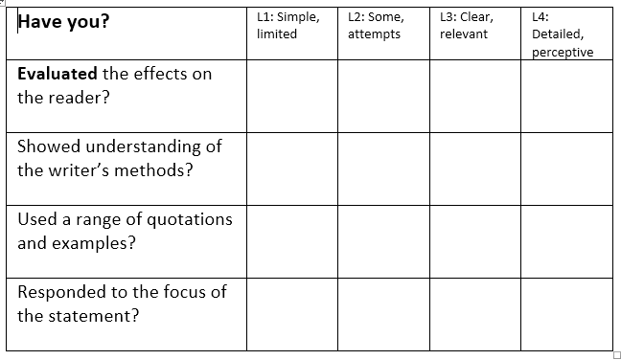
Learning Objective: Q4: evaluate the effects of the writer’s methods…
Having read this section of the text, one pupil wrote, ‘In this text, school is presented as a challenging place for the pupils.” To what extent do you agree?
?
I agree with the idea that the school is presented as a challenging place for pupils. This is demonstrated through Muriel Spark’s use of structure in a one sentence paragraph, ‘Mary did not know.’ This is particularly effective at presenting the school as a challenging place for pupils because the line serves to highlight Mary’s isolation from the rest of the girls in the class. She does not know the answer and instead of finding herself in a warm and nurturing environment, she is the subject of ridicule and embarrassment. There is an underlying feeling of tension here which Spark deliberately creates in order to show us how the girls do their best to please Miss Brodie, fearing the rebuke they will receive if they do not know the answer. Furthermore,…
It could also be argued that the school is a challenging place for pupils because…

Slide 55
QUESTION 4
A student said ‘Whilst the mother is disgusted by Billy, the boys are fascinated by him.’ To what extent do you agree?
Read lines 32 to end.
TASK:
Highlight 3 quotations that show they are interested in Billy
Can you find a quotation that shows the mother is disgusted?
Structurally, why does the ending show he is interested in Billy?

Slide 57
The language of evaluation – don’t just say ‘good’!
Powerful
Memorable
Intriguing
Engaging
Vivid
Life-like
Insightful
Specific
Impressive
Striking
Don’t always say it’s ‘good’ or ‘interesting’.
Think about the different ways you can describe something…
Always say WHY!
Effective
Dramatic
Engaging
Concise

Slide 58
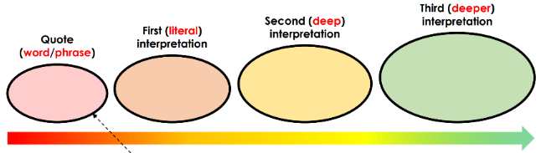
Question 4:
Focus this part of your answer on the second part of the source from line 32 to the end.
A student said ‘Whilst the mother is disgusted by Billy, the boys are fascinated by him.’ To what extent do you agree?
In your response, you could:
• consider your own impressions of Billy
• evaluate how the writer creates these impressions
• support your opinions with references to the text.
[20 Marks]
25 minutes
Remember to use your evaluative statements when you respond to the question.
The writer successfully depicts…
The writer effectively conveys…
The use of _____ works well because…
The writer deliberately/purposefully chose to use…
The use of _____ has great impact because…

Slide 59
Learning Objective: To practise answering Q4
?
STRENGTHS | WEAKNESSES | NEXT STEPS
Clear and relevant points. Consideration of the view given. Evidence used to support interpretations. The effect of methods is explained clearly. A range of quotations used. | Limited range of points. Effects of methods not analysed clearly. Interpretations are not connected to the statement in the question. No use of subject terminology. | Be critical in evaluation of the statement. Include a range of points and quotations. Analyse the effect of methods precisely. Use subject terminology accurately.

