Slide 1
PAPER 1
PAPER 2

Slide 2
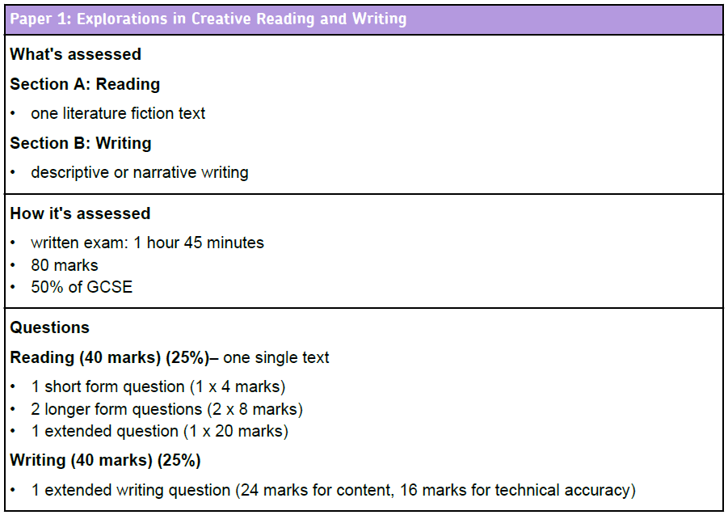
Learning Objective: To practise answering Paper 1 Section A

Slide 3
Learning to Read…
Learning Objective: To practise answering Paper 1 Section A
Your exam will be on a text that you’ve never read before
You know what the questions will ask you (language and structure)
You have 15 minutes’ reading time at the start of the exam

Slide 4
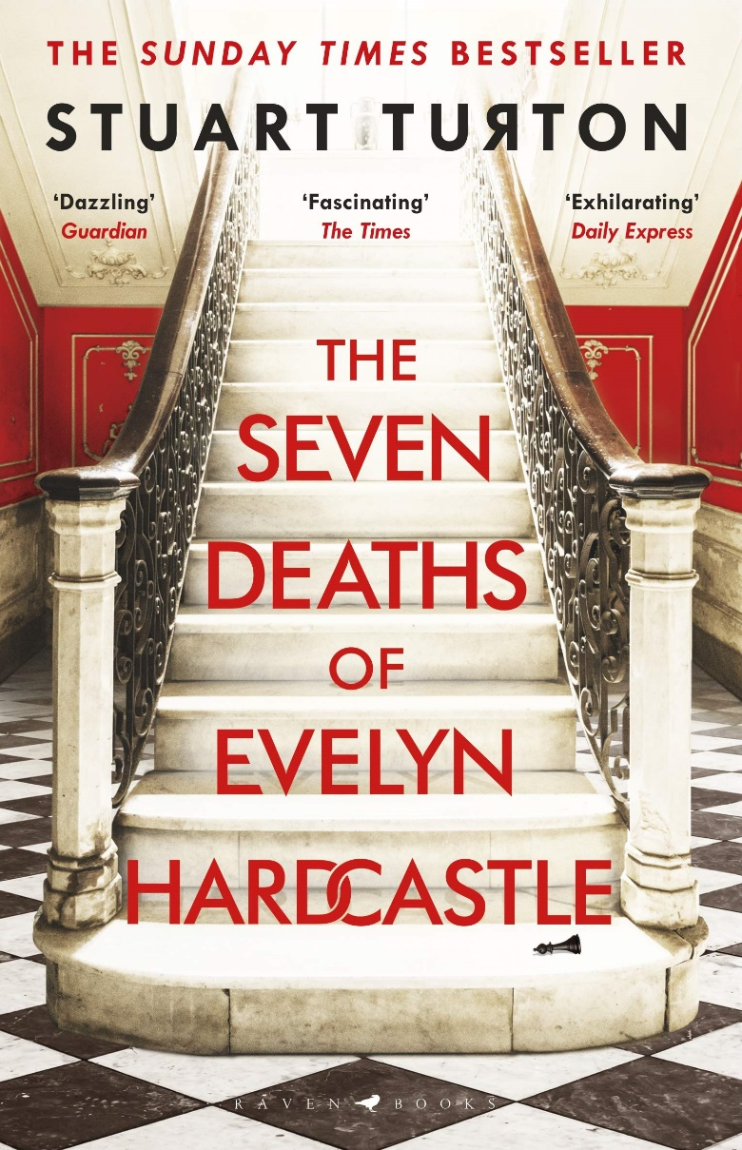
Read the title
What are your expectations?
What does this suggest?
The Seven Deaths of Evelyn Hardcastle
by Stuart Turton

Slide 5
Read the blurb
What’s the significance of this?
This extract is from the opening of a novel by Stuart Turton, first published in 2018. A man finds himself alone in the woods with no memory of who he is.
What are your expectations?

Slide 6
Learning Objective: To practise answering Paper 1 Section A
You know the questions so look for the answers as you read…

Slide 7
Q2: Language
Facts
Superlative Adjectives
First person pronoun
Lists
Direct Address
Past tense
Adverbs
Simile
Onomatopoeia
Questions
Proper Nouns
Repetition
Verbs
Adjectives
Statistics, figures and measurements
Adverbial Phrases

Slide 8
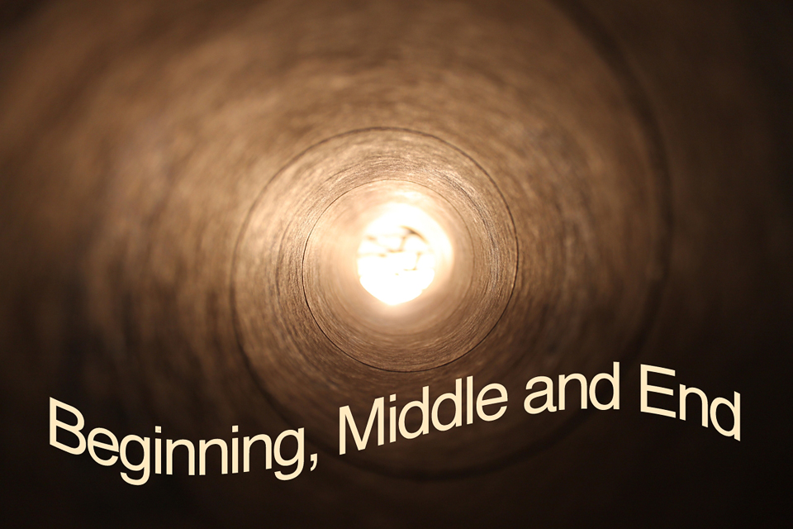
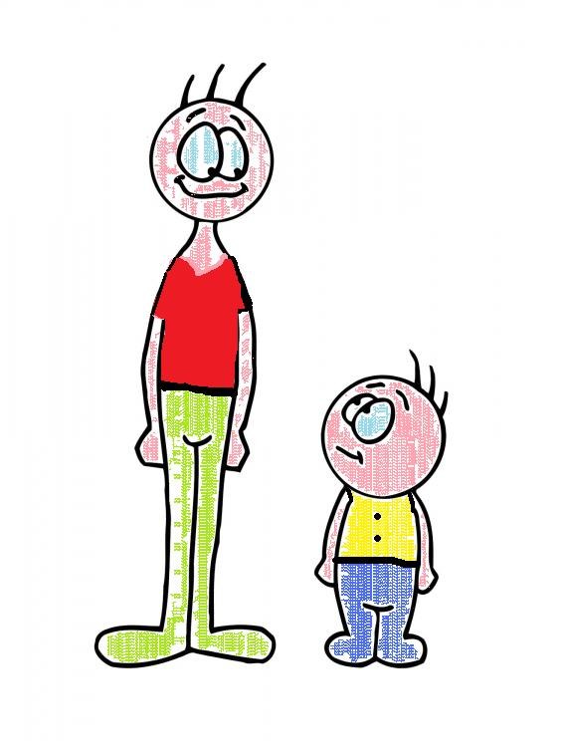
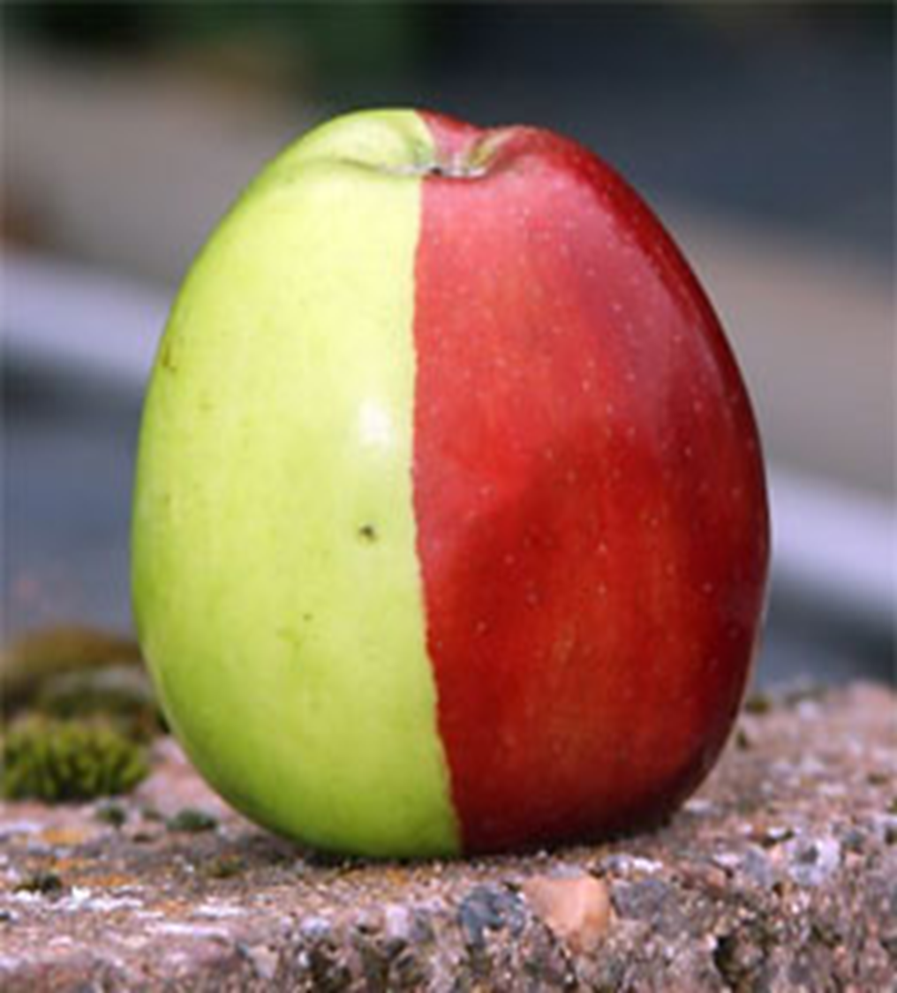
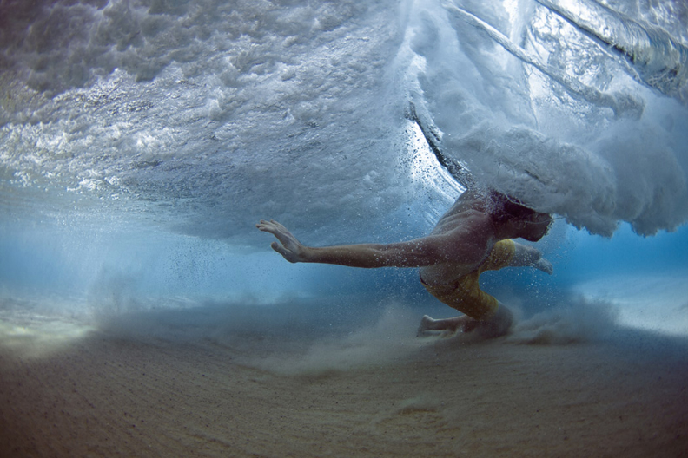
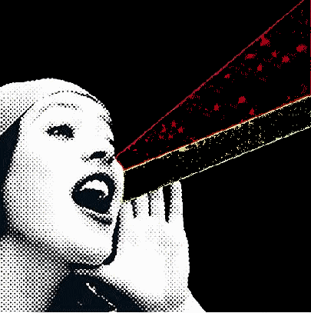
Q3: Structure
Contrasts
Central Ideas, settings or themes
Pivotal/ Turning Points
Build up of ideas, image, feeling
Movement (sentence types / punctuation)
Passages of time
Voice

Slide 9
Day One
I forget everything between footsteps. ‘Anna!’ I finish shouting, snapping my mouth shut in surprise. My mind has gone blank. I don’t know who Anna is or why I’m calling her name. I don’t even know how I got here. I’m standing in a forest, shielding my eyes from the spitting rain. My heart’s thumping, I reek of sweat and my legs are shaking. I must have been running but I can’t remember why.
Structure: How is the writer guiding us through the story? Look for structural techniques.
Language: highlight key words or phrases. Look for language techniques.

Slide 10
‘How did—’ I’m cut short by the sight of my own hands. They’re bony, ugly. A stranger’s hands. I don’t recognise them at all. Feeling the ﬁrst touch of panic, I try to recall something else about myself: a family member, my address, age, anything, but nothing’s coming. I don’t even have a name. Every memory I had a few seconds ago is gone.
Structure: How is the writer guiding us through the story? Look for structural techniques.
Language: highlight key words or phrases. Look for language techniques.

Slide 11
My throat tightens, breaths coming loud and fast. The forest is spinning, black spots inking my sight. Be calm. ‘I can’t breathe,’ I gasp, blood roaring in my ears as I sink to the ground, my ﬁngers digging into the dirt.
You can breathe, you just need to calm down.
There’s comfort in this inner voice, cold authority. Close your eyes, listen to the forest. Collect yourself.
Structure: How is the writer guiding us through the story? Look for structural techniques.
Language: highlight key words or phrases. Look for language techniques.

Slide 12
Obeying the voice, I squeeze my eyes shut but all I can hear is my own panicked wheezing. For the longest time it crushes every other sound, but slowly, ever so slowly, I work a hole in my fear, allowing other noises to break through. Raindrops are tapping the leaves, branches rustling overhead. There’s a stream away to my right and crows in the trees, their wings cracking the air as they take ﬂight. Something’s scurrying in the undergrowth, the thump of rabbit feet passing near enough to touch. One by one I knit these new memories together until I’ve got ﬁve minutes of past to wrap myself in.
Structure: How is the writer guiding us through the story? Look for structural techniques.
Language: highlight key words or phrases. Look for language techniques.

Slide 13
It’s enough to staunch the panic, at least for now. I get to my feet clumsily, surprised by how tall I am, how far from the ground I seem to be. Swaying a little, I wipe the wet leaves from my trousers, noticing for the ﬁrst time that I’m wearing a dinner jacket, the shirt splattered with mud and red wine. I must have been at a party. My pockets are empty and I don’t have a coat, so I can’t have strayed too far. That’s reassuring.
Structure: How is the writer guiding us through the story? Look for structural techniques.
Language: highlight key words or phrases. Look for language techniques.

Slide 14
Judging by the light, it’s morning, so I’ve probably been out here all night. No one gets dressed up to spend an evening alone, which means somebody must know I’m missing by now. Surely, beyond these trees, a house is coming awake in alarm, search parties striking out to ﬁnd me? My eyes roam the trees, half-expecting to see my friends emerging through the foliage, pats on the back and gentle jokes escorting me back home, but daydreams won’t deliver me from this forest, and I can’t linger here hoping for rescue. I’m shivering, my teeth chattering. I need to start walking, if only to keep warm, but I can’t see anything except trees. There’s no way to know whether I’m moving towards help, or blundering away from it.
Structure: How is the writer guiding us through the story? Look for structural techniques.
Language: highlight key words or phrases. Look for language techniques.

Slide 15
At a loss, I return to the last concern of the man I was.
‘Anna!’ Whoever this woman is, she’s clearly the reason I’m out here, but I can’t picture her. Perhaps she’s my wife, or my daughter? Neither feels right, and yet there’s a pull in the name. I can feel it trying to lead my mind somewhere.
‘Anna!’ I shout, more out of desperation than hope. ‘Help me!’ a woman screams back.
Structure: How is the writer guiding us through the story? Look for structural techniques.
Language: highlight key words or phrases. Look for language techniques.

Slide 16
Paper 1
Question 1
This question is the easiest. It will ask you to pick out FOUR things from the text.
DO NOT just copy the entire paragraph. This will not get you any marks.
DO:
Box off the lines the question refers to
Underline each relevant detail from the extract as you find it
Write down each detail as a short sentence, using quotation marks around your evidence

Slide 17
Question 1:
Question 1:
Read again the first four paragraphs. List four things from this part of the text about the narrator.
____________________________________________________
____________________________________________________
____________________________________________________
____________________________________________________
[4 marks]
5 minutes

Slide 18
Paper 1
Question 2
This question asks you to read a short section of the text again.
The question is always about what language the writer has used.
DO:
Box off the lines the question refers to
Underline interesting words and phrases from the extract as you find them
Use three layers to write up your answer, using quotation marks around your evidence

Slide 19
x3
Question 2:
Question 2: Look at the bolded section of text.
How does the writer use language to describe what the narrator hears?
You could include the writer’s choice of:
Words and phrases
Language features and techniques
Sentence forms
[8 marks]
Close your eyes, listen to the forest. Collect yourself.
Obeying the voice, I squeeze my eyes shut but all I can hear is my own panicked wheezing. For the longest time it crushes every other sound, but slowly, ever so slowly, I work a hole in my fear, allowing other noises to break through. Raindrops are tapping the leaves, branches rustling overhead. There’s a stream away to my right and crows in the trees, their wings cracking the air as they take ﬂight. Something’s scurrying in the undergrowth, the thump of rabbit feet passing near enough to touch. One by one I knit these new memories together until I’ve got ﬁve minutes of past to wrap myself in.
10
minutes

Slide 20
Learning Objective: Q2: explain, comment on and analyse how writers use language…
Level 4 Perceptive, Detailed 7-8 marks | Shows detailed and perceptive understanding of language: • Analyses the effects of the writer’s choices of language • Selects a judicious range of quotations • Uses a range of subject terminology appropriately
Level 3 Clear, relevant 5-6 marks | Shows clear understanding of language: • Clearly explains the effects of the writer’s choices of language • Selects relevant quotations • Uses a subject terminology accurately
Level 2 Some, attempts 3-4 marks | Shows some understanding of language: • Attempts to comment on the effect of language • Selects some relevant quotations • Uses some subject terminology, not always appropriately
Level 1 Simple, limited 1-2 marks | Shows simple awareness of language: • Offers simple comment on the effects of language • Simple references or textual details • Simple mention of subject terminology
Grade 4

Slide 21
Question 2: How does the writer use language to describe what the narrator hears?
Close your eyes, listen to the forest. Collect yourself.
Obeying the voice, I squeeze my eyes shut but all I can hear is my own panicked wheezing. For the longest time it crushes every other sound, but slowly, ever so slowly, I work a hole in my fear, allowing other noises to break through. Raindrops are tapping the leaves, branches rustling overhead. There’s a stream away to my right and crows in the trees, their wings cracking the air as they take ﬂight. Something’s scurrying in the undergrowth, the thump of rabbit feet passing near enough to touch. One by one I knit these new memories together until I’ve got ﬁve minutes of past to wrap myself in.

Slide 22
Paper 1
Question 3
This question asks you about the whole text.
The question is always about the structure of the text. STRUCTURE simply means the order of the things the writer describes in the text.
DO:
Look at the beginning, middle and end of the text
Look for a place where the focus shifts (changes)
Make notes on the text as you find structural features
Write about WHAT the writer has done and WHY

Slide 23
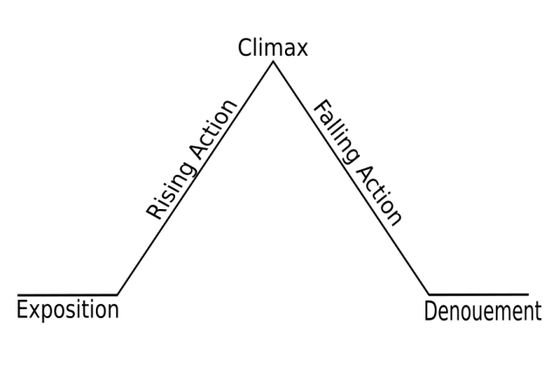
Question 3:
Question 3: You now need to think about the whole of the source.
This text is taken from the beginning of a novel.
How has the writer structured the text to interest you as a reader?
You could write about:
What the writer focuses your attention on at the beginning
How and why the writer changes this focus as the source develops
Any other structural devices that interest you.
[8 marks]

Slide 24
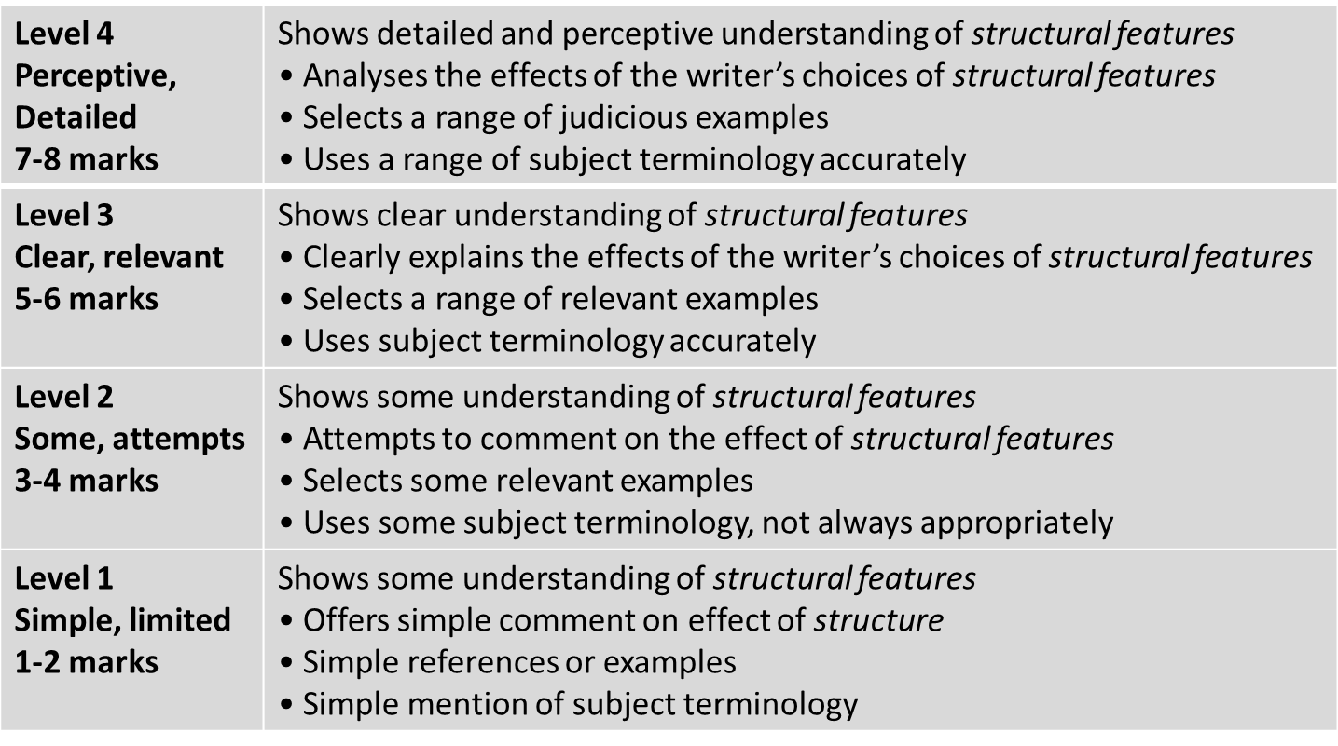
Learning Objective: Q3: explain, comment on and analyse how writers use structure…
Grade 4

Slide 25
2 – look for two examples of rising action. What is the writer focusing on to create tension? How does he shift the focus?
3- what is the climax? How does it make us feel?
It is unlikely you will get any falling action in your exam text.
The writer begins by introducing… This interests us because…
The narrative focus shifts to… This is interesting because…
Tension builds when…
The climax of the extract is… It makes us feel…
1- at the start, what does the writer introduce, and why?
It is unlikely you will get any denouement in your exam text.

Slide 26
Question 4:
Question 4:
Focus on the second half of the extract, from ‘It’s enough to staunch the panic’ to the end.
A student said, ‘The writer builds a real sense of mystery in this extract; we share the narrator’s desire to know who he is and why he is in the woods.’
To what extent do you agree?
In your response, you could:
• consider your own impressions of the narrator and his situation
• evaluate how the writer creates these impressions
• support your opinions with references to the text.
[20 Marks]
25 minutes

Slide 27
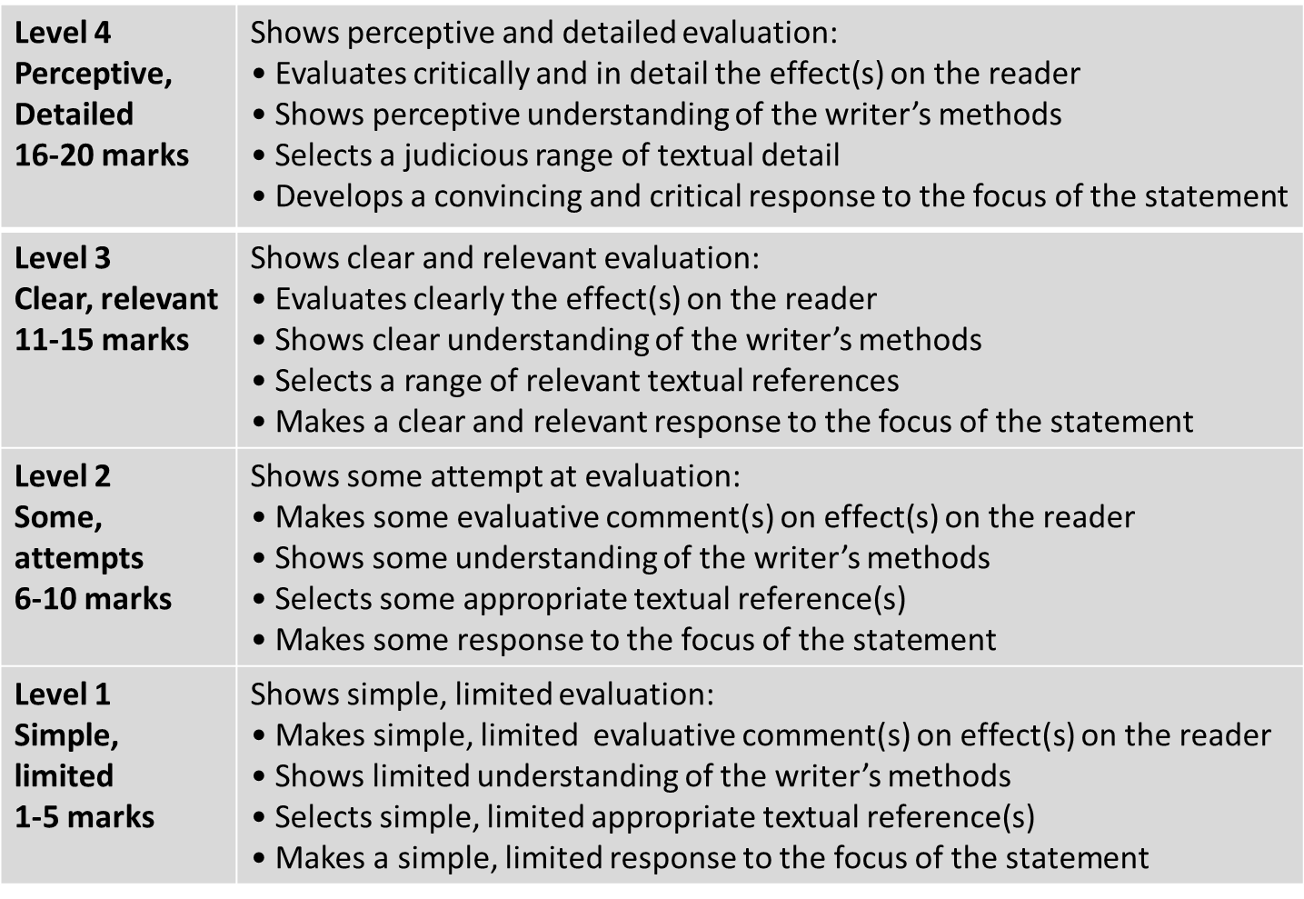
Learning Objective: Q4: evaluate the effects of the writer’s methods…
Grade 4

Slide 28
Learning Objective: To practise answering Paper 1 Section A
What the writer is doing
‘The writer builds a real sense of mystery in this extract; we share the narrator’s desire to know who he is and why he is in the woods.’
To what extent do you agree?
Find an example from the text.
Look for language or structure.
Analyse and consider the author’s intention.
Consider HOW EFFECTIVE the method is (i.e. what is the effect and why does it work?)
The effect it is having on you

Slide 29
Learning Objective: To practise answering Paper 1 Section A
FOCUS: there is a sense of mystery.
It makes me share the narrator’s desire to know who he is and why he is in the woods.
It’s enough to staunch the panic, at least for now. I get to my feet clumsily, surprised by how tall I am, how far from the ground I seem to be. Swaying a little, I wipe the wet leaves from my trousers, noticing for the ﬁrst time that I’m wearing a dinner jacket, the shirt splattered with mud and red wine. I must have been at a party. My pockets are empty and I don’t have a coat, so I can’t have strayed too far. That’s reassuring.
Judging by the light, it’s morning, so I’ve probably been out here all night. No one gets dressed up to spend an evening alone, which means somebody must know I’m missing by now. Surely, beyond these trees, a house is coming awake in alarm, search parties striking out to ﬁnd me? My eyes roam the trees, half-expecting to see my friends emerging through the foliage, pats on the back and gentle jokes escorting me back home, but daydreams won’t deliver me from this forest, and I can’t linger here hoping for rescue. I’m shivering, my teeth chattering. I need to start walking, if only to keep warm, but I can’t see anything except trees. There’s no way to know whether I’m moving towards help, or blundering away from it.

Slide 30
Learning Objective: To practise answering Paper 1 Section A
FOCUS: there is a sense of mystery.
It makes me share the narrator’s desire to know who he is and why he is in the woods.
At a loss, I return to the last concern of the man I was.
‘Anna!’ Whoever this woman is, she’s clearly the reason I’m out here, but I can’t picture her. Perhaps she’s my wife, or my daughter? Neither feels right, and yet there’s a pull in the name. I can feel it trying to lead my mind somewhere.
‘Anna!’ I shout, more out of desperation than hope. ‘Help me!’ a woman screams back.

Slide 31
The language of evaluation – don’t just say ‘good’!
Powerful
Memorable
Intriguing
Engaging
Vivid
Life-like
Insightful
Specific
Impressive
Striking
Don’t always say it’s ‘good’ or ‘interesting’.
Think about the different ways you can describe something…
Always say WHY!
Effective
Dramatic
Engaging
Concise

Slide 32
Advice: remember to use evaluate words such as ‘successfully’.
Remember to use your evaluative statements when you respond to the question.
The writer successfully depicts…
The writer effectively conveys…
The use of _____ works well because…
The writer deliberately/purposefully chose to use…
The use of _____ has great impact because…

Slide 33
Question 4:
Focus on the second half of the extract, from ‘It’s enough to staunch the panic’ to the end.
A student said, ‘The writer builds a real sense of mystery in this extract; we share the narrator’s desire to know who he is and why he is in the woods.’
To what extent do you agree?
In your response, you could:
• consider your own impressions of the
narrator and his situation
• evaluate how the writer creates these
impressions
• support your opinions with references
to the text.
[20 Marks]
25 minutes

