Slide 1
PAPER 1
PAPER 2

Slide 2
English Language Paper 1
Explorations in creative reading and writing
A new section in your folder!

Slide 3
Learning to Read…
Your exam will be on a text that you’ve never read before
You know what the questions will ask you (language and structure)
You have 15 minutes at the start of the exam to read the text, make notes on your paper and plan your answers

Slide 4
Read the title
What are your expectations?
What does this suggest?
Ruby in the Smoke
by Philip Pullman

Slide 5
Read the blurb
What’s the significance of this?
In the extract below, taken from a novel set in 19th century London, Sally Lockhart has just entered a deprived area of the city.
What are your expectations?
What are your expectations?

Slide 6
Learning Objective: To practise answering Paper 1 Section A
You know the questions so look for the answers as you read…

Slide 7
Q2: Language
Facts
Superlative Adjectives
First person pronoun
Lists
Direct Address
Past tense
Adverbs
Simile
Onomatopoeia
Questions
Proper Nouns
Repetition
Verbs
Adjectives
Statistics, figures and measurements
Adverbial Phrases

Slide 8
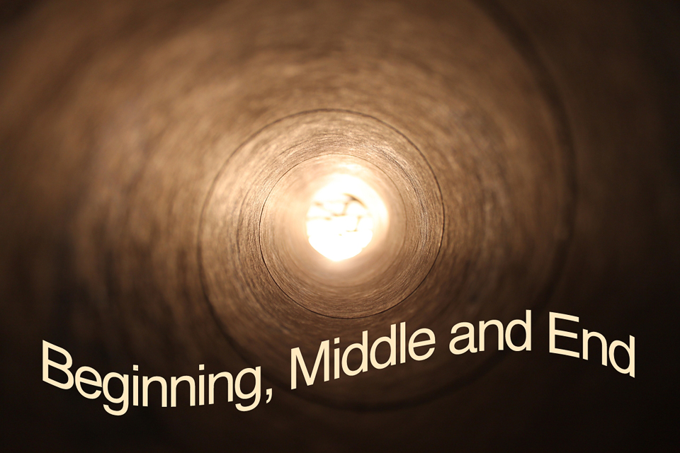
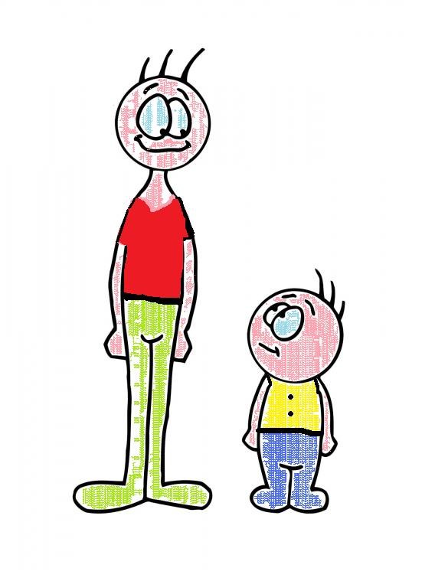
Q3: Structure
Contrasts
Central Ideas, settings or themes
Pivotal/ Turning Points
Build up of ideas, image, feeling
Movement (sentence types / punctuation)
Passages of time
Voice

Slide 9
Paper 1
Question 1
This question is the easiest. It will ask you to pick out FOUR things from the text.
DO NOT just copy the entire paragraph. This will not get you any marks.
DO:
Box off the lines the question refers to
Underline each relevant detail from the extract as you find it
Write down each detail as a short sentence, using quotation marks around your evidence

Slide 10
Question 1:
Question 1:
Read again the first part of the source, lines 1 to 4.
List four things from this part of the text that we learn about the West India Docks.
____________________________________________________
____________________________________________________
____________________________________________________
____________________________________________________
[4 marks]
5 minutes

Slide 11
Paper 1
Question 2
This question asks you to read a short section of the text again.
The question is always about what language the writer has used.
DO:
Box off the lines the question refers to
Underline interesting words and phrases from the extract as you find them
Use three layers to write up your answer, using quotation marks around your evidence

Slide 12
x2
Question 2:
Question 2: Look in detail from lines lines 6 to 19 of the source.
How does the writer use language here to describe the setting?
You could include the writer’s choice of:
Words and phrases
Language features and techniques
Sentence forms
[8 marks]
Barefoot children, ragged and filthy, played among the rubbish and the streams of stinking water that trickled thickly over the cobbles. Women standing in their doorways fell silent as they passed, and stared with hostile eyes, arms folded, until they had gone by. They look so old, thought Sally; even the children had pinched, old-men’s faces, with wrinkled brows and tight-drawn lips. Once they came on a group of men at the entrance to a narrow court. Some were leaning on the wall, some squatting on doorsteps. Their clothes were torn and clotted with dirt, their eyes were full of hatred, and one of them stood up and two others shifted away from the wall as Frederick and Sally approached, as if to challenge their right to pass.
10
minutes

Slide 13
WHAT THE EXAMINER WILL SEE
SIMPLE AWARENESS OF LANGUAGE (L1)
Simple comment on the effect of language (L1)
Simple textual detail (L1)
Simple use of subject terminology (L1)
SOME UNDERSTANDING OF LANGUAGE (L2)
Attempt to comment on the effect of language (L2)
Some appropriate textual detail (L2)
Some use of subject terminology (L2)
CLEAR UNDERSTANDING OF LANGUAGE (L3)
Clear explanation of the effects of language (L3)
Range of relevant textual detail (L3)
Clear/accurate use of subject terminology (L3)
DETAILED AND PERCEPTIVE UNDERSTANDING OF LANGUAGE (L4)
Analysis of the effects of language (L4)
Judicious textual detail (L4)
Sophisticated use of subject terminology (L4)
Candidate’s answer will appear here on the examiner’s marking screen.

Slide 14
WHAT THE EXAMINER WILL SEE
SIMPLE AWARENESS OF LANGUAGE (L1)
Simple comment on the effect of language (L1)
Simple textual detail (L1)
Simple use of subject terminology (L1)
SOME UNDERSTANDING OF LANGUAGE (L2)
Attempt to comment on the effect of language (L2)
Some appropriate textual detail (L2)
Some use of subject terminology (L2)
CLEAR UNDERSTANDING OF LANGUAGE (L3)
Clear explanation of the effects of language (L3)
Range of relevant textual detail (L3)
Clear/accurate use of subject terminology (L3)
DETAILED AND PERCEPTIVE UNDERSTANDING OF LANGUAGE (L4)
Analysis of the effects of language (L4)
Judicious textual detail (L4)
Sophisticated use of subject terminology (L4)
The examiner will see the candidate’s answer to the right of these comments.
The examiner will then click and drag these comments onto your answer to show where you have met the criteria.
This means that part of your answer could contain a L1 comment but also a L4 comment. This means that if part of your answer is L4 but the rest is L1, you will receive a mark in the L4 section of the mark scheme.

Slide 15
YOUR TASK: BE THE EXAMINER. MARK THE FOLLOWING ANSWERS
SIMPLE AWARENESS OF LANGUAGE (L1)
Simple comment on the effect of language (L1)
Simple textual detail (L1)
Simple use of subject terminology (L1)
SOME UNDERSTANDING OF LANGUAGE (L2)
Attempt to comment on the effect of language (L2)
Some appropriate textual detail (L2)
Some use of subject terminology (L2)
CLEAR UNDERSTANDING OF LANGUAGE (L3)
Clear explanation of the effects of language (L3)
Range of relevant textual detail (L3)
Clear/accurate use of subject terminology (L3)
DETAILED AND PERCEPTIVE UNDERSTANDING OF LANGUAGE (L4)
Analysis of the effects of language (L4)
Judicious textual detail (L4)
Sophisticated use of subject terminology (L4)
Annotate the following answers with the comments on the left. See if you can identify the highest level the answer achieves and where it achieves it.

Slide 16
YOUR TASK: BE THE EXAMINER (CANDIDATE ONE)
The writer uses the destitute inhabitants to symbolise and parallel the deplorable setting in which they live. The semantic field of poverty is used when the writer explains that the children are ‘barefoot,’ ‘ragged’ and ‘filthy.’ All three adjectives imply that the children, symbols of innocence, are deprived of the basic necessities: clean water and clothing. This idea is reinforced by the metaphor ‘streams of stinking water’ as the plural noun ‘streams’ implies that sewage flows freely throughout the setting, contaminating anything and anyone it comes into contact with with its repugnant stench, including the helpless children who are powerless to escape the destitution that encapsulates them.
SIMPLE AWARENESS OF LANGUAGE (L1)
Simple comment on the effect of language (L1)
Simple textual detail (L1)
Simple use of subject terminology (L1)
SOME UNDERSTANDING OF LANGUAGE (L2)
Attempt to comment on the effect of language (L2)
Some appropriate textual detail (L2)
Some use of subject terminology (L2)
CLEAR UNDERSTANDING OF LANGUAGE (L3)
Clear explanation of the effects of language (L3)
Range of relevant textual detail (L3)
Clear/accurate use of subject terminology (L3)
DETAILED AND PERCEPTIVE UNDERSTANDING OF LANGUAGE (L4)
Analysis of the effects of language (L4)
Judicious textual detail (L4)
Sophisticated use of subject terminology (L4)
Notes:
LEVEL 4 ANSWER

Slide 17
YOUR TASK: BE THE EXAMINER (CANDIDATE TWO)
SIMPLE AWARENESS OF LANGUAGE (L1)
Simple comment on the effect of language (L1)
Simple textual detail (L1)
Simple use of subject terminology (L1)
SOME UNDERSTANDING OF LANGUAGE (L2)
Attempt to comment on the effect of language (L2)
Some appropriate textual detail (L2)
Some use of subject terminology (L2)
CLEAR UNDERSTANDING OF LANGUAGE (L3)
Clear explanation of the effects of language (L3)
Range of relevant textual detail (L3)
Clear/accurate use of subject terminology (L3)
DETAILED AND PERCEPTIVE UNDERSTANDING OF LANGUAGE (L4)
Analysis of the effects of language (L4)
Judicious textual detail (L4)
Sophisticated use of subject terminology (L4)
The writer uses negative language to describe both the setting and its inhabitants. The sensory adjective ‘stinking’ implies that the setting is beset by the stench of sewage running through the streets. This lack of hygiene is reinforced by the description of the children who are ‘barefoot’, ‘ragged’ and ‘filthy.’ These three adjectives connote poverty and suggest that the children are forced to live in these abhorrent conditions as they do not have the means to escape destitution.
Notes:
LEVEL 3 ANSWER

Slide 18
YOUR TASK: BE THE EXAMINER (CANDIDATE THREE)
SIMPLE AWARENESS OF LANGUAGE (L1)
Simple comment on the effect of language (L1)
Simple textual detail (L1)
Simple use of subject terminology (L1)
SOME UNDERSTANDING OF LANGUAGE (L2)
Attempt to comment on the effect of language (L2)
Some appropriate textual detail (L2)
Some use of subject terminology (L2)
CLEAR UNDERSTANDING OF LANGUAGE (L3)
Clear explanation of the effects of language (L3)
Range of relevant textual detail (L3)
Clear/accurate use of subject terminology (L3)
DETAILED AND PERCEPTIVE UNDERSTANDING OF LANGUAGE (L4)
Analysis of the effects of language (L4)
Judicious textual detail (L4)
Sophisticated use of subject terminology (L4)
The writer says ‘streams of stinking water’ and the word ‘stinking’ suggests it’s dirty which shows it’s a poor area.
‘Ragged’ and ‘filthy’ show that the people who live there are poor which means it’s not a very nice place to live.
The children are ‘barefoot’ which means they don’t have a lot of money. This might be why they live in a poor area.
Notes:
LEVEL 1 ANSWER

Slide 19
YOUR TASK: BE THE EXAMINER (CANDIDATE FOUR)
The writer uses sensory language when he explains the water is ‘stinking’. This suggests that the setting is unhygienic and sewage runs through it. This also suggests that the people living there don’t have access to clean water and live in a dirty environment. This could also explain why the children are ‘ragged’ and ‘filthy’ as the adjectives suggest that they have no way of keeping themselves clean as they are surrounded by dirt.
SIMPLE AWARENESS OF LANGUAGE (L1)
Simple comment on the effect of language (L1)
Simple textual detail (L1)
Simple use of subject terminology (L1)
SOME UNDERSTANDING OF LANGUAGE (L2)
Attempt to comment on the effect of language (L2)
Some appropriate textual detail (L2)
Some use of subject terminology (L2)
CLEAR UNDERSTANDING OF LANGUAGE (L3)
Clear explanation of the effects of language (L3)
Range of relevant textual detail (L3)
Clear/accurate use of subject terminology (L3)
DETAILED AND PERCEPTIVE UNDERSTANDING OF LANGUAGE (L4)
Analysis of the effects of language (L4)
Judicious textual detail (L4)
Sophisticated use of subject terminology (L4)
Notes:
LEVEL 2 ANSWER

Slide 20
YOUR TASK: BE THE EXAMINER (CANDIDATE ONE)
The writer uses the destitute inhabitants to symbolise and parallel the deplorable setting in which they live. The semantic field of poverty is used when the writer explains that the children are ‘barefoot,’ ‘ragged’ and ‘filthy.’ All three adjectives imply that the children, symbols of innocence, are deprived of the basic necessities: clean water and clothing. This idea is reinforced by the metaphor ‘streams of stinking water’ as the plural noun ‘streams’ implies that sewage flows freely throughout the setting, contaminating anything and anyone it comes into contact with with its repugnant stench, including the helpless children who are powerless to escape the destitution that encapsulates them.
SIMPLE AWARENESS OF LANGUAGE (L1)
Simple comment on the effect of language (L1)
Simple textual detail (L1)
Simple use of subject terminology (L1)
SOME UNDERSTANDING OF LANGUAGE (L2)
Attempt to comment on the effect of language (L2)
Some appropriate textual detail (L2)
Some use of subject terminology (L2)
CLEAR UNDERSTANDING OF LANGUAGE (L3)
Clear explanation of the effects of language (L3)
Range of relevant textual detail (L3)
Clear/accurate use of subject terminology (L3)
DETAILED AND PERCEPTIVE UNDERSTANDING OF LANGUAGE (L4)
Analysis of the effects of language (L4)
Judicious textual detail (L4)
Sophisticated use of subject terminology (L4)
BAND
FOUR
Notes:
LEVEL 4 ANSWER

Slide 21
YOUR TASK: BE THE EXAMINER (CANDIDATE TWO)
SIMPLE AWARENESS OF LANGUAGE (L1)
Simple comment on the effect of language (L1)
Simple textual detail (L1)
Simple use of subject terminology (L1)
SOME UNDERSTANDING OF LANGUAGE (L2)
Attempt to comment on the effect of language (L2)
Some appropriate textual detail (L2)
Some use of subject terminology (L2)
CLEAR UNDERSTANDING OF LANGUAGE (L3)
Clear explanation of the effects of language (L3)
Range of relevant textual detail (L3)
Clear/accurate use of subject terminology (L3)
DETAILED AND PERCEPTIVE UNDERSTANDING OF LANGUAGE (L4)
Analysis of the effects of language (L4)
Judicious textual detail (L4)
Sophisticated use of subject terminology (L4)
The writer uses negative language to describe both the setting and its inhabitants. The sensory adjective ‘stinking’ implies that the setting is beset by the stench of sewage running through the streets. This lack of hygiene is reinforced by the description of the children who are ‘barefoot’, ‘ragged’ and ‘filthy.’ These three adjectives connote poverty and suggest that the children are forced to live in these abhorrent conditions as they do not have the means to escape destitution.
BAND
THREE
Notes:
LEVEL 3 ANSWER

Slide 22
YOUR TASK: BE THE EXAMINER (CANDIDATE THREE)
SIMPLE AWARENESS OF LANGUAGE (L1)
Simple comment on the effect of language (L1)
Simple textual detail (L1)
Simple use of subject terminology (L1)
SOME UNDERSTANDING OF LANGUAGE (L2)
Attempt to comment on the effect of language (L2)
Some appropriate textual detail (L2)
Some use of subject terminology (L2)
CLEAR UNDERSTANDING OF LANGUAGE (L3)
Clear explanation of the effects of language (L3)
Range of relevant textual detail (L3)
Clear/accurate use of subject terminology (L3)
DETAILED AND PERCEPTIVE UNDERSTANDING OF LANGUAGE (L4)
Analysis of the effects of language (L4)
Judicious textual detail (L4)
Sophisticated use of subject terminology (L4)
The writer says ‘streams of stinking water’ and the word ‘stinking’ suggests it’s dirty which shows it’s a poor area.
‘Ragged’ and ‘filthy’ show that the people who live there are poor which means it’s not a very nice place to live.
The children are ‘barefoot’ which means they don’t have a lot of money. This might be why they live in a poor area.
BAND
ONE
Notes:
LEVEL 1 ANSWER

Slide 23
YOUR TASK: BE THE EXAMINER (CANDIDATE FOUR)
The writer uses sensory language when he explains the water is ‘stinking’. This suggests that the setting is unhygienic and sewage runs through it. This also suggests that the people living there don’t have access to clean water and live in a dirty environment. This could also explain why the children are ‘ragged’ and ‘filthy’ as the adjectives suggest that they have no way of keeping themselves clean as they are surrounded by dirt.
SIMPLE AWARENESS OF LANGUAGE (L1)
Simple comment on the effect of language (L1)
Simple textual detail (L1)
Simple use of subject terminology (L1)
SOME UNDERSTANDING OF LANGUAGE (L2)
Attempt to comment on the effect of language (L2)
Some appropriate textual detail (L2)
Some use of subject terminology (L2)
CLEAR UNDERSTANDING OF LANGUAGE (L3)
Clear explanation of the effects of language (L3)
Range of relevant textual detail (L3)
Clear/accurate use of subject terminology (L3)
DETAILED AND PERCEPTIVE UNDERSTANDING OF LANGUAGE (L4)
Analysis of the effects of language (L4)
Judicious textual detail (L4)
Sophisticated use of subject terminology (L4)
BAND
TWO
Notes:
LEVEL 2 ANSWER

Slide 24
x2
Question 2:
Question 2: Look in detail from lines lines 6 to 19 of the source.
How does the writer use language here to describe the setting?
You could include the writer’s choice of:
Words and phrases
Language features and techniques
Sentence forms
[8 marks]
Barefoot children, ragged and filthy, played among the rubbish and the streams of stinking water that trickled thickly over the cobbles. Women standing in their doorways fell silent as they passed, and stared with hostile eyes, arms folded, until they had gone by. They look so old, thought Sally; even the children had pinched, old-men’s faces, with wrinkled brows and tight-drawn lips. Once they came on a group of men at the entrance to a narrow court. Some were leaning on the wall, some squatting on doorsteps. Their clothes were torn and clotted with dirt, their eyes were full of hatred, and one of them stood up and two others shifted away from the wall as Frederick and Sally approached, as if to challenge their right to pass.
10
minutes

Slide 25
YOUR TASK: WRITE YOUR ANSWER
How does the writer use language to describe the setting?
Making the process of analysis simpler:
What is the writer telling us about the setting?
How do they use language to do this?
Why are they doing this?
Layer up from the basic questions:
What does the writer want us to feel as a reader?
How does the writer use key words to show this?
How does it tell us something about a time that a text was written in?
Why have they chosen that language over other language?
Why might they want us to interpret it in different ways?
These 3 questions will help you think an explore the BIG ideas. They cover the basic assessment objectives. If you are answering these questions, you are hitting the assessment objectives.

Slide 26
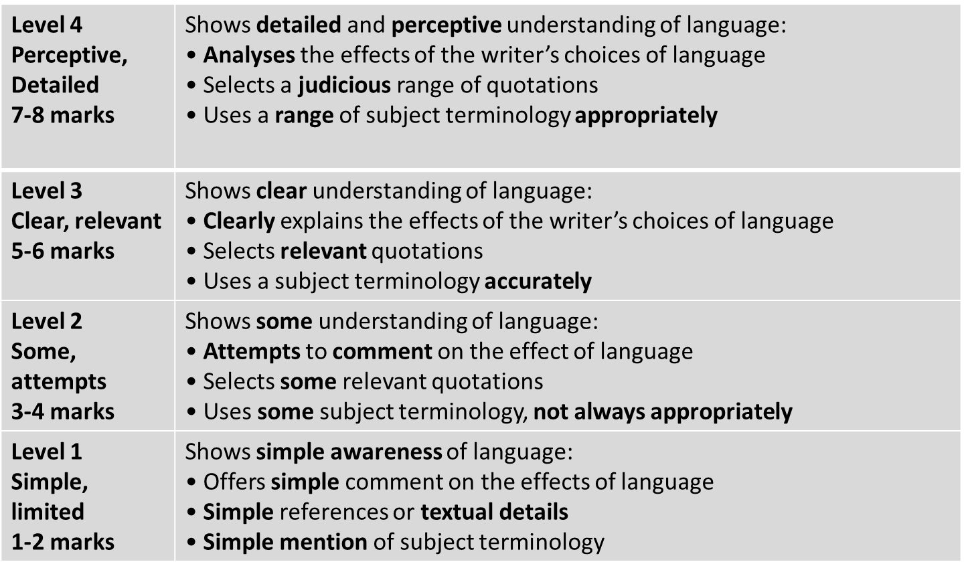
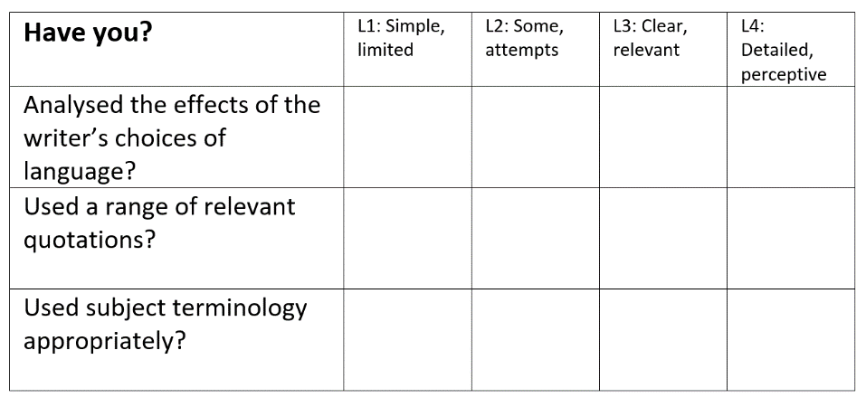
Learning Objective: To practise answering Paper 1 Section A
?
STRENGTHS | WEAKNESSES | NEXT STEPS
Clear and relevant points. Explained effects of language. Range of evidence included. Subject terminology used. | Limited range of points. Only one or two points made. No comment on the effect of language. Subject terminology not used accurately. | Show a detailed understanding of language. Analyse the effect of language. Include a range of precise evidence. Use a range of subject terminology.

Slide 27
Paper 1
Question 3
This question asks you about the whole text.
The question is always about the structure of the text. STRUCTURE simply means the order of the things the writer describes in the text.
DO:
Look at the beginning, middle and end of the text
Look for a place where the focus shifts (changes)
Make notes on the text as you find structural features
Write about WHAT the writer has done and WHY

Slide 28
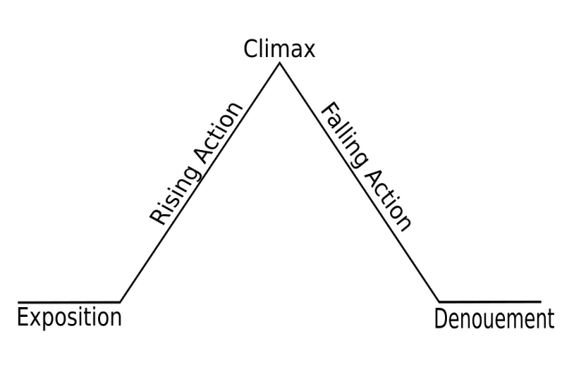
Question 3:
Question 3: You now need to think about the whole of the source.
This text is taken from the beginning of a novel.
How has the writer structured the text to interest you as a reader?
You could write about:
What the writer focuses your attention on at the beginning
How and why the writer changes this focus as the source develops
Any other structural devices that interest you.
[8 marks]

Slide 29
2 – look for two examples of rising action. What is the writer focusing on to create tension? How does he shift the focus?
3- what is the climax? How does it make us feel?
It is unlikely you will get any falling action in your exam text.
The writer begins by introducing… This interests us because…
The narrative focus shifts to… This is interesting because…
Tension builds when…
The climax of the extract is… It makes us feel…
1- at the start, what does the writer introduce, and why?
It is unlikely you will get any denouement in your exam text.

Slide 30
WHAT THE EXAMINER WILL SEE
SIMPLE AWARENESS OF STRUCTURE (L1)
Simple comment on the effect of structure (L1)
Simple textual detail (L1)
Simple use of subject terminology (L1)
SOME UNDERSTANDING OF STRUCTURE (L2)
Attempt to comment on the effect of structure (L2)
Some appropriate textual detail (L2)
Some use of subject terminology (L2)
CLEAR UNDERSTANDING OF STRUCTURE (L3)
Clear explanation of the effects of structure (L3)
Range of relevant textual detail (L3)
Clear/accurate use of subject terminology (L3)
DETAILED AND PERCEPTIVE UNDERSTANDING OF STRUCTURE (L4)
Analysis of the effects of structure (L4)
Judicious textual detail (L4)
Sophisticated use of subject terminology (L4)
Candidate’s answer will appear here on the examiner’s marking screen.

Slide 31
WHAT THE EXAMINER WILL SEE
SIMPLE AWARENESS OF STRUCTURE (L1)
Simple comment on the effect of structure (L1)
Simple textual detail (L1)
Simple use of subject terminology (L1)
SOME UNDERSTANDING OF STRUCTURE (L2)
Attempt to comment on the effect of structure (L2)
Some appropriate textual detail (L2)
Some use of subject terminology (L2)
CLEAR UNDERSTANDING OF STRUCTURE (L3)
Clear explanation of the effects of structure (L3)
Range of relevant textual detail (L3)
Clear/accurate use of subject terminology (L3)
DETAILED AND PERCEPTIVE UNDERSTANDING OF STRUCTURE (L4)
Analysis of the effects of structure (L4)
Judicious textual detail (L4)
Sophisticated use of subject terminology (L4)
The examiner will see the candidate’s answer to the right of these comments.
The examiner will then click and drag these comments onto your answer to show where you have met the criteria.
This means that part of your answer could contain a L1 comment but also a L4 comment. This means that if part of your answer is L4 but the rest is L1, you will receive a mark in the L4 section of the mark scheme.

Slide 32
YOUR TASK: BE THE EXAMINER. MARK THE FOLLOWING ANSWERS
SIMPLE AWARENESS OF STRUCTURE (L1)
Simple comment on the effect of structure (L1)
Simple textual detail (L1)
Simple use of subject terminology (L1)
SOME UNDERSTANDING OF STRUCTURE (L2)
Attempt to comment on the effect of structure (L2)
Some appropriate textual detail (L2)
Some use of subject terminology (L2)
CLEAR UNDERSTANDING OF STRUCTURE (L3)
Clear explanation of the effects of structure (L3)
Range of relevant textual detail (L3)
Clear/accurate use of subject terminology (L3)
DETAILED AND PERCEPTIVE UNDERSTANDING OF STRUCTURE (L4)
Analysis of the effects of structure (L4)
Judicious textual detail (L4)
Sophisticated use of subject terminology (L4)
Annotate the following answers with the comments on the left. See if you can identify the highest level the answer achieves and where it achieves it.

Slide 33
YOUR TASK: BE THE EXAMINER (CANDIDATE ONE)
In the beginning we are introduced to the West India docks. In the middle the writer introduces us to two characters who are walking through some streets where poor people live. In the end there is some speech which shows that Frederick understands the poor people and Sally doesn’t.
SIMPLE AWARENESS OF STRUCTURE (L1)
Simple comment on the effect of structure (L1)
Simple textual detail (L1)
Simple use of subject terminology (L1)
SOME UNDERSTANDING OF STRUCTURE (L2)
Attempt to comment on the effect of structure (L2)
Some appropriate textual detail (L2)
Some use of subject terminology (L2)
CLEAR UNDERSTANDING OF STRUCTURE (L3)
Clear explanation of the effects of structure (L3)
Range of relevant textual detail (L3)
Clear/accurate use of subject terminology (L3)
DETAILED AND PERCEPTIVE UNDERSTANDING OF STRUCTURE (L4)
Analysis of the effects of structure (L4)
Judicious textual detail (L4)
Sophisticated use of subject terminology (L4)
Notes:
LEVEL 4 ANSWER

Slide 34
YOUR TASK: BE THE EXAMINER (CANDIDATE TWO)
At the beginning of the text the reader is introduced to the setting of London when the writer states the ‘jibs of cranes pointed to the grey sky like skeletal fingers’ which creates a sense of foreboding for the reader. In the middle of the text, the writer shifts the focus from West India docks to an area suffering from extreme poverty. He introduces two new characters, who at this point remain unnamed, and reader is taken on a journey through the streets. The writer zooms in on not only the setting and how it is affected by poverty, but the people who live there as well which creates a sense of sympathy for them. At the end, the writer uses dialogue to demonstrate how Frederick is familiar with the suffering of the poor but Sally has never truly understood it; possibly because she’s never been exposed to it, which creates a contrast between their characters.
SIMPLE AWARENESS OF STRUCTURE (L1)
Simple comment on the effect of structure (L1)
Simple textual detail (L1)
Simple use of subject terminology (L1)
SOME UNDERSTANDING OF STRUCTURE (L2)
Attempt to comment on the effect of structure (L2)
Some appropriate textual detail (L2)
Some use of subject terminology (L2)
CLEAR UNDERSTANDING OF STRUCTURE (L3)
Clear explanation of the effects of structure (L3)
Range of relevant textual detail (L3)
Clear/accurate use of subject terminology (L3)
DETAILED AND PERCEPTIVE UNDERSTANDING OF STRUCTURE (L4)
Analysis of the effects of structure (L4)
Judicious textual detail (L4)
Sophisticated use of subject terminology (L4)
Notes:
LEVEL 3 ANSWER

Slide 35
YOUR TASK: BE THE EXAMINER (CANDIDATE THREE)
The writer focuses on the setting of the West India docks at the beginning of the source where ‘jibs of cranes pointed to the grey sky like skeletal fingers.’ He then shifts the focus to two characters and we follow them into a poor part of London. He zooms in on the poor people and we understand how they live. At the end of the source Frederick explains to Sally that the people are poor and can’t get jobs because Sally doesn’t understand. This creates a contrast.
SIMPLE AWARENESS OF STRUCTURE (L1)
Simple comment on the effect of structure (L1)
Simple textual detail (L1)
Simple use of subject terminology (L1)
SOME UNDERSTANDING OF STRUCTURE (L2)
Attempt to comment on the effect of structure (L2)
Some appropriate textual detail (L2)
Some use of subject terminology (L2)
CLEAR UNDERSTANDING OF STRUCTURE (L3)
Clear explanation of the effects of structure (L3)
Range of relevant textual detail (L3)
Clear/accurate use of subject terminology (L3)
DETAILED AND PERCEPTIVE UNDERSTANDING OF STRUCTURE (L4)
Analysis of the effects of structure (L4)
Judicious textual detail (L4)
Sophisticated use of subject terminology (L4)
Notes:
LEVEL 1 ANSWER

Slide 36
YOUR TASK: BE THE EXAMINER (CANDIDATE FOUR)
Throughout the text the reader is taken on a journey through a poverty-stricken area of London to emphasise the effects of poverty: the first setting introduced, of ‘jibs of cranes pointed to the grey sky like skeletal fingers’, is a dismal symbol of the wealth of London and indicates to the reader that this is having a dreadful effect on the city. The writer then shifts the focus of the text to introduce two characters, who at this point remain unnamed, and reader is taken on a journey through the poorest streets of the city, extending the symbolism of the initial image. The writer zooms in on the impoverished setting – the ‘streams of stinking water’ creating a hostile atmosphere. This is paralleled by the writer then zooming in on the people, who ‘stare with hostile eyes’. The idea of poverty and its effects is developed by this focus and the sympathy is created in the reader’s mind.
The writer then uses dialogue to create a contrast between the two walking characters: Sally’s speech - ‘there must be jobs’ - represents the ignorance of the middle classes; Frederick’s response represents knowledge, understanding and empathy and indicates that he is the more knowledgeable of the two. The climax of the extract, when Sally ‘looks around’ at the impoverished setting, reinforces the contrast between these streets and the wealth represented at the beginning of the extract through the description of the docks.
SIMPLE AWARENESS OF STRUCTURE (L1)
Simple comment on the effect of structure (L1)
Simple textual detail (L1)
Simple use of subject terminology (L1)
SOME UNDERSTANDING OF STRUCTURE (L2)
Attempt to comment on the effect of structure (L2)
Some appropriate textual detail (L2)
Some use of subject terminology (L2)
CLEAR UNDERSTANDING OF STRUCTURE (L3)
Clear explanation of the effects of structure (L3)
Range of relevant textual detail (L3)
Clear/accurate use of subject terminology (L3)
DETAILED AND PERCEPTIVE UNDERSTANDING OF STRUCTURE (L4)
Analysis of the effects of structure (L4)
Judicious textual detail (L4)
Sophisticated use of subject terminology (L4)
Notes:
LEVEL 2 ANSWER

Slide 37
YOUR TASK: BE THE EXAMINER (CANDIDATE ONE)
In the beginning we are introduced to the West India docks. In the middle the writer introduces us to two characters who are walking through some streets where poor people live. In the end there is some speech which shows that Frederick understands the poor people and Sally doesn’t.
SIMPLE AWARENESS OF STRUCTURE (L1)
Simple comment on the effect of structure (L1)
Simple textual detail (L1)
Simple use of subject terminology (L1)
SOME UNDERSTANDING OF STRUCTURE (L2)
Attempt to comment on the effect of structure (L2)
Some appropriate textual detail (L2)
Some use of subject terminology (L2)
CLEAR UNDERSTANDING OF STRUCTURE (L3)
Clear explanation of the effects of structure (L3)
Range of relevant textual detail (L3)
Clear/accurate use of subject terminology (L3)
DETAILED AND PERCEPTIVE UNDERSTANDING OF STRUCTURE (L4)
Analysis of the effects of structure (L4)
Judicious textual detail (L4)
Sophisticated use of subject terminology (L4)
BAND
ONE
Notes:
LEVEL 4 ANSWER

Slide 38
YOUR TASK: BE THE EXAMINER (CANDIDATE TWO)
At the beginning of the text the reader is introduced to the setting of London when the writer states the ‘jibs of cranes pointed to the grey sky like skeletal fingers’ which creates a sense of foreboding for the reader. In the middle of the text, the writer shifts the focus from West India docks to an area suffering from extreme poverty. He introduces two new characters, who at this point remain unnamed, and reader is taken on a journey through the streets. The writer zooms in on not only the setting and how it is affected by poverty, but the people who live there as well which creates a sense of sympathy for them. At the end, the writer uses dialogue to demonstrate how Frederick is familiar with the suffering of the poor but Sally has never truly understood it; possibly because she’s never been exposed to it, which creates a contrast between their characters.
SIMPLE AWARENESS OF STRUCTURE (L1)
Simple comment on the effect of structure (L1)
Simple textual detail (L1)
Simple use of subject terminology (L1)
SOME UNDERSTANDING OF STRUCTURE (L2)
Attempt to comment on the effect of structure (L2)
Some appropriate textual detail (L2)
Some use of subject terminology (L2)
CLEAR UNDERSTANDING OF STRUCTURE (L3)
Clear explanation of the effects of structure (L3)
Range of relevant textual detail (L3)
Clear/accurate use of subject terminology (L3)
DETAILED AND PERCEPTIVE UNDERSTANDING OF STRUCTURE (L4)
Analysis of the effects of structure (L4)
Judicious textual detail (L4)
Sophisticated use of subject terminology (L4)
BAND
THREE
Notes:
LEVEL 3 ANSWER

Slide 39
YOUR TASK: BE THE EXAMINER (CANDIDATE THREE)
The writer focuses on the setting of the West India docks at the beginning of the source where ‘jibs of cranes pointed to the grey sky like skeletal fingers.’ He then shifts the focus to two characters and we follow them into a poor part of London. He zooms in on the poor people and we understand how they live. At the end of the source Frederick explains to Sally that the people are poor and can’t get jobs because Sally doesn’t understand. This creates a contrast.
SIMPLE AWARENESS OF STRUCTURE (L1)
Simple comment on the effect of structure (L1)
Simple textual detail (L1)
Simple use of subject terminology (L1)
SOME UNDERSTANDING OF STRUCTURE (L2)
Attempt to comment on the effect of structure (L2)
Some appropriate textual detail (L2)
Some use of subject terminology (L2)
CLEAR UNDERSTANDING OF STRUCTURE (L3)
Clear explanation of the effects of structure (L3)
Range of relevant textual detail (L3)
Clear/accurate use of subject terminology (L3)
DETAILED AND PERCEPTIVE UNDERSTANDING OF STRUCTURE (L4)
Analysis of the effects of structure (L4)
Judicious textual detail (L4)
Sophisticated use of subject terminology (L4)
BAND
TWO
Notes:
LEVEL 1 ANSWER

Slide 40
YOUR TASK: BE THE EXAMINER (CANDIDATE FOUR)
Throughout the text the reader is taken on a journey through a poverty-stricken area of London to emphasise the effects of poverty: the first setting introduced, of ‘jibs of cranes pointed to the grey sky like skeletal fingers’, is a dismal symbol of the wealth of London and indicates to the reader that this is having a dreadful effect on the city. The writer then shifts the focus of the text to introduce two characters, who at this point remain unnamed, and reader is taken on a journey through the poorest streets of the city, extending the symbolism of the initial image. The writer zooms in on the impoverished setting – the ‘streams of stinking water’ creating a hostile atmosphere. This is paralleled by the writer then zooming in on the people, who ‘stare with hostile eyes’. The idea of poverty and its effects is developed by this focus and the sympathy is created in the reader’s mind.
The writer then uses dialogue to create a contrast between the two walking characters: Sally’s speech - ‘there must be jobs’ - represents the ignorance of the middle classes; Frederick’s response represents knowledge, understanding and empathy and indicates that he is the more knowledgeable of the two. The climax of the extract, when Sally ‘looks around’ at the impoverished setting, reinforces the contrast between these streets and the wealth represented at the beginning of the extract through the description of the docks.
SIMPLE AWARENESS OF STRUCTURE (L1)
Simple comment on the effect of structure (L1)
Simple textual detail (L1)
Simple use of subject terminology (L1)
SOME UNDERSTANDING OF STRUCTURE (L2)
Attempt to comment on the effect of structure (L2)
Some appropriate textual detail (L2)
Some use of subject terminology (L2)
CLEAR UNDERSTANDING OF STRUCTURE (L3)
Clear explanation of the effects of structure (L3)
Range of relevant textual detail (L3)
Clear/accurate use of subject terminology (L3)
DETAILED AND PERCEPTIVE UNDERSTANDING OF STRUCTURE (L4)
Analysis of the effects of structure (L4)
Judicious textual detail (L4)
Sophisticated use of subject terminology (L4)
BAND
FOUR
Notes:
LEVEL 2 ANSWER

Slide 41
Question 3:
Question 3: You now need to think about the whole of the source.
This text is taken from the beginning of a novel.
How has the writer structured the text to interest you as a reader?
You could write about:
What the writer focuses your attention on at the beginning
How and why the writer changes this focus as the source develops
Any other structural devices that interest you.
[8 marks]

Slide 42
YOUR TASK: WRITE YOUR ANSWER
How has the writer structured the text to interest you as a reader?
Making the process of analysis simpler:
What structural feature is being used?
Why do they use this feature?
How does it interest us?
Layer up from the basic questions:
What does the writer want us to feel as a reader?
How does the writer use structural features to do this?
How does the writer move from one structural feature to another?
Why have they chosen that structural feature over another structural feature?
Why might they want us to interpret it in different ways?
These 3 questions will help you think an explore the BIG ideas. They cover the basic assessment objectives. If you are answering these questions, you are hitting the assessment objectives.

Slide 43
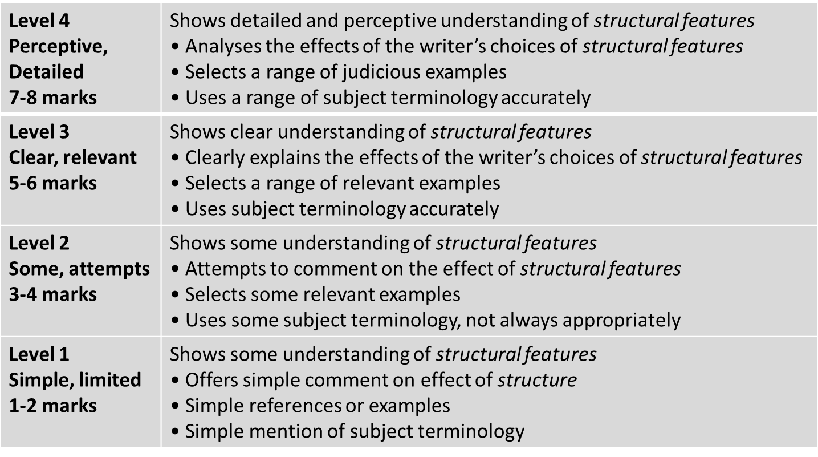
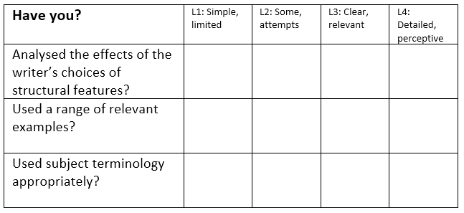
Learning Objective: To practise answering Paper 1 Section A
?
STRENGTHS | WEAKNESSES | NEXT STEPS
Clear and relevant points. Explained effects of structure. Range of evidence included. Subject terminology used. | Limited range of points. Only one or two points made. No comment/analysis on the effect of structure. Subject terminology not used accurately. | Show a detailed understanding of structure. Analyse the effect of structure. Include a range of precise evidence. Use a range of subject terminology.

Slide 44
Paper 1
Question 4
This question asks you about the second half of the text.
The question always asks you to EVALUATE.
Evaluate means explain how well the writer has done something.
DO:
Box off the lines the question refers to
Start by agreeing with the statement in the question
Underline interesting words and phrases from the extract that agree with the statement
Write about WHAT the writer has done, HOW it works and WHY it is successful, using adverbs

Slide 45
Question 4:
Question 4:
Focus this part of your answer on the second half of the source, from line 14 to the end.
A student, having read this section of the text said, “The writer paints a dark picture of London here; it’s an unwelcoming place.”
To what extent do you agree?
You could write about:
your own impression of London in the text
evaluate how the writer has portrayed it as an unwelcoming place
support your opinions with reference to the text
[20 Marks]
25 minutes

Slide 46
Learning Objective: To practise answering Paper 1 Section A
A student, having read this section of the text said, “The writer paints a dark picture of London here; it’s an unwelcoming place.”
To what extent do you agree?
Find an example from the text.
Analyse and consider the author’s intention.
Consider HOW EFFECTIVE the method is

Slide 47
WHAT THE EXAMINER WILL SEE
Candidate’s answer will appear here on the examiner’s marking screen.
SIMPLE/LIMITED (L1)
Simple evaluative statement (L1)
Limited method (L1)
Simple references (L1)
Simple response to statement (L1)
SOME/ATTEMPTS (L2)
Some evaluative comment (L2)
Some method (L2)
Some appropriate references (L2)
Some response to statement (L2)
CLEAR/RELEVANT (L3)
Clearly evaluates effect on reader (L3)
Clear understanding of method (L3)
Range of references (L3)
Clear and relevant response to statement (L3)
PERCEPTIVE/JUDICIOUS (L4)
Critically evaluates the effect on the reader (L4)
Perceptive understanding of method (L4)
Judicious range of references (L4)
Convincing and critical response to statement (L4)

Slide 48
WHAT THE EXAMINER WILL SEE
The examiner will see the candidate’s answer to the right of these comments.
The examiner will then click and drag these comments onto your answer to show where you have met the criteria.
This means that part of your answer could contain a L1 comment but also a L4 comment. This means that if part of your answer is L4 but the rest is L1, you will receive a mark in the L4 section of the mark scheme.
SIMPLE/LIMITED (L1)
Simple evaluative statement (L1)
Limited method (L1)
Simple references (L1)
Simple response to statement (L1)
SOME/ATTEMPTS (L2)
Some evaluative comment (L2)
Some method (L2)
Some appropriate references (L2)
Some response to statement (L2)
CLEAR/RELEVANT (L3)
Clearly evaluates effect on reader (L3)
Clear understanding of method (L3)
Range of references (L3)
Clear and relevant response to statement (L3)
PERCEPTIVE/JUDICIOUS (L4)
Critically evaluates the effect on the reader (L4)
Perceptive understanding of method (L4)
Judicious range of references (L4)
Convincing and critical response to statement (L4)

Slide 49
YOUR TASK: BE THE EXAMINER. MARK THE FOLLOWING ANSWERS
SIMPLE/LIMITED (L1)
Simple evaluative statement (L1)
Limited method (L1)
Simple references (L1)
Simple response to statement (L1)
SOME/ATTEMPTS (L2)
Some evaluative comment (L2)
Some method (L2)
Some appropriate references (L2)
Some response to statement (L2)
CLEAR/RELEVANT (L3)
Clearly evaluates effect on reader (L3)
Clear understanding of method (L3)
Range of references (L3)
Clear and relevant response to statement (L3)
PERCEPTIVE/JUDICIOUS (L4)
Critically evaluates the effect on the reader (L4)
Perceptive understanding of method (L4)
Judicious range of references (L4)
Convincing and critical response to statement (L4)
Annotate the following answers with the comments on the left. See if you can identify the highest level the answer achieves and where it achieves it.

Slide 50
YOUR TASK: BE THE EXAMINER (CANDIDATE ONE)
SIMPLE/LIMITED (L1)
Simple evaluative statement (L1)
Limited method (L1)
Simple references (L1)
Simple response to statement (L1)
SOME/ATTEMPTS (L2)
Some evaluative comment (L2)
Some method (L2)
Some appropriate references (L2)
Some response to statement (L2)
CLEAR/RELEVANT (L3)
Clearly evaluates effect on reader (L3)
Clear understanding of method (L3)
Range of references (L3)
Clear and relevant response to statement (L3)
PERCEPTIVE/JUDICIOUS (L4)
Critically evaluates the effect on the reader (L4)
Perceptive understanding of method (L4)
Judicious range of references (L4)
Convincing and critical response to statement (L4)
I agree that London is an unwelcoming place when the writer uses the metaphor ‘eyes full of hatred.’ This suggests that the people living there are angry and don’t want to be stuck the setting they are living in. The adjective ‘hatred’ implies that the people are hostile and don’t want stranger like Sally and Frederick there.
Notes:
LEVEL 4 ANSWER

Slide 51
YOUR TASK: BE THE EXAMINER (CANDIDATE TWO)
I agree because the writer says ‘eyes full of hatred’. This suggests that the people living there are very angry and don’t want Sally and Frederick there. This makes me agree that London is an unwelcoming place as you wouldn’t want to be there with angry people.
SIMPLE/LIMITED (L1)
Simple evaluative statement (L1)
Limited method (L1)
Simple references (L1)
Simple response to statement (L1)
SOME/ATTEMPTS (L2)
Some evaluative comment (L2)
Some method (L2)
Some appropriate references (L2)
Some response to statement (L2)
CLEAR/RELEVANT (L3)
Clearly evaluates effect on reader (L3)
Clear understanding of method (L3)
Range of references (L3)
Clear and relevant response to statement (L3)
PERCEPTIVE/JUDICIOUS (L4)
Critically evaluates the effect on the reader (L4)
Perceptive understanding of method (L4)
Judicious range of references (L4)
Convincing and critical response to statement (L4)
Notes:
LEVEL 3 ANSWER

Slide 52
YOUR TASK: BE THE EXAMINER (CANDIDATE THREE)
I partially agree with the statement as although the setting is presented as unwelcoming due to the intimidating atmosphere created by its inhabitants, the writer also creates feelings of sympathy and enables the reader to understand the reasons behind the occupants’ threatening behaviour. Firstly, the metaphor ‘eyes full of hatred’ implies that the men omit hostile glares to deter Sally and Frederick from encroaching on their territory; the only power they obtain as lower working class citizens. The emotive adjective ‘hatred’ and the verb ‘challenged’ both convey aggressive connotations that emphasise the unwelcoming atmosphere created by the inhabitants – this dilapidated setting is all they have and they do not wish to share it. However, the writer also reveals (through the dialogue of Frederick) that they lack opportunity and options when he refers to them as ‘poor fellows.’ The adjective ‘poor’ detracts from the hostile atmosphere as the inhabitants now appear defensive as opposed to confrontational. They only wish to be left alone with what is theirs; they do not wish to be in the presence of those who represent the very classes who ensure they are deprived of basic human rights.
SIMPLE/LIMITED (L1)
Simple evaluative statement (L1)
Limited method (L1)
Simple references (L1)
Simple response to statement (L1)
SOME/ATTEMPTS (L2)
Some evaluative comment (L2)
Some method (L2)
Some appropriate references (L2)
Some response to statement (L2)
CLEAR/RELEVANT (L3)
Clearly evaluates effect on reader (L3)
Clear understanding of method (L3)
Range of references (L3)
Clear and relevant response to statement (L3)
PERCEPTIVE/JUDICIOUS (L4)
Critically evaluates the effect on the reader (L4)
Perceptive understanding of method (L4)
Judicious range of references (L4)
Convincing and critical response to statement (L4)
Notes:
LEVEL 1 ANSWER

Slide 53
YOUR TASK: BE THE EXAMINER (CANDIDATE FOUR)
SIMPLE/LIMITED (L1)
Simple evaluative statement (L1)
Limited method (L1)
Simple references (L1)
Simple response to statement (L1)
SOME/ATTEMPTS (L2)
Some evaluative comment (L2)
Some method (L2)
Some appropriate references (L2)
Some response to statement (L2)
CLEAR/RELEVANT (L3)
Clearly evaluates effect on reader (L3)
Clear understanding of method (L3)
Range of references (L3)
Clear and relevant response to statement (L3)
PERCEPTIVE/JUDICIOUS (L4)
Critically evaluates the effect on the reader (L4)
Perceptive understanding of method (L4)
Judicious range of references (L4)
Convincing and critical response to statement (L4)
I completely agree with the statement that London is an unwelcoming place as the writer uses the metaphor ‘eyes full of hatred’ to emphasise the hostility that is omitted by the people who live there. The adjective ‘hatred’ implies that the inhabitants are intimidating and convey negative feelings towards those who don’t belong in the poverty-stricken streets of London. This could imply that despite the fact the setting itself is an unpleasant place to visit yet alone live, it is all the inhabitants have and therefore they attempt to deter anyone who encroaches on their territory.
Notes:
LEVEL 2 ANSWER

Slide 54
YOUR TASK: BE THE EXAMINER (CANDIDATE ONE)
SIMPLE/LIMITED (L1)
Simple evaluative statement (L1)
Limited method (L1)
Simple references (L1)
Simple response to statement (L1)
SOME/ATTEMPTS (L2)
Some evaluative comment (L2)
Some method (L2)
Some appropriate references (L2)
Some response to statement (L2)
CLEAR/RELEVANT (L3)
Clearly evaluates effect on reader (L3)
Clear understanding of method (L3)
Range of references (L3)
Clear and relevant response to statement (L3)
PERCEPTIVE/JUDICIOUS (L4)
Critically evaluates the effect on the reader (L4)
Perceptive understanding of method (L4)
Judicious range of references (L4)
Convincing and critical response to statement (L4)
I agree that London is an unwelcoming place when the writer uses the metaphor ‘eyes full of hatred.’ This suggests that the people living there are angry and don’t want to be stuck the setting they are living in. The adjective ‘hatred’ implies that the people are hostile and don’t want stranger like Sally and Frederick there.
BAND
TWO
Notes:
LEVEL 4 ANSWER

Slide 55
YOUR TASK: BE THE EXAMINER (CANDIDATE TWO)
I agree because the writer says ‘eyes full of hatred’. This suggests that the people living there are very angry and don’t want Sally and Frederick there. This makes me agree that London is an unwelcoming place as you wouldn’t want to be there with angry people.
SIMPLE/LIMITED (L1)
Simple evaluative statement (L1)
Limited method (L1)
Simple references (L1)
Simple response to statement (L1)
SOME/ATTEMPTS (L2)
Some evaluative comment (L2)
Some method (L2)
Some appropriate references (L2)
Some response to statement (L2)
CLEAR/RELEVANT (L3)
Clearly evaluates effect on reader (L3)
Clear understanding of method (L3)
Range of references (L3)
Clear and relevant response to statement (L3)
PERCEPTIVE/JUDICIOUS (L4)
Critically evaluates the effect on the reader (L4)
Perceptive understanding of method (L4)
Judicious range of references (L4)
Convincing and critical response to statement (L4)
BAND
ONE
Notes:
LEVEL 3 ANSWER

Slide 56
YOUR TASK: BE THE EXAMINER (CANDIDATE THREE)
I partially agree with the statement as although the setting is presented as unwelcoming due to the intimidating atmosphere created by its inhabitants, the writer also creates feelings of sympathy and enables the reader to understand the reasons behind the occupants’ threatening behaviour. Firstly, the metaphor ‘eyes full of hatred’ implies that the men omit hostile glares to deter Sally and Frederick from encroaching on their territory; the only power they obtain as lower working class citizens. The emotive adjective ‘hatred’ and the verb ‘challenged’ both convey aggressive connotations that emphasise the unwelcoming atmosphere created by the inhabitants – this dilapidated setting is all they have and they do not wish to share it. However, the writer also reveals (through the dialogue of Frederick) that they lack opportunity and options when he refers to them as ‘poor fellows.’ The adjective ‘poor’ detracts from the hostile atmosphere as the inhabitants now appear defensive as opposed to confrontational. They only wish to be left alone with what is theirs; they do not wish to be in the presence of those who represent the very classes who ensure they are deprived of basic human rights
SIMPLE/LIMITED (L1)
Simple evaluative statement (L1)
Limited method (L1)
Simple references (L1)
Simple response to statement (L1)
SOME/ATTEMPTS (L2)
Some evaluative comment (L2)
Some method (L2)
Some appropriate references (L2)
Some response to statement (L2)
CLEAR/RELEVANT (L3)
Clearly evaluates effect on reader (L3)
Clear understanding of method (L3)
Range of references (L3)
Clear and relevant response to statement (L3)
PERCEPTIVE/JUDICIOUS (L4)
Critically evaluates the effect on the reader (L4)
Perceptive understanding of method (L4)
Judicious range of references (L4)
Convincing and critical response to statement (L4)
BAND
FOUR
Notes:
LEVEL 1 ANSWER

Slide 57
YOUR TASK: BE THE EXAMINER (CANDIDATE FOUR)
SIMPLE/LIMITED (L1)
Simple evaluative statement (L1)
Limited method (L1)
Simple references (L1)
Simple response to statement (L1)
SOME/ATTEMPTS (L2)
Some evaluative comment (L2)
Some method (L2)
Some appropriate references (L2)
Some response to statement (L2)
CLEAR/RELEVANT (L3)
Clearly evaluates effect on reader (L3)
Clear understanding of method (L3)
Range of references (L3)
Clear and relevant response to statement (L3)
PERCEPTIVE/JUDICIOUS (L4)
Critically evaluates the effect on the reader (L4)
Perceptive understanding of method (L4)
Judicious range of references (L4)
Convincing and critical response to statement (L4)
I completely agree with the statement that London is an unwelcoming place as the writer uses the metaphor ‘eyes full of hatred’ to emphasise the hostility that is omitted by the people who live there. The adjective ‘hatred’ implies that the inhabitants are intimidating and convey negative feelings towards those who don’t belong in the poverty-stricken streets of London. This could imply that despite the fact the setting itself is an unpleasant place to visit yet alone live, it is all the inhabitants have and therefore they attempt to deter anyone who encroaches on their territory.
BAND
THREE
Notes:
LEVEL 2 ANSWER

Slide 58
Advice: remember to use evaluate words such as ‘successfully’.
Remember to use your evaluative statements when you respond to the question.
The writer successfully depicts…
The writer effectively conveys…
The use of _____ works well because…
The writer deliberately/purposefully chose to use…
The use of _____ has great impact because…

Slide 59
Question 4:
Focus this part of your answer on the second part of the source from line 14 to the end.
A student, having read this section of the text said, “The writer paints a dark picture of London here; it’s an unwelcoming place.”
To what extent do you agree?
In your response, you could:
• write about your own impressions
of London in the text
• evaluate how the writer has portrayed
it as an unwelcoming place
• support your opinions with
references to the text
[20 Marks]
I agree with the student that…
The writer creates dark picture of London because of the way he refers to/ describes / focuses on...
This is unwelcoming because…
The use of <method> is effective as…. and successfully creates the idea that…
This is successful because…
Furthermore, the writer...
25 minutes

Slide 60
YOUR TASK: WRITE YOUR ANSWER
SIMPLE/LIMITED (L1)
Simple evaluative statement (L1)
Limited method (L1)
Simple references (L1)
Simple response to statement (L1)
SOME/ATTEMPTS (L2)
Some evaluative comment (L2)
Some method (L2)
Some appropriate references (L2)
Some response to statement (L2)
CLEAR/RELEVANT (L3)
Clearly evaluates effect on reader (L3)
Clear understanding of method (L3)
Range of references (L3)
Clear and relevant response to statement (L3)
PERCEPTIVE/JUDICIOUS (L4)
Critically evaluates the effect on the reader (L4)
Perceptive understanding of method (L4)
Judicious range of references (L4)
Convincing and critical response to statement (L4)
Write your answer to the following question:
A student, having read this section of the text said, “The writer paints a dark picture of London here; it’s an unwelcoming place.” To what extent do you agree?
Use the examiner’s comments on the left to help you consider what you are writing.
Remember, this question is worth 20 marks.

Slide 61
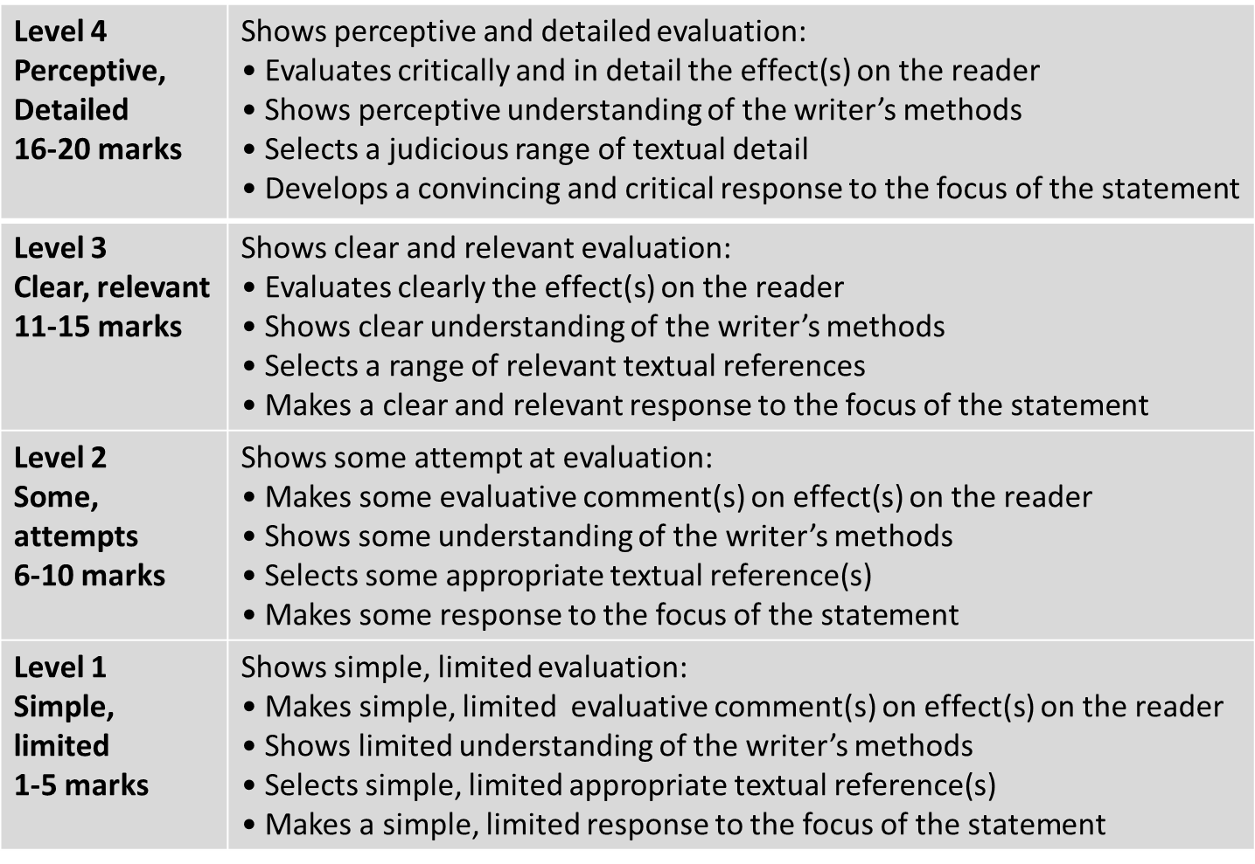
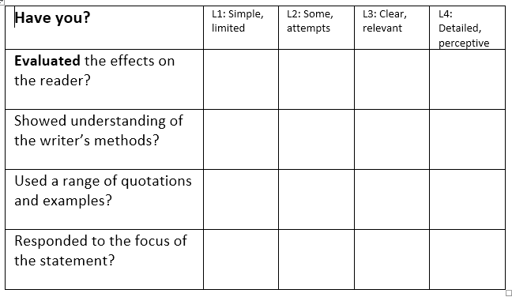
Learning Objective: To practise answering Paper 1 Section A
?
STRENGTHS | WEAKNESSES | NEXT STEPS
Clear and relevant points. Consideration of the view given. Evidence used to support interpretations. The effect of methods is explained clearly. A range of quotations used. | Limited range of points. Effects of methods not analysed clearly. Interpretations are not connected to the statement in the question. No use of subject terminology. | Be critical in evaluation of the statement. Include a range of points and quotations. Analyse the effect of methods precisely. Use subject terminology accurately.

