Slide 1
PAPER 1
PAPER 2

Slide 2
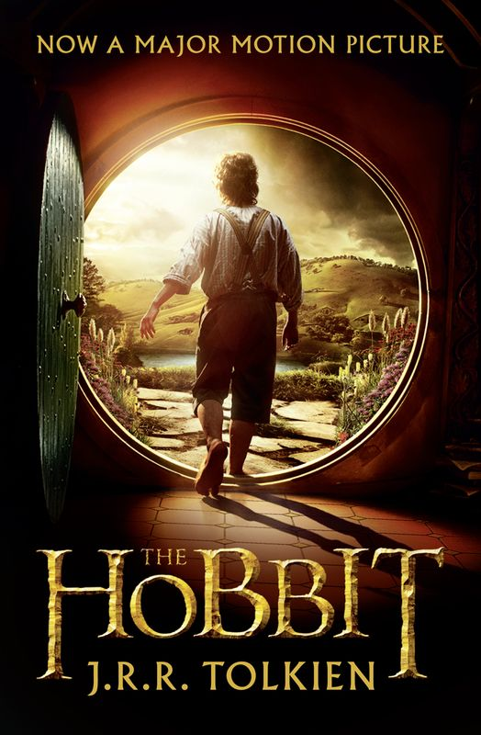
Read the title
What are your expectations?
What does this suggest?
The Hobbit
by JRR Tolkein

Slide 3
Read the blurb
What’s the significance of this?
In this extract, taken from the middle of a novel, a hobbit named Bilbo Baggins
enters the lair of a dragon named Smaug and steals a golden cup.
What are your expectations?
What are your expectations?

Slide 4
Learning Objective: To practise answering Paper 1 Section A
You know the questions so look for the answers as you read…

Slide 5
Q2: Language
Facts
Superlative Adjectives
First person pronoun
Lists
Direct Address
Past tense
Adverbs
Simile
Onomatopoeia
Questions
Proper Nouns
Repetition
Verbs
Adjectives
Statistics, figures and measurements
Adverbial Phrases

Slide 6
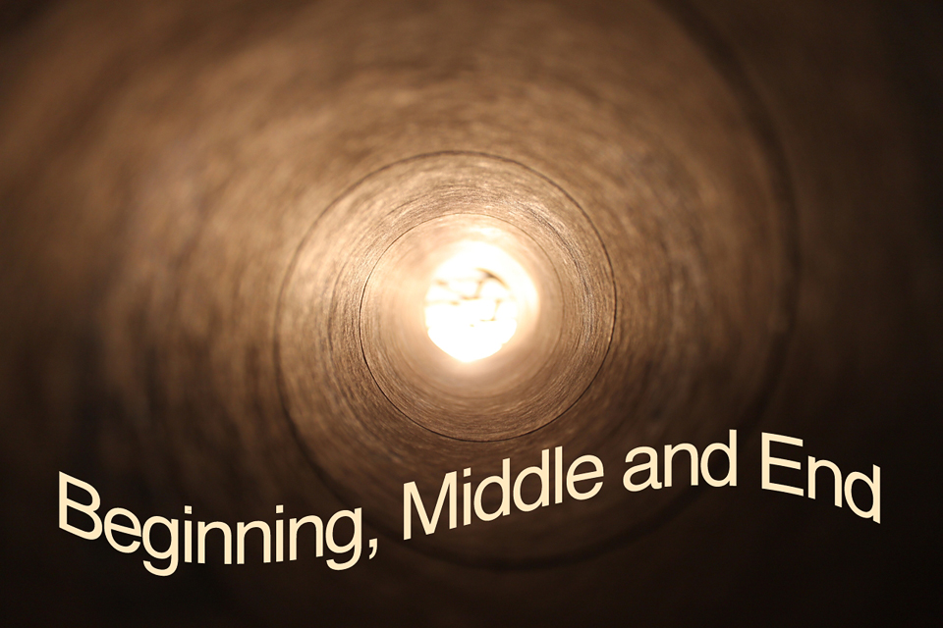
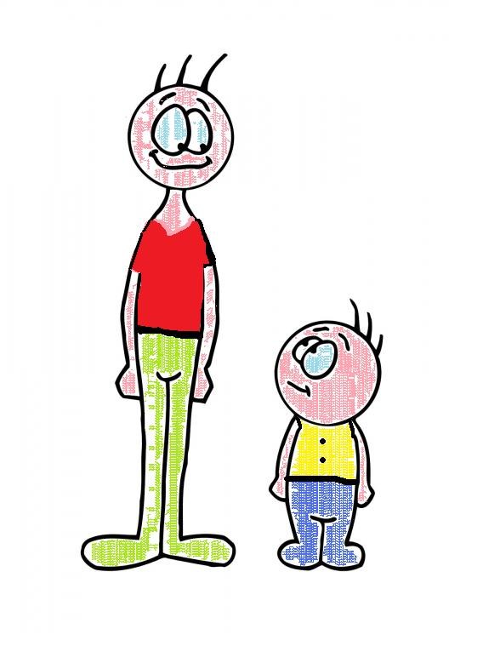
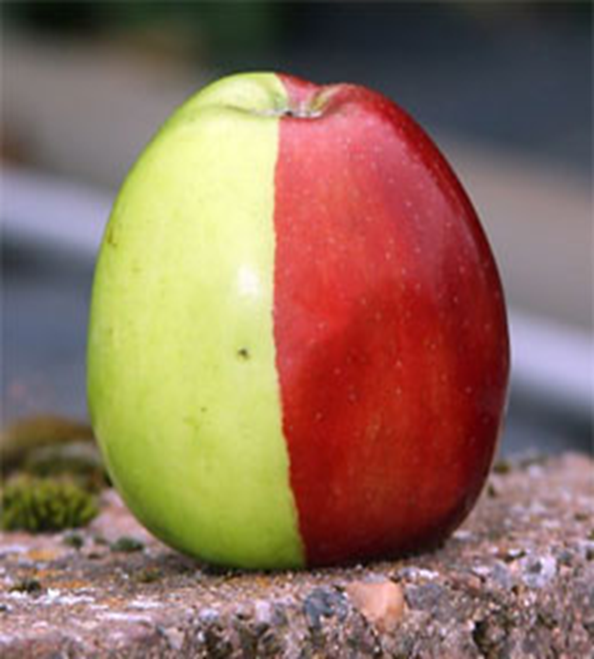
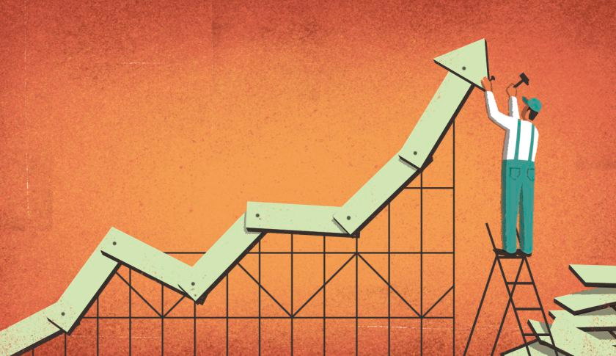
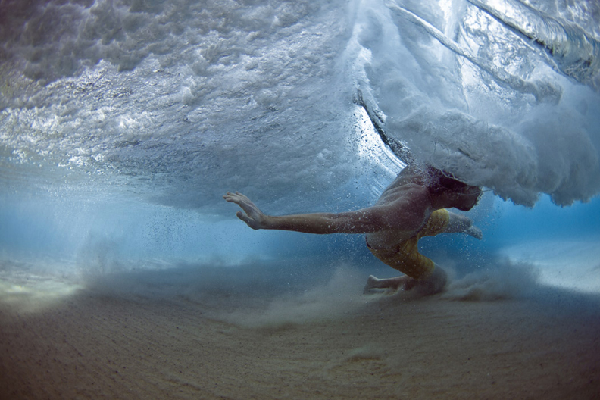
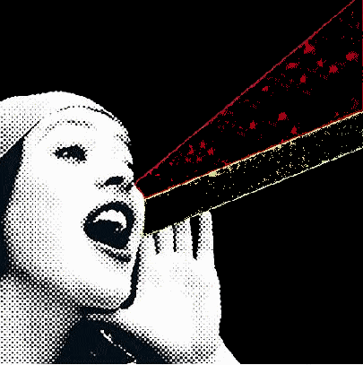
Q3: Structure
Contrasts
Central Ideas, settings or themes
Pivotal/ Turning Points
Build up of ideas, image, feeling
Movement (sentence types / punctuation)
Passages of time
Voice

Slide 7
Paper 1
Question 1
This question is the easiest. It will ask you to pick out FOUR things from the text.
DO NOT just copy the entire paragraph. This will not get you any marks.
DO:
Box off the lines the question refers to
Underline each relevant detail from the extract as you find it
Write down each detail as a short sentence, using quotation marks around your evidence

Slide 8
Question 1:
Question 1:
Read again the first part of the source, lines 1 to 8. List four things that Bilbo Baggins sees and hears in the tunnel.
____________________________________________________
____________________________________________________
____________________________________________________
____________________________________________________
[4 marks]
5 minutes

Slide 9
Paper 1
Question 2
This question asks you to read a short section of the text again.
The question is always about what language the writer has used.
DO:
Box off the lines the question refers to
Underline interesting words and phrases from the extract as you find them
Use three layers to write up your answer, using quotation marks around your evidence

Slide 10
x2
Question 2:
Question 2: Look in detail from lines 17 to 27 of the source.
How does the writer use language here to describe the dragon and his lair?
You could include the writer’s choice of:
Words and phrases
Language features and techniques
Sentence forms
[8 marks]
There he lay, a vast red-golden dragon, fast asleep; thrumming came from his jaws and nostrils, and wisps of smoke, but his fires were low in slumber. Beneath him, under all his limbs and his huge coiled tail, and about him on all sides stretching away across the unseen floors, lay countless piles of precious things, gold wrought and unwrought, gems and jewels, and silver red-stained in the ruddy light. Smaug lay, with wings folded like an immeasurable bat, turned partly on one side, so that the hobbit could see his underparts and his long pale belly crusted with gems and fragments of gold from his long lying on his costly bed. Behind him where the walls were nearest could dimly be seen coats of mail, helms and axes, swords and spears hanging; and there in rows stood great jars and vessels filled with a wealth that could not be guessed. To say that Bilbo’s breath was taken away is
no description at all. There are no words left to express his astonishment, since Men changed the language that they learned of elves in the days when all the world was wonderful.
10
minutes

Slide 11
Question 2: How does the writer use language here to describe the dragon and his lair?
There he lay, a vast red-golden dragon, fast asleep; thrumming came from his jaws and nostrils, and wisps of smoke, but his fires were low in slumber. Beneath him, under all his limbs and his huge coiled tail, and about him on all sides stretching away across the unseen floors, lay countless piles of precious things, gold wrought and unwrought, gems and jewels, and silver red-stained in the ruddy light. Smaug lay, with wings folded like an immeasurable bat, turned partly on one side, so that the hobbit could see his underparts and his long pale belly crusted with gems and fragments of gold from his long lying on his costly bed. Behind him where the walls were nearest could dimly be seen coats of mail, helms and axes, swords and spears hanging; and there in rows stood great jars and vessels filled with a wealth that could not be guessed. To say that Bilbo’s breath was taken away is no description at all. There are no words left to express his astonishment, since Men changed the language that they learned of elves in the days when all the world was wonderful.

Slide 12
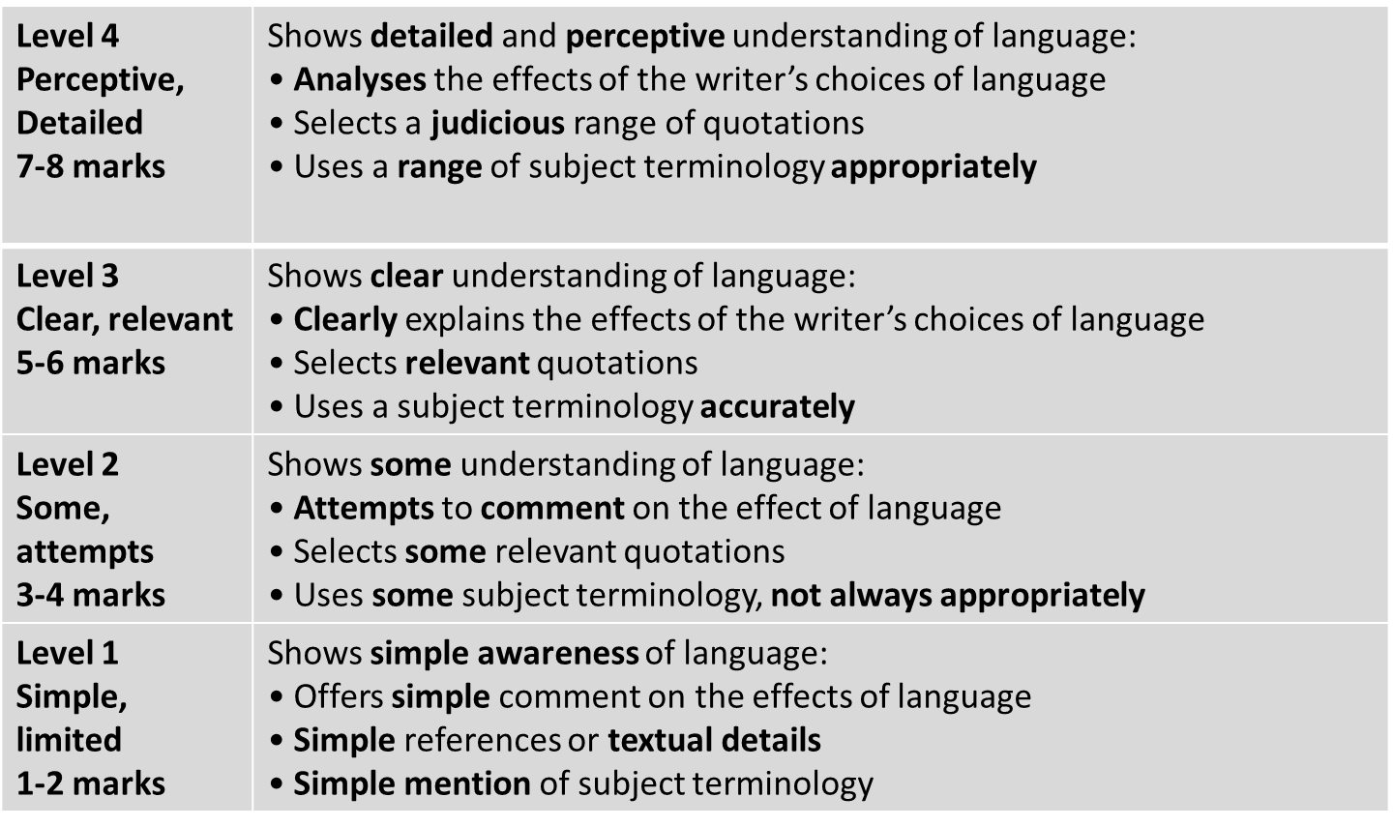
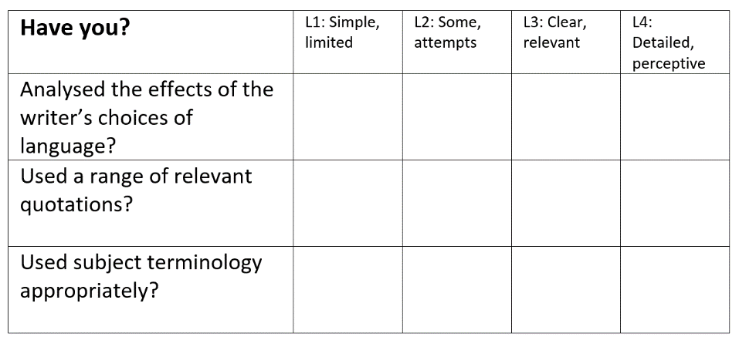
Learning Objective: To practise answering Paper 1 Section A
?
STRENGTHS | WEAKNESSES | NEXT STEPS
Clear and relevant points. Explained effects of language. Range of evidence included. Subject terminology used. | Limited range of points. Only one or two points made. No comment on the effect of language. Subject terminology not used accurately. | Show a detailed understanding of language. Analyse the effect of language. Include a range of precise evidence. Use a range of subject terminology.

Slide 13
Paper 1
Question 3
This question asks you about the whole text.
The question is always about the structure of the text. STRUCTURE simply means the order of the things the writer describes in the text.
DO:
Look at the beginning, middle and end of the text
Look for a place where the focus shifts (changes)
Make notes on the text as you find structural features
Write about WHAT the writer has done and WHY

Slide 14
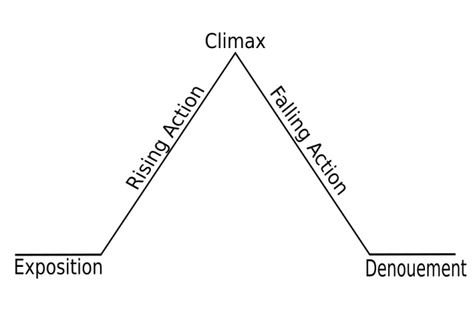
Question 3:
Question 3: You now need to think about the whole of the source.
This text is taken from the beginning of a novel.
How has the writer structured the text to interest you as a reader?
You could write about:
What the writer focuses your attention on at the beginning
How and why the writer changes this focus as the source develops
Any other structural devices that interest you.
[8 marks]

Slide 15
2 – look for two examples of rising action. What is the writer focusing on to create tension? How does he shift the focus?
3- what is the climax? How does it make us feel?
It is unlikely you will get any falling action in your exam text.
The writer begins by introducing… This interests us because…
The narrative focus shifts to… This is interesting because…
Tension builds when…
The climax of the extract is… It makes us feel…
1- at the start, what does the writer introduce, and why?
It is unlikely you will get any denouement in your exam text.

Slide 16
2 – look for two examples of rising action. What is the writer focusing on to create tension? How does he shift the focus?
3- what is the climax? How does it make us feel?
It is unlikely you will get any falling action in your exam text.
The writer begins by introducing… This interests us because…
The narrative focus shifts to… This is interesting because…
Tension builds when…
The climax of the extract is… It makes us feel…
1- at the start, what does the writer introduce, and why?
It is unlikely you will get any denouement in your exam text.

Slide 17
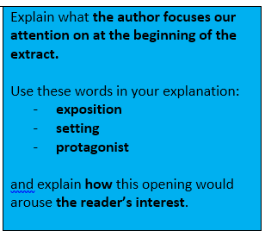
2 – look for two examples of rising action. What is the writer focusing on to create tension? How does he shift the focus?
3- what is the climax? How does it make us feel?
It is unlikely you will get any falling action in your exam text.
The writer begins by introducing… This interests us because…
The narrative focus shifts to… This is interesting because…
Tension builds when…
The climax of the extract is… It makes us feel…
1- at the start, what does the writer introduce, and why?
It is unlikely you will get any denouement in your exam text.

Slide 18
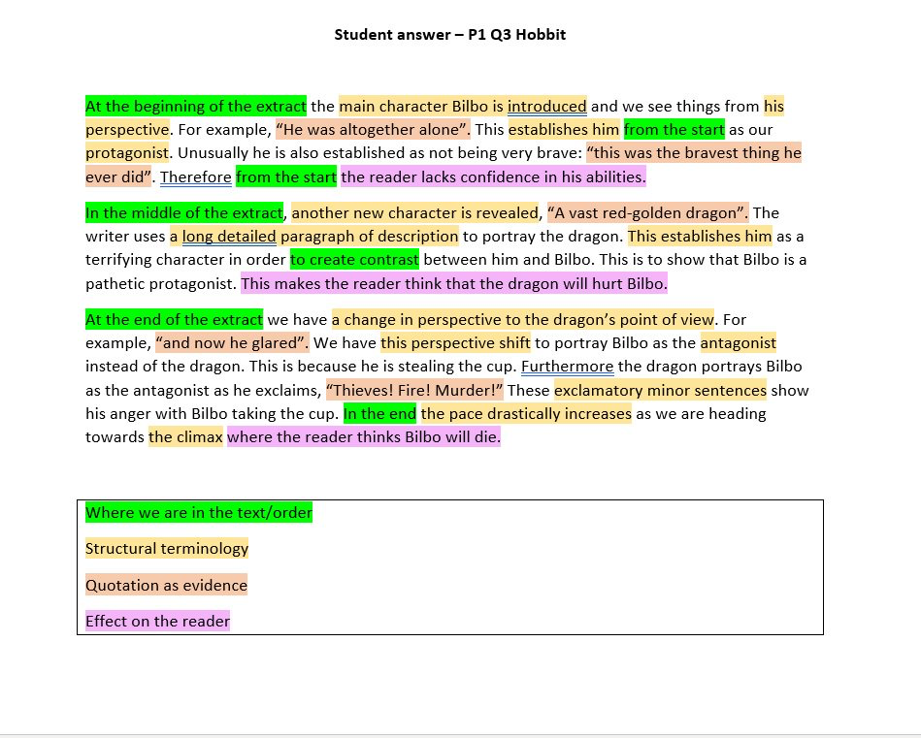

Slide 19
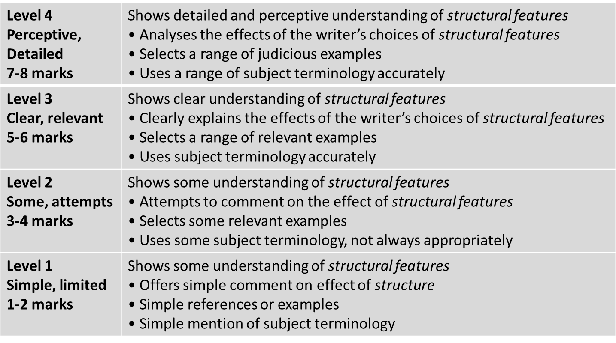
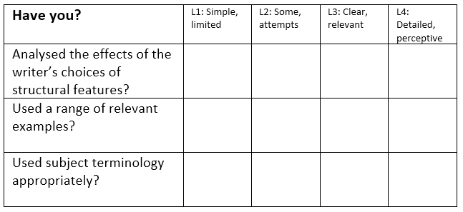
Learning Objective: To practise answering Paper 1 Section A
?
STRENGTHS | WEAKNESSES | NEXT STEPS
Clear and relevant points. Explained effects of structure. Range of evidence included. Subject terminology used. | Limited range of points. Only one or two points made. No comment/analysis on the effect of structure. Subject terminology not used accurately. | Show a detailed understanding of structure. Analyse the effect of structure. Include a range of precise evidence. Use a range of subject terminology.

Slide 20
Paper 1
Question 4
This question asks you about the second half of the text.
The question always asks you to EVALUATE.
Evaluate means explain how well the writer has done something.
DO:
Box off the lines the question refers to
Start by agreeing with the statement in the question
Underline interesting words and phrases from the extract that agree with the statement
Write about WHAT the writer has done, HOW it works and WHY it is successful, using adverbs

Slide 21
Question 4:
Question 4:
Focus this part of your answer on the second part of the source from line 28 to the end.
A student, having read this section of the text, said “I like the way the author makes this moment of the story very dramatic.”
To what extent do you agree?
In your response, you could:
• write about the ways the author develops the tension
• evaluate how the writer makes this moment dramatic
• support your opinions with references to the text
[20 Marks]
25 minutes

Slide 22
Learning Objective: To practise answering Paper 1 Section A
A student, having read this section of the text, said “I like the way the author makes this moment of the story very dramatic.”
To what extent do you agree?
Find an example from the text.
Analyse and consider the author’s intention.
Consider HOW EFFECTIVE the method is

Slide 23
Learning Objective: To practise answering Paper 1 Section A
Read from line 28 to the end
FOCUS: the moment is dramatic.
Bilbo had heard tell and sing of dragon hoards before, but the splendour, the lust, the glory of such treasure had never yet come home to him. His heart was filled and pierced with enchantment and with the desire of dwarves; and he gazed motionless, almost forgetting the frightful guardian, at the gold beyond price and count.
He gazed for what seemed an age, before drawn almost against his will; he stole from the shadow of the doorway, across the floor to the nearest edge of the mounds of treasure. Above him the sleeping dragon lay, a dire menace even in his sleep. He grasped a great two-handled cup, as heavy as he could carry, and cast one fearful eye upwards. Smaug stirred a wing, opened a claw, the rumble of his snoring changed its note.

Slide 24
Learning Objective: To practise answering Paper 1 Section A
Read from line 28 to the end
FOCUS: the moment is dramatic.
Dragons may not have much real use for all their wealth, but they know it to an ounce as a rule, especially after long possession; and Smaug was no exception. He had passed from an uneasy dream (in which a warrior, altogether insignificant in size but provided with a bitter sword and great courage, figured most unpleasantly) to a doze, and from a doze to wide waking. There was a breath of strange air in his cave. Could there be a draught from that little hole? He had never felt quite happy about it, though was so small, and now he glared at it in suspicion and wondered why he had never blocked it up. Of late he had half fancied he had caught the dim echoes of a knocking sound from far above that came down through it to his lair. He stirred and stretched forth his neck to sniff. Then he missed the cup!
Thieves! Fire! Murder! Such a thing had not happened since first he came to the Mountain! His rage passes description - the sort of rage that is only seen when rich folk that have more than they can enjoy suddenly lose something that they have long had but have never before used or wanted. His fire belched forth, the hall smoked, he shook the mountain roots. He thrust his head in vain at the little hole, and then coiling his length together, roaring like thunder underground, he sped from his deep lair through its great door, out into the huge passages of the mountain palace and up towards the Front Gate.

Slide 25
The language of evaluation – don’t just say ‘good’!
Powerful
Memorable
Intriguing
Engaging
Vivid
Life-like
Insightful
Specific
Impressive
Striking
Don’t always say it’s ‘good’ or ‘interesting’.
Think about the different ways you can describe something…
Always say WHY!
Effective
Dramatic
Engaging
Concise

Slide 26
Advice: remember to use evaluate words such as ‘successfully’.
Remember to use your evaluative statements when you respond to the question.
The writer successfully depicts…
The writer effectively conveys…
The use of _____ works well because…
The writer deliberately/purposefully chose to use…
The use of _____ has great impact because…

Slide 27
Question 4:
Focus this part of your answer on the second part of the source from line 28 to the end.
A student, having read this section of the text, said “I like the way the author makes this moment of the story very dramatic.”
To what extent do you agree?
In your response, you could:
• write about the ways the author
develops the tension
• evaluate how the writer makes this
moment dramatic
• support your opinions with
references to the text
[20 Marks]
I agree with the student that…
The writer creates tension because of the way he refers to/ describes / focuses on...
This is dramatic because…
The use of <method> is effective as…. and successfully creates the idea that…
This is dramatic because…
Furthermore, the writer...
25 minutes

Slide 28
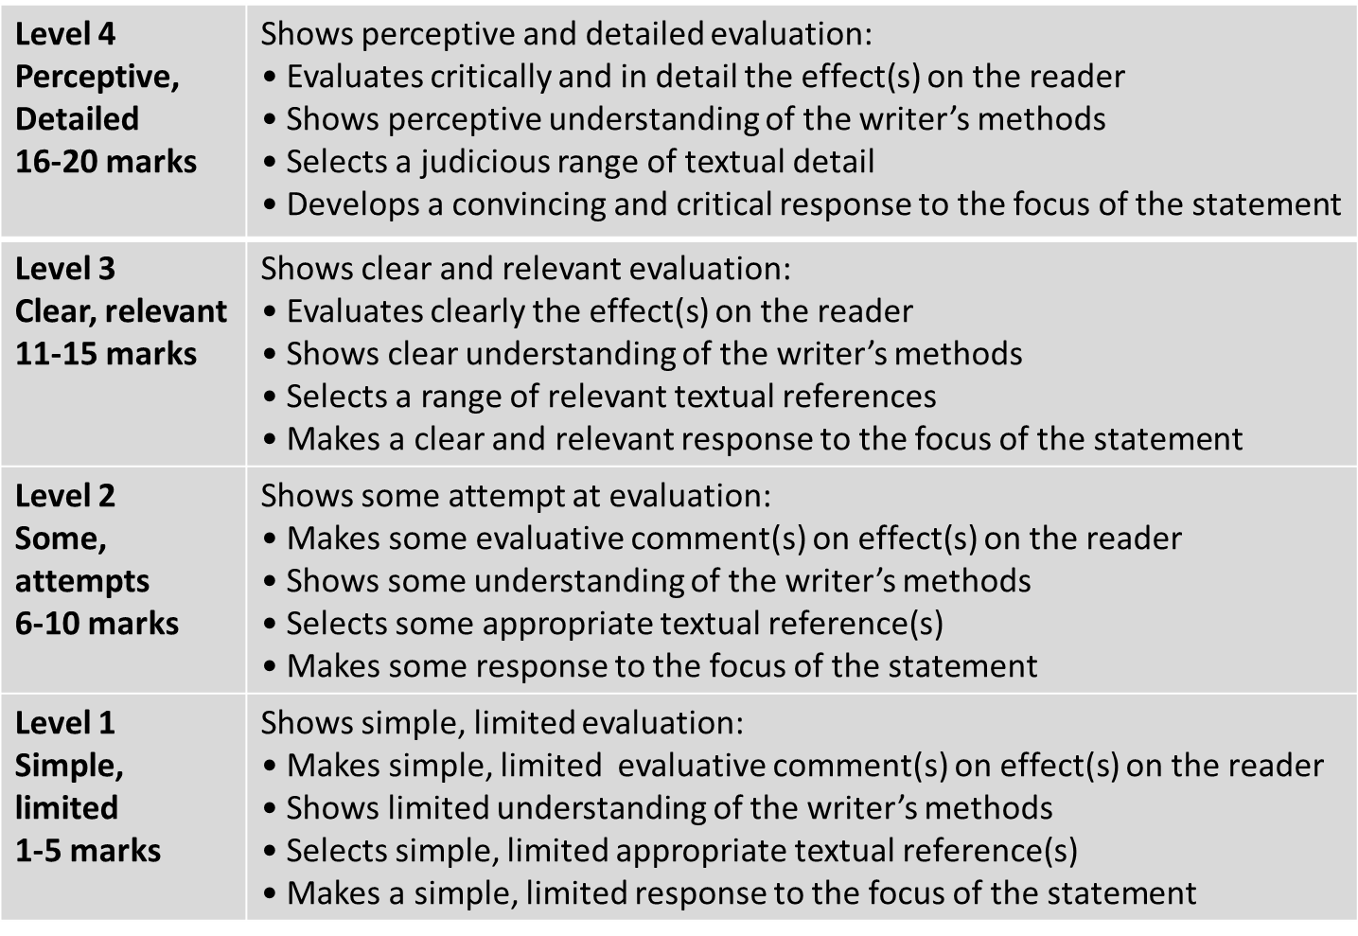
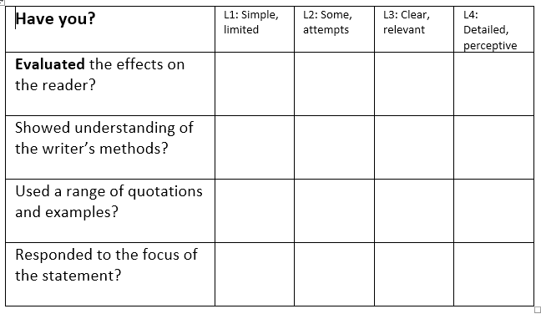
Learning Objective: To practise answering Paper 1 Section A
?
STRENGTHS | WEAKNESSES | NEXT STEPS
Clear and relevant points. Consideration of the view given. Evidence used to support interpretations. The effect of methods is explained clearly. A range of quotations used. | Limited range of points. Effects of methods not analysed clearly. Interpretations are not connected to the statement in the question. No use of subject terminology. | Be critical in evaluation of the statement. Include a range of points and quotations. Analyse the effect of methods precisely. Use subject terminology accurately.

