Slide 1
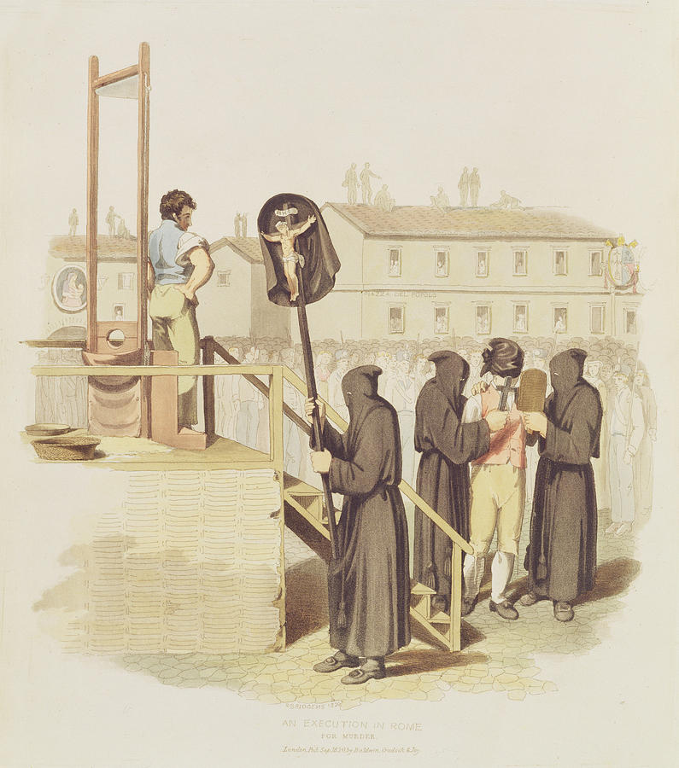
AQA GCSE LANGUAGE – PAPER TWO
CAPITAL PUNISHMENT
Notes:
@SPryke2

Slide 2
READ THE SOURCES
Read the sources.
As you read, highlight anything you can use to answer Q2 and Q4.
The differences between the methods of execution
The differences in the writers’ attitudes towards capital punishment

Slide 3
SOURCE A: Lord Byron writes a letter to a friend, describing a public execution he witnessed in Rome, 1817
The day before I left Rome, I saw three robbers guillotined. The ceremony — including the masked priests; the half-naked executioners; the bandaged criminals; the scaffold; the soldiery; the slow procession, and the quick rattle and heavy fall of the axe; the splash of the blood, and the ghastliness of the exposed heads — is altogether more impressive than the vulgar and ungentlemanly dirty ‘new drop’, and dog-like agony of infliction upon the sufferers of the English sentence.
Two of these men behaved calmly enough, but the first of the three died with great terror and reluctance, which was very horrible. He would not lie down; then his neck was too large for the aperture, and the priest was obliged to drown his exclamations by still louder exhortations.
The head was off before the eye could trace the blow; but from an attempt to draw back the head, notwithstanding it was held forward by the hair, the first head was cut off close to the ears: the other two were taken off more cleanly. It is better than the oriental way, and (I should think) than the axe of our ancestors.
The pain seems little; and yet the effect to the spectator, and the preparation to the criminal, are very striking and chilling. The first turned me quite hot and thirsty, and made me shake so that I could hardly hold the opera-glass (I was close, but determined to see, as one should, see everything, once, with attention); the second and third (which shows how dreadfully soon things grow indifferent), I am ashamed to say, had no effect on me as a horror, though I would have saved them if I could.
— May 30, 1817

Slide 4
SOURCE B: An article for Reprieve (2018) by Sabrina Butler
Last week, news broke that a prisoner on death row in Tennessee had asked to be executed by electric chair, rather than lethal injection. Edmund Zagorski, 63, said the chair was “the lesser of the two evils.” Many people were shocked by his decision, but I wasn’t. I was sentenced to die by lethal injection for a crime I didn’t commit — and the thought of it still gives me nightmares.
I heard stories of people choking and convulsing on the gurney as they died by lethal injection, and hoped my death would not be like that. I didn’t want my family to be burdened with the knowledge that I was suffering during my last moments on earth.
My ordeal ended when I was finally found innocent, after six terrifying years, but it chills me to consider how narrowly I escaped an agonizing, drawn-out death.
Justice Sonia Sotomayor has called lethal injection “the chemical equivalent of being burned at the stake”.
In March of this year, Alabama tried to execute Doyle Lee Hamm, a 61-year-old prisoner with terminal cancer. Prison personnel spent two-and-a-half hours sticking Hamm’s legs, ankles and groin with needles in an attempt to set up an IV line. The prison punctured his bladder before giving up and returning him to his cell. In Texas, Danny Bible took quick breaths before saying that his body was “burning” as he was killed by lethal injection this year.
As lethal drugs were injected into Anthony Shore’s veins, witnesses reported that his body started to tremble and he said: “I can feel that it does burn. Burning!”
In Missouri, a man named Russell Bucklew has requested death by lethal gas, because he has a health condition that would cause him to choke on his own blood if he were executed by lethal injection. In Arkansas last year, nine prisoners requested the firing squad or gas. Another man on death row preferred hanging.
When states turned away from using the electric chair around the time of my conviction, they presented lethal injection as a safe, medically-administered, all-but painless alternative. Two decades later, we know this to be a lie, and yet we persist in order to avoid confronting the awful reality of capital punishment.

Slide 5
KEY SKILL – SUMMARISING AND INFERENCE (QUESTION 2)
SUMMARY
A summary means you need to ‘sum up’ the text.
Question 2: You need to refer to Source A and Source B for this question.
Use details from both Sources. Write a summary of the differences between the methods of execution in the two sources.
8 marks
INFERENCE
Making a prediction about something based on evidence.
Source A
Source B
WHAT DOES THE MARK SCHEME SAY?
Identify and interpret explicit and implicit information and ideas.

Slide 6
Q2 Refer to source A and Source B. Use details from both Sources. Write a summary of the differences between the methods of execution. [8 marks]
Q
One thing we learn…
The writer says…
…which suggests…
Source A
Source B
E
Y
LINK
Q
One thing we learn…
The writer describes…
This suggests…
x2
E
Y
Note! These all show differences.
To make sure you synthesize, you will need to use linking words such as ‘whereas’, ‘unlike’, ‘but’, ‘however’, ‘on the other hand’…

Slide 7
PAPER TWO, QUESTION FOUR
For this question, you need to refer to the whole of Source A, together with the whole of Source B.
Compare how the writers have conveyed their different attitudes towards capital punishment.
In your answer, you should:
- compare their different attitudes
- compare the methods they use to convey their attitudes
- support your ideas with quotations from both texts
How do they use language?
How do they present their thoughts and feelings?
How do they tell us about their experiences?
What do the writers think?
What has shaped these thoughts and feelings?
What are the writer’s thinking, feeling, imagining and experiencing? What do they do to present these thoughts, feelings and experiences? How do they write to ensure they get these ideas across to their reader?

Slide 8
PAPER TWO, QUESTION FOUR
What do the writers think?
What has shaped these thoughts and feelings?
How do they use language?
How do they present their thoughts and feelings?
How do they tell us about their experiences?
Source A
Source B

Slide 9
Q4 For this question, you need to refer to the whole of Source A, together with Source B.
Compare how the two writers convey their different attitudes towards capital punishment.
In your response, you could:
• compare the different attitudes
• compare the methods used to compare their attitudes
• support your ideas with quotations from both texts. [16 marks]
Source A
Source B
Dig in to words – what do they suggest about capital punishment?
What does (s)he think about capital punishment?
What does this literally tell us?
Both writers show their views of ...
Byron thinks...
He writes ‘…’ This literally means…
The [T] ‘…’ suggests…
This tells us that the writer thinks…
On the other hand, Butler thinks…
She writes …
This literally means…
The [T] ‘…’ suggests…
This tells us that Butler thinks…

Slide 10
Q3 Refer to Source A. How does the writer use language to describe the execution?
[12 marks]
Dig in to one word – what does it suggest?
Pull back: what is the writer trying to say about the execution?
Most obvious idea here.
‘QUOTATION’
WHAT HOW WHY
Byron describes the execution as…
He uses the [T] ‘…’ …
This literally means…
The [T] ‘….’ suggests… / could imply…
Furthermore, this could represent…
Another quotation to reinforce this is…

