Slide 1
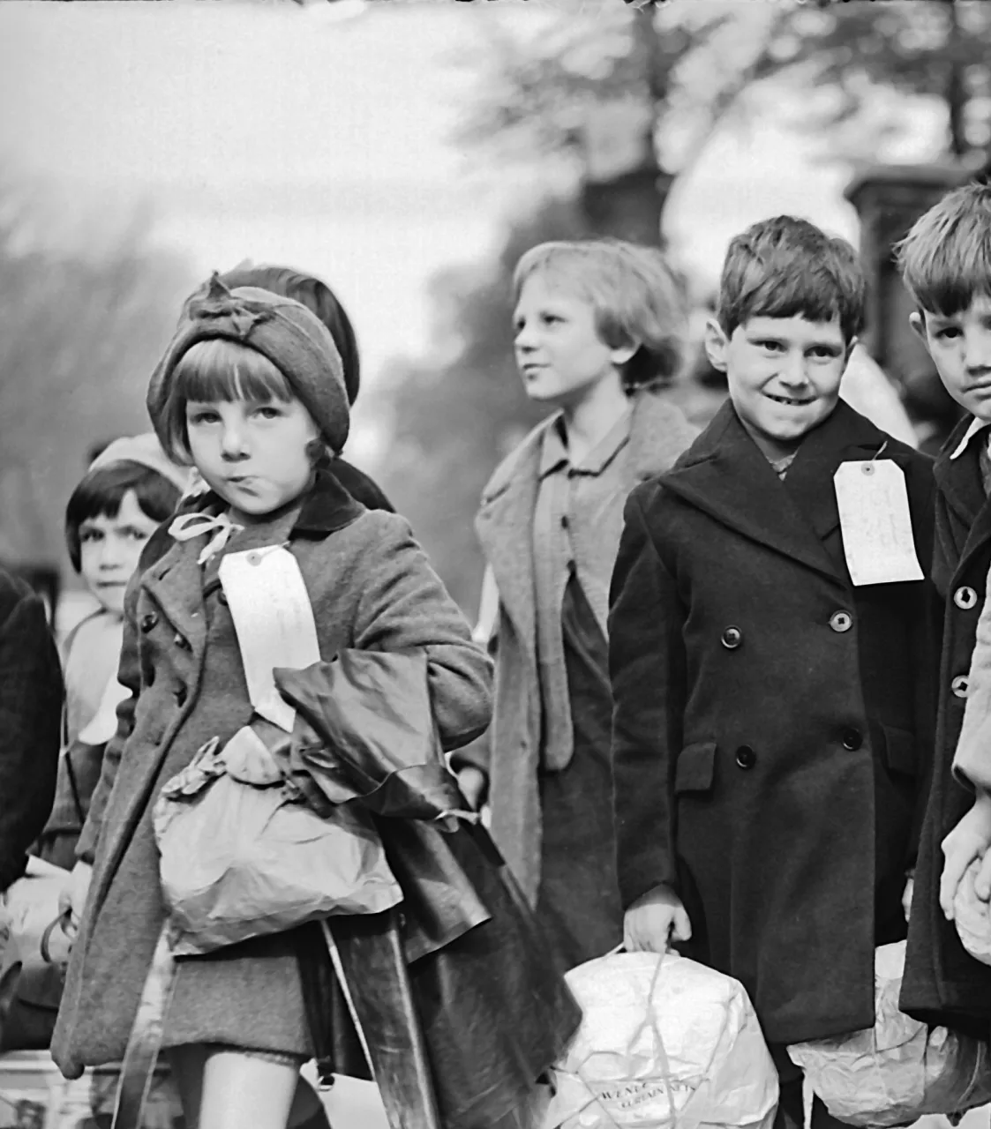
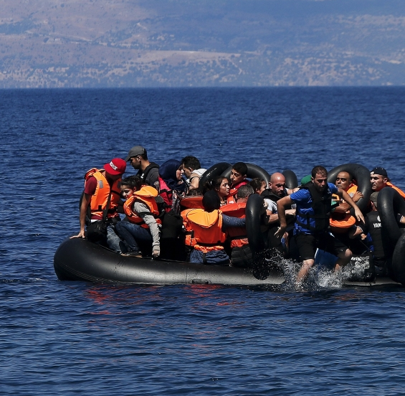
AQA GCSE LANGUAGE – PAPER TWO
EVACUATION
Notes:
@SPryke2

Slide 2
READ THE SOURCES
Read the sources.
As you read, highlight anything you can use to answer Q2 and Q4.
The differences between Alan Day and Hamed Shurbaji’s situation.
The differences in their perspectives towards their experiences.

Slide 3
Source A - A PERSONAL ACCOUNT OF EVACUATION by Alan Day, 1939
I woke up that morning feeling fearful of the events to come. I was young to be evacuated. Up to then I had not been anywhere without my parents except for one or two Sunday school outings. My clothes had been packed in my regulation rucksack; it was the deluxe version, crudely made of sacking but water- proofed and green coloured supplied by the school at the cost of 9d, the ordinary ones were brown, sack colour, not water-proofed and cost 6d. I don’t remember the journey to school but my mother came with me. I don’t even remember my farewell to my dad and sister but they went off to work as usual. Not many east end dads could afford to lose a day’s work in those days.
At school those of us who were going away assembled in the hall, the other children stayed in the classroom. Each of us in the hall had our rucksack, our gas-mask in a cardboard box and hung round our necks by a piece of string. Our hands clasped a paper bag containing the prescribed iron rations, a bar of chocolate, some raisins and an orange. The lonely fear was soon replaced by a group excitement, just like going on a school outing, but none of us had ever experienced that. None knew what to expect. Where we were going or how long we would be away. I supposed that none of us realised what was really happening.
We were grouped into classes and at the appointed hour we marched out of the school, single file and across the road, it was a main road and the traffic had been stopped by a policeman while a crocodile of several hundred kids crossed over, there must have been a big hold up for the traffic. There were lots of mums outside the school gates and along the 200 yards of road to the station - my mum was there but I didn’t notice her. I do not remember any kids crying.

Slide 4
Source B - Hamed Shurbaji's account of leaving Syria, 2016
My third and final attempt was the most bizarre and horrible of them all. On a two-level boat, the smugglers this time managed to cram in more than 730 people. We did not expect to see this many people all at once on the same boat. They segregated us this time. They put all the African people in the lower level where the engine was located, and on the upper level they put all the Palestinians, Syrians, and Lebanese.
This trip was disastrous. After few hours of sailing in sea, the boat started to sink and water started to leak inside the boat. We started to bail the water out using buckets for at least 24 hours non-stop. A few hours later, we noticed a helicopter in the horizon. It circled around us in the air for few minutes then left.
Right after that, we saw a ship with a Danish flag approaching us fast. While we tried to get close to it, the big ship hit the nose of our boat and made it sink even faster. People started to jump off the boat, and for 30 minutes of chaos, there wasn't any kind of rescue happening... After I jumped off the boat, I started to swim toward the ship. When I finally reached it, I looked back and saw this horrifying scene of all these people fighting for their lives.
A rescue team had been deployed. It took at least five hours to rescue people, and then only with the aid of the Maltese coast guard. Nevertheless, for some it was too late. Nine people drowned and 30 others who were in the lower level of the boat suffocated to death from the smoke from the engine and died. I was one of the lucky ones.

Slide 5
KEY SKILL – SUMMARISING AND INFERENCE (QUESTION 2)
SUMMARY
A summary means you need to ‘sum up’ the text.
Question 2: You need to refer to Source A and Source B for this question.
Use details from both Sources. Write a summary of the differences between Alan Day and Hamed Shurbaji’s situation.
8 marks
INFERENCE
Making a prediction about something based on evidence.
Source A
Source B
WHAT DOES THE MARK SCHEME SAY?
Identify and interpret explicit and implicit information and ideas.

Slide 6
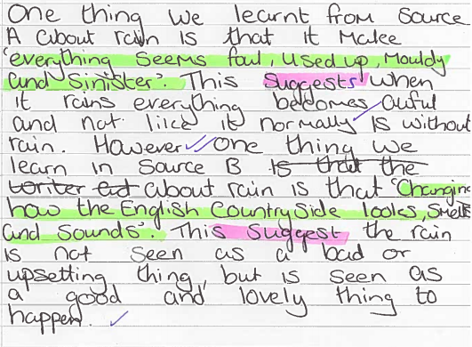

Slide 7
Q2 Refer to source A and Source B. Use details from both Sources. Write a summary of the differences between Alan Day and Hamed Shurbaji’s situation. [8 marks]
Q
One thing we learn…
The writer says…
…which suggests…
Source A
Source B
E
Y
LINK
Q
One thing we learn…
The writer describes…
This suggests…
x2
E
Y
Note! These all show differences.
To make sure you synthesize, you will need to use linking words such as ‘whereas’, ‘unlike’, ‘but’, ‘however’, ‘on the other hand’…

Slide 8
PAPER TWO, QUESTION FOUR
For this question, you need to refer to the whole of Source A, together with the whole of Source B.
Compare how the writers convey their different perspectives on their experiences.
In your answer, you should:
- compare their different perspectives
- compare the methods they use to convey their attitudes
- support your ideas with quotations from both texts
How do they use language?
How do they present their thoughts and feelings?
How do they tell us about their experiences?
What do the writers think?
What has shaped these thoughts and feelings?
What are the writer’s thinking, feeling, imagining and experiencing? What do they do to present these thoughts, feelings and experiences? How do they write to ensure they get these ideas across to their reader?

Slide 9
PAPER TWO, QUESTION FOUR
What do the writers think?
What has shaped these thoughts and feelings?
How do they use language?
How do they present their thoughts and feelings?
How do they tell us about their experiences?
Source A
Source B

Slide 10
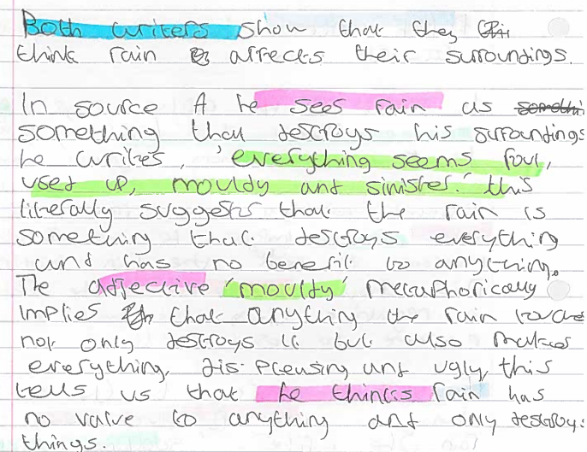

Slide 11
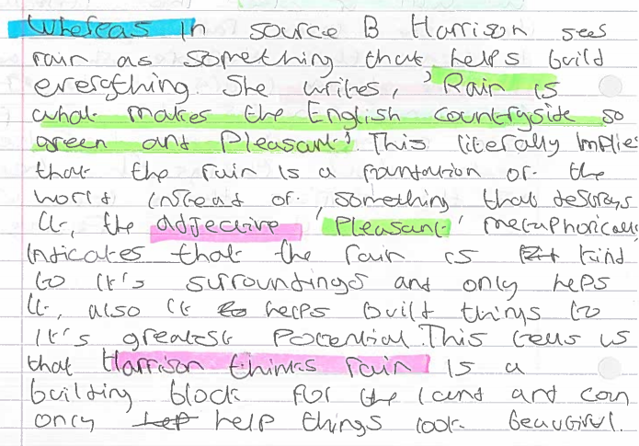

Slide 12
Q4 For this question, you need to refer to the whole of Source A, together with Source B.
Compare how the two writers convey their different perspectives on their experiences.
In your response, you could:
• compare the different views
• compare the methods used to compare their views
• support your ideas with quotations from both texts. [16 marks]
Source A
Source B
Dig in to words – what do they suggest about the experience?
What does he think about the experience?
What does this literally tell us?
Both writers show their views of ...
Day thinks...
He writes ‘…’ This literally means…
The [T] ‘…’ suggests…
This tells us that the writer thinks…
On the other hand, Shurbaji thinks…
He writes …
This literally means…
The [T] ‘…’ suggests…
This tells us that Surbaji thinks…

Slide 13
Q3 Refer to Source B. How does the writer use language to describe the boat sinking?
[12 marks]
Dig in to one word – what does it suggest?
Pull back: what is the writer trying to say about the trip?
Most obvious idea here.
‘QUOTATION’
WHAT HOW WHY
The writer describes the boat as…
He uses the [T] ‘…’ …
This literally means…
The [T] ‘….’ suggests… / could imply…
Furthermore, this could represent…
Another quotation to reinforce this is…

