Slide 1
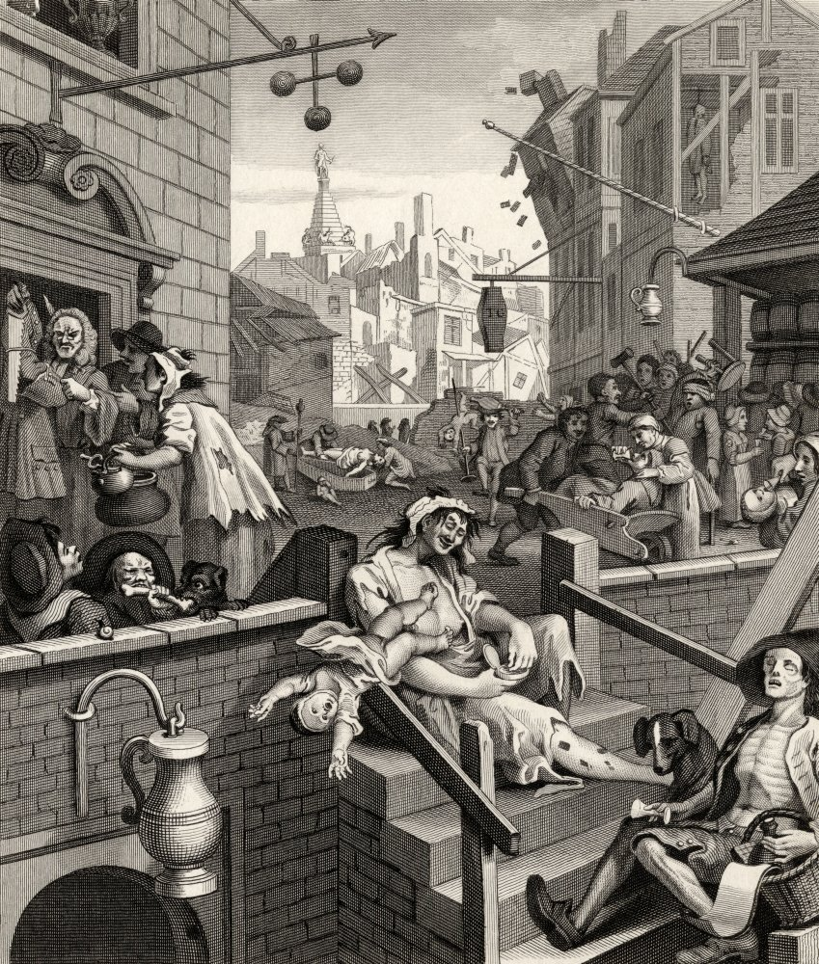
AQA GCSE LANGUAGE – PAPER TWO
GIN
Notes:
@SPryke2

Slide 2
READ THE SOURCES
Read the sources.
As you read, highlight anything you can use to answer Q2 and Q4.
The differences between the effects of gin.
The differences in their perspectives on gin.

Slide 3
Source A: Seven Dials by Charles Dickens (1835)
The stranger who finds himself in 'The Dials' for the first time, and stands at the entrance of seven obscure passages, uncertain which to take, will see enough around him to keep his curiosity and attention awake for no inconsiderable time. From the irregular square into which he has plunged, the streets and courts dart in all directions, until they are lost in the unwholesome vapour which hangs over the house-tops, and renders the dirty perspective uncertain and confined; and lounging at every corner, as if they came there to take a few gasps of such fresh air as has found its way so far, but is too much exhausted already, to be enabled to force itself into the narrow alleys around, are groups of people, whose appearance and dwellings would fill any mind but a regular Londoner's with astonishment.
On one side, a little crowd has collected round a couple of ladies, who having imbibed the contents of various 'three-outs' of gin and bitters in the course of the morning, have at length differed on some point and are on the eve of settling the quarrel satisfactorily, by an appeal to blows, greatly to the interest of other ladies who live in the same house, and tenements adjoining, and who are all partisans on one side or other.
'Why don't you pitch into her, Sarah?' exclaims one half-dressed matron, by way of encouragement. 'Why don't you? if MY 'usband had treated her with a drain last night, unbeknown to me, I'd tear her precious eyes out - a vixen!'
'Never mind,' replies the opposition expressively, 'never mind; YOU go home, and, when you're quite sober, mend your stockings.‘
This somewhat personal allusion, not only to the lady's habits of intemperance, but also to the state of her wardrobe, rouses her utmost ire, and she accordingly complies with the urgent request of the bystanders to 'pitch in'. The scuffle became general, and terminates, in minor play-bill phraseology, with 'arrival of the policemen, interior of the station-house, and impressive denouement.‘
In addition to the numerous groups who are idling about the gin- shops and squabbling in the centre of the road, every post in the open space has its occupant, who leans against it for hours, with listless perseverance. It is odd enough that one class of men in London appear to have no enjoyment beyond leaning against posts. We never saw a regular bricklayer's labourer take any other recreation, fighting excepted.

Slide 4
Source B: Botanical Bliss: Gin Spa opens in Glasgow (The Independent, 2018)
What is more relaxing than getting a pedicure? Getting your feet pampered while enjoying a gin and tonic.
If this sounds too good to be true, we have great news: Gin Spa is an actual place in Glasgow, Scotland - and it sounds incredible. Dedicated solely to the botanicals found in gin, the spirit-themed spa offers up massages, facials, pedicures, and reflexology - with products featuring clove, lavender, eucalyptus, and pink grapefruit.
According to their website, “Gin Spa is the very first botanically inspired day spa in the world, and offers visitors a truly unique experience right in the stylish Merchant City area of Glasgow.” And considering the spa was founded by the team who created Gin71 in 2014, you can guarantee the gin is delicious.
In addition to offering your favourite spirit, customers can also choose their treatments based on how they want to feel - options include: happy, active, tranquil, pure, or detox.
If that doesn’t convince you to book a spa day, the offers will.
You can choose from treatments such as a luxury manicure, which includes a hand massage and a gin cocktail, or a head massage, which comes with a complimentary gin and tonic and an aromatherapy chocolate.
Who else thinks this spa sounds like the most relaxing place on earth?

Slide 5
KEY SKILL – SUMMARISING AND INFERENCE (QUESTION 2)
SUMMARY
A summary means you need to ‘sum up’ the text.
Question 2: You need to refer to Source A and Source B for this question.
Use details from both Sources. Write a summary of the differences between the effects of gin in the two sources.
8 marks
INFERENCE
Making a prediction about something based on evidence.
Source A
Source B
WHAT DOES THE MARK SCHEME SAY?
Identify and interpret explicit and implicit information and ideas.

Slide 6
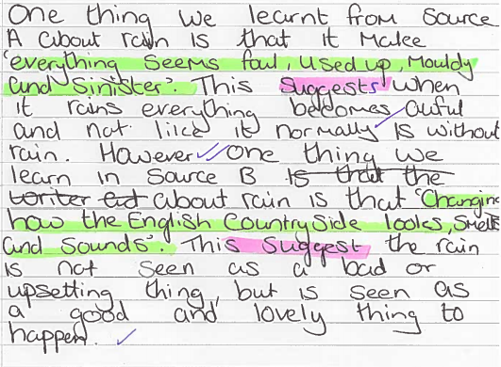

Slide 7
Q2 Refer to source A and Source B. Use details from both Sources. Write a summary of the differences between the effects of gin in the two sources. [8 marks]
Q
One thing we learn…
The writer says…
…which suggests…
Source A
Source B
E
Y
LINK
Q
One thing we learn…
The writer describes…
This suggests…
x2
E
Y
Note! These all show differences.
To make sure you synthesize, you will need to use linking words such as ‘whereas’, ‘unlike’, ‘but’, ‘however’, ‘on the other hand’…

Slide 8
PAPER TWO, QUESTION FOUR
For this question, you need to refer to the whole of Source A, together with the whole of Source B.
Compare how the writers have conveyed their different perspectives on gin.
In your answer, you should:
- compare their different perspectives
- compare the methods they use to convey their attitudes
- support your ideas with quotations from both texts
How do they use language?
How do they present their thoughts and feelings?
How do they tell us about their experiences?
What do the writers think?
What has shaped these thoughts and feelings?
What are the writer’s thinking, feeling, imagining and experiencing? What do they do to present these thoughts, feelings and experiences? How do they write to ensure they get these ideas across to their reader?

Slide 9
PAPER TWO, QUESTION FOUR
What do the writers think?
What has shaped these thoughts and feelings?
How do they use language?
How do they present their thoughts and feelings?
How do they tell us about their experiences?
Source A
Source B

Slide 10
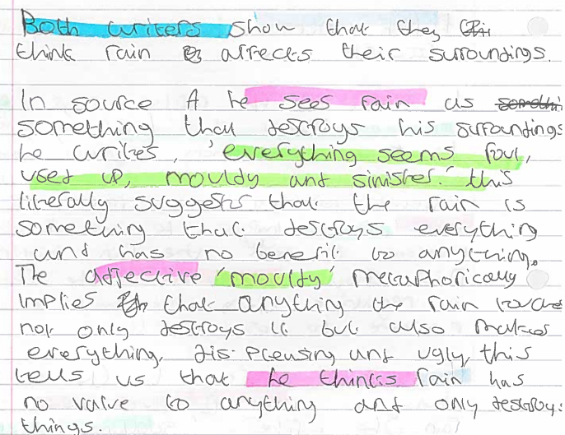

Slide 11
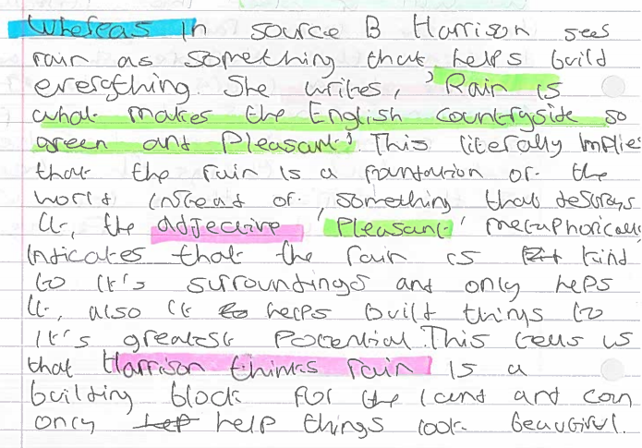

Slide 12
Q4 For this question, you need to refer to the whole of Source A, together with Source B.
Compare how the two writers convey their different perspectives on gin.
In your response, you could:
• compare the different views
• compare the methods used to compare their views
• support your ideas with quotations from both texts. [16 marks]
Source A
Source B
Dig in to words – what do they suggest about gin?
What does he think about gin?
What does this literally tell us?
Both writers show their views of ...
Dickens thinks...
He writes ‘…’ This literally means…
The [T] ‘…’ suggests…
This tells us that the writer thinks…
On the other hand, Writer B thinks…
He writes …
This literally means…
The [T] ‘…’ suggests…
This tells us that Writer B thinks…

Slide 13
Q3 Refer to Source A. How does the writer use language to describe Seven Dials?
[12 marks]
Dig in to one word – what does it suggest?
Pull back: what is the writer trying to say about Seven Dials?
Most obvious idea here.
‘QUOTATION’
WHAT HOW WHY
The writer describes Seven Dials as…
He uses the [T] ‘…’ …
This literally means…
The [T] ‘….’ suggests… / could imply…
Furthermore, this could represent…
Another quotation to reinforce this is…

