Slide 1
PAPER 1
PAPER 2

Slide 2
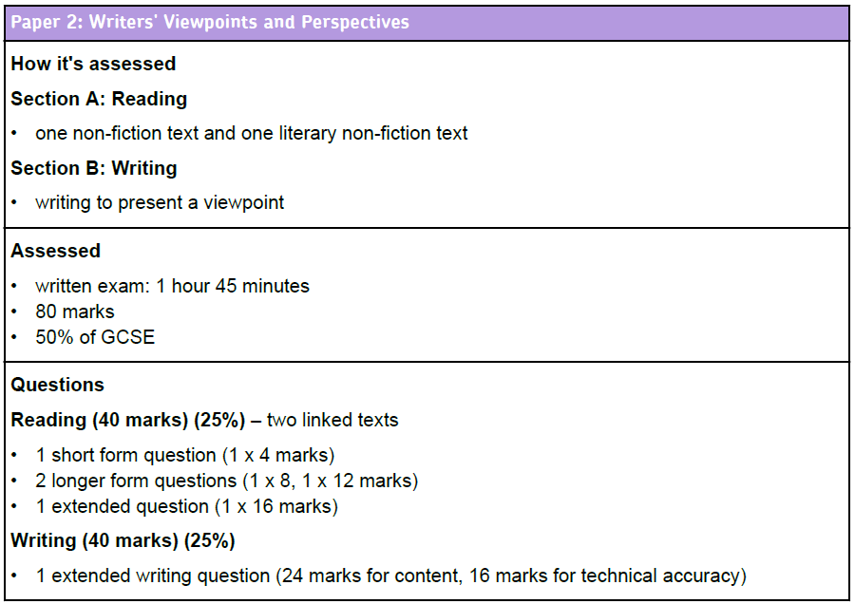
One text will be modern and one will be from the 1800s.
You will be asked to find differences between them.

Slide 3
Learning Objective To be able to identify viewpoints and perspectives

Slide 4
English Language Paper 2
Writers’ Viewpoints and Perspectives
Today’s Title
(Remember to underline it!)

Slide 5
Learning Objective: To be able to identify viewpoints and perspectives
What are viewpoints and perspectives?

Slide 6
Learning Objective: To be able to identify viewpoints and perspectives
Viewpoint:
The way a writer thinks or feels about a topic. This may be explicit (clearly stated) or implicit (implied by the tone or language used).

Slide 7
Learning Objective: To be able to identify viewpoints and perspectives
I hate Las Vegas. It is a terrible, tacky place and the casinos are only interested in encouraging visitors to lose all their money.
How does the writer feel about Las Vegas?
Is this explicit or implicit?

Slide 8
Learning Objective: To be able to identify viewpoints and perspectives
When you have been to one or two casinos and seen how the money just pours into them, like gravel off a dump truck, it is hard to believe that there could be enough spare cash in the world to feed still more of them, yet more are being built all the time. The greed of mankind is practically insatiable, mine included.
How does the writer feel about Las Vegas?
Is this explicit or implicit?

Slide 9
Learning Objective: To be able to identify viewpoints and perspectives
When you have been to one or two casinos and seen how the money just pours into them, like gravel off a dump truck, it is hard to believe that there could be enough spare cash in the world to feed still more of them, yet more are being built all the time. The greed of mankind is practically insatiable, mine included.
Annotate the words and phrases that tell us how the writer (Bill Bryson) feels about Las Vegas. What techniques can you identify?

Slide 10
Did you get?
The verb ‘pours’ suggests a torrent of money, almost like a stream or a river.
This simile is striking but ugly. ‘Gravel’ is used instead of ‘gold’; ‘dump’ suggests something of no worth.
The intensifier ‘just’ adds emphasis.
When you have been to one or two casinos and seen how the money just pours into them, like gravel off a dump truck, it is hard to believe that there could be enough spare cash in the world to feed still more of them, yet more are being built all the time. The greed of mankind is practically insatiable, mine included.
‘Feed’ is personification, making the casinos seem like greedy monsters.
The adjective ‘spare’ makes the ‘cash’ sound worthless.
He uses first person to include himself, suggesting he too will be tricked into losing money.
This metaphor widens the significance of the casinos.

Slide 11
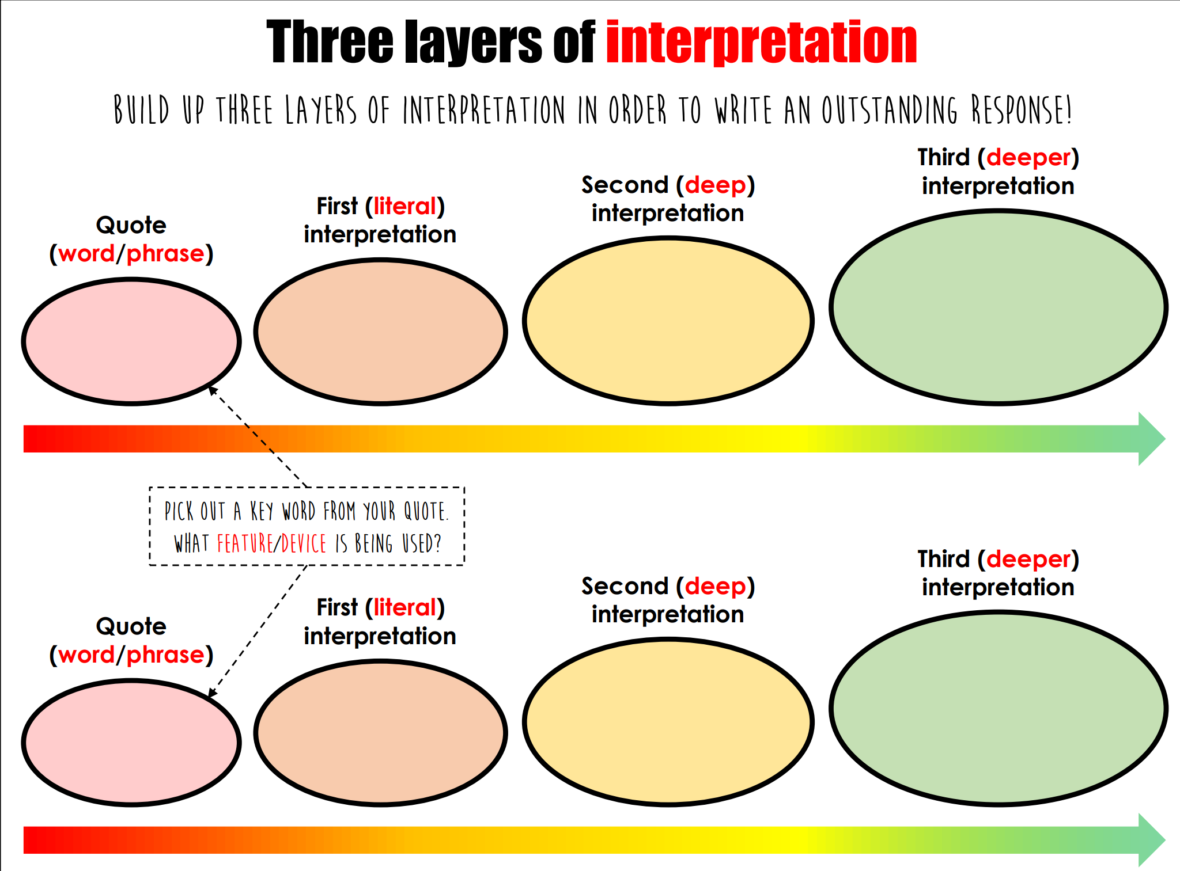
How does Bryson use language to convey his attitude to Las Vegas?

Slide 12
Has connotations of speed: fast moving, and very large quantities
Implies excess and implies a lack of control: unstoppable gambling habit
‘pours’
Verb
Shows money is going into the casinos
WHAT HOW WHY
Bryson uses language to convey a negative view of Las Vegas’ casinos, describing how the gamblers’ money ‘pours’ into them. This verb shows the money being transferred from gambler to the casino; moreover it has connotations of high speed and high volume, implying that lots of money is moving very fast. Furthermore, this volume and speed implies excess and a lack of control, as though the gambler cannot stop this action. This unstoppable gambling culture is one of the features of Las Vegas that Bryson portrays negatively.

Slide 13
Has connotations of speed: fast moving, and very large quantities
Implies excess and implies a lack of control: unstoppable gambling habit
‘pours’
Verb
Shows money is going into the casinos
WHAT HOW WHY
‘like gravel off a dump truck’
WHAT HOW WHY

Slide 14
Learning Objective: Q3: explain, comment on and analyse how writers use language…
Level 4 Perceptive, Detailed 10-12 marks | Shows detailed and perceptive understanding of language: • Analyses the effects of the writer’s choices of language • Selects a judicious range of quotations • Uses a range of subject terminology appropriately
Level 3 Clear, relevant 7-9 marks | Shows clear understanding of language: • Clearly explains the effects of the writer’s choices of language • Selects relevant quotations • Uses a subject terminology accurately
Level 2 Some, attempts 4-6 marks | Shows some understanding of language: • Attempts to comment on the effect of language • Selects some relevant quotations • Uses some subject terminology, not always appropriately
Level 1 Simple, limited 1-3 marks | Shows simple awareness of language: • Offers simple comment on the effects of language • Simple references or textual details • Simple mention of subject terminology

Slide 15
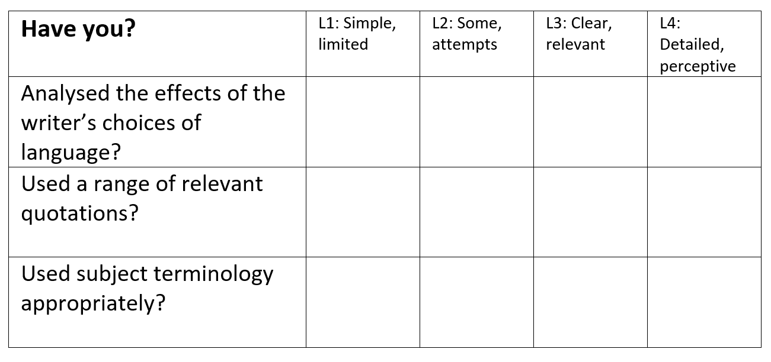
?

Slide 16
Learning Objective: Q1: identify and interpret explicit and implicit information and ideas
Toast by Nigel Slater
How does Slater use language to describe his feelings towards his mother?
My mother is scraping a piece of burned toast out of the kitchen window, a crease of annoyance across her forehead. This is not an occasional occurrence, a once-in-a-while hiccup in a busy mother’s day. My mother burns the toast as surely as the sun rises each morning. In fact, I doubt if she has ever made a round of toast in her life that failed to fill the kitchen with plumes of throat-catching smoke. I am nine now and have never seen butter without black bits in it.
It is impossible not to love someone who makes toast for you. People’s failings, even major ones such as when they make you wear short trousers to school, fall into insignificance as your teeth break through the rough, toasted crust and sink into the doughy cushion of white bread underneath. Once the warm, salty butter has hit your tongue, you are smitten. Putty in their hands.

