Slide 1
Learning Objective To understand Q2: select and synthesize evidence from different texts

Slide 2
Paper 2, Question 2 (AO1) 8 marks Looks something like this:
Learning Objective: Q2: select and synthesize evidence from different texts
You need to refer to source A and source B for this question. Use details from both sources.
Write a summary of the differences between
Eddie and Henry.
Able to synthesise (summarise) explicit and implicit ideas/information

Slide 3
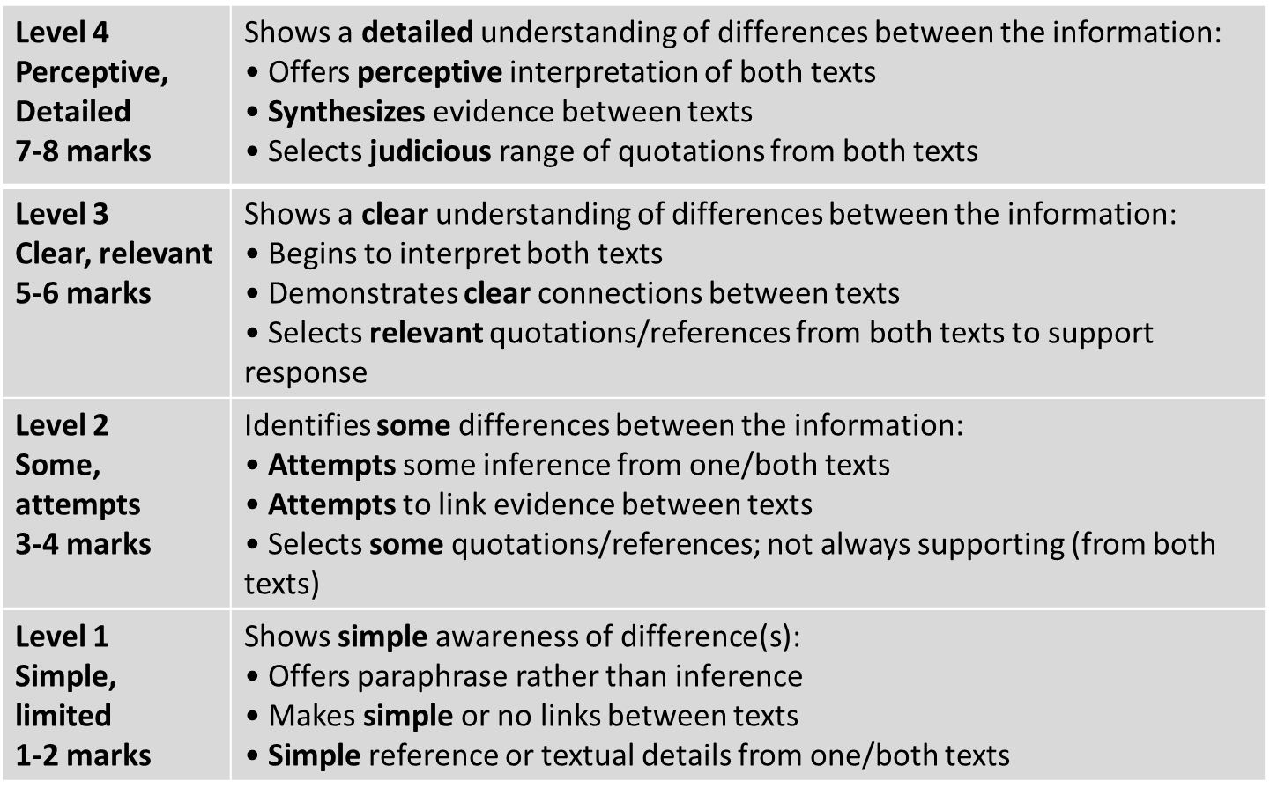
Learning Objective: Q2: select and synthesize evidence from different texts

Slide 4
Learning Objective: Q2: select and synthesize evidence from different texts
Synthesize:
To combine information from different sources. In this exam, it means you have to put together information from the two texts you are given.

Slide 5
Learning Objective: Q2: select and synthesize evidence from different texts
Source A/Source B
The sources will have been chosen because they share a common theme. There will, however, be differences which you will be expected to find.

Slide 6
Learning Objective: Q2: select and synthesize evidence from different texts
Differences:
One big difference will be the time the texts were written. C19th writing style is quite different to a modern style.

Slide 7
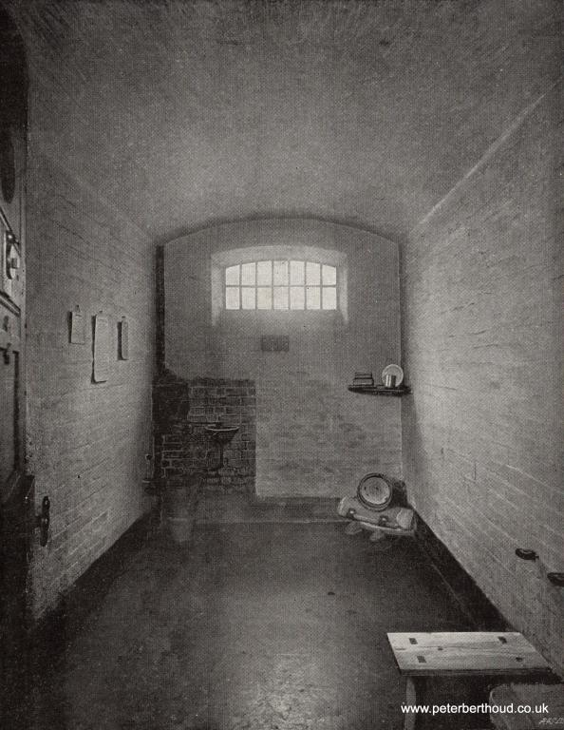
Learning Objective: Q2: select and synthesize evidence from different texts
Q2: Summarise the differences between the two prisons in these images.

Slide 8
Learning Objective: Q2: select and synthesize evidence from different texts
WHAT
One thing we learn…
The picture shows…
…which suggests…
HOW
LINK
WHAT
One thing we learn…
The picture shows…
This suggests…
HOW
Note! These all show differences.
To make sure you synthesize, you will need to use linking words such as ‘whereas’, ‘unlike’, ‘but’, ‘however’, ‘on the other hand’…

Slide 9
Learning Objective: Q2: select and synthesize evidence from different texts
What key details do you want to pick out in the blurbs?
What are your expectations?
Source A
An anonymous inmate describes arriving in Newgate Gaol, a Victorian prison.
Source B
A female inmate describes arriving at Holloway to begin her sentence in a modern jail.

Slide 10
Learning Objective: Q2: select and synthesize evidence from different texts
Read the extract from a c19th article by an anonymous prisoner, describing his first day in Newgate Gaol.

Slide 11
Learning Objective: Q2: select and synthesize evidence from different texts
What do we learn about a new inmate’s experience of a Victorian prison from Source A?
He focuses on three aspects:
Physical details – what the prison and the accommodation was like
Relationships – with the guards
Processes – administration and learning the rules

Slide 12
Learning Objective: Q2: select and synthesize evidence from different texts
He focuses on three aspects:
Physical details – what the prison and the accommodation was like
Relationships – with the guards
Processes – administration and learning the rules
Newgate Gaol – Anonymous
Strong and stony as the prison seems to passers-by, it looks much stonier and stronger to the men who enter it. The multiplicity of heavy walls, of iron gates and doorways; of huge locks, of bolts, spikes and bars of every imaginable shape and size, make of the place a very nightmare dungeon. I followed the gruff under- warden, through some dark and chilly vaulted passages, now turning to the right, now to the left. We crossed a large hall, in the centre of which is a glass room for the use of prisoners when they are giving instructions to their lawyers […].
Still following; I was led into another large recess or chamber, on one side of which was a huge boiler with a furnace glowing under it, and on another side a large stone bath. On the third wall there were a couple of round towels on a roller, with a wooden bench beneath them.
"Stop," cried the warden, "take your clothes off." I hesitated. "Take off your clothes, do you hear?" My clothes were soon laid on the bench, and a hot bath filled, and I went in. The officer had then his opportunity of taking up my garments one by one, searching their pockets and their linings, feeling them about and holding them against the light. My boots appeared to be especially suspicious. After he had put his hands into them, he thumped them violently on the stone floor; but there rolled nothing out.

Slide 13
Learning Objective: Q2: select and synthesize evidence from different texts
He focuses on three aspects:
Physical details – what the prison and the accommodation was like
Relationships – with the guards
Processes – administration and learning the rules
Having bathed, I was led down another passage, at the end of which were two gratings of iron bars, closely woven over with wire-work, distant about two feet from each other. Unlocking both he pushed me through, and started me up two or three steps into a square court-yard, where there was a man walking to and fro very violently. After shouting "One in!" he locked the two gratings, and retreated rapidly in the direction of his dinner. Another warden with a bunch of keys came from a gloomy building that formed one side of the court. "Go up," he said to the pedestrian; who disappeared up a staircase instantly.
"Where from?" the jailor asked me, and "What are you here for?" Being replied to on these points, he said shortly, “Come this way.” He led up the dark stone staircase to a corridor with cells on one side, having iron doors to them a foot or more in thickness. One of these cells was to be mine. Venturing as I went in to ask "Whether I might be allowed to walk in the yard when I pleased?” he answered sharply, “You'll just please to walk where and when you're told." He slammed the door, bolted it, locked and padlocked it.

Slide 14
Learning Objective: Q2: select and synthesize evidence from different texts
He focuses on three aspects:
Physical details – what the prison and the accommodation was like
Relationships – with the guards
Processes – administration and learning the rules
The cell was about eight feet by four, lighted by a Ioophole above eye-level. It contained, besides an iron bedstead with a straw mattress and two coarse rugs upon it, an uncomfortable stool and a slanting reading-desk fastened to the wall, on which were a Bible, a prayer-book, and hymn-book. Alone for the first time since my apprehension, I stretched myself upon the bed; and, with my hands over my eyes endeavoured to collect my thoughts.
I was soon aroused by the undoing of bolts and bars below, while a stentorian* voice shouted from the yard, "All — down!" I heard the cell doors being opened in the corridor; and, in due turn mine was flung open, and the jailor looked in. The impression my body had left upon the rugs enraged him dreadfully. "What," he cried, almost in a scream, "you've been a lying on that 'ere bed, have you! You just let me catch you on it again till night, that's all!"
"Oh," I said soothingly, "I didn't know. Now that I do know, I will not lie down again."
"If I find you on it again I'll have you up before the governor or stop your supper. That's all. Go down."
* stentorian – loud, powerful, booming (describing a voice)

Slide 15
Learning Objective: Q2: select and synthesize evidence from different texts
What do we learn about a new inmate’s experience of a modern prison from Source B?
Focus on three aspects:
Physical details – what the prison and the accommodation was like
Relationships – with the guards
Processes – administration and learning the rules

Slide 16
Learning Objective: Q2: select and synthesize evidence from different texts
Diary of a modern prisoner
Monday 11th March
Many people think that prison must be a terrifying place with lots of violent women locked behind bars. It isn’t. My arrival at Holloway was smooth, humane and expertly carried out, involving quick fingerprinting and the BOSS chair (Body Orifice Security Scanner), essentially a metal detector.
There was no strip search but there are rules. It was clear I had brought in far too many clothes. I was allowed to keep just 12 tops (shirts, T-shirts and jumpers) and six bottoms (trousers, tracksuit bottoms and pyjamas).
No toiletries were allowed but I was given an emergency bag with prison issue and I bought a ‘welcome’ bag for £2.99, which would be subtracted from the cash I brought in with me.
It contained a bottle of orange squash, biscuits, a bar of milk chocolate, deodorant, toothbrush and toothpaste, a comb and some tea bags and sugar. I had the choice of that or a smoker’s bag. But I could take in my books, all 18 of them and many given to me by my children, as well as my writing pads and a couple of pens.
The welcome group and prison guards helped me and some other new inmates move our personal belongings, which had been transferred into transparent prison plastic bags, to landing A3, the reception landing, which ended up being my home for the next few days.
Focus on three aspects:
Physical details – what the prison and the accommodation was like
Relationships – with the guards
Processes – administration and learning the rules

Slide 17
Learning Objective: Q2: select and synthesize evidence from different texts
You need to refer to Source A and Source B for this question.
Use details from both sources. Write a summary of the differences between a prisoner’s experience of arriving in a Victorian and a modern prison.
LINK
Now you have your information, you need to synthesize it: bring it together, looking for differences between the modern and Victorian prisons.

Slide 18
Learning Objective: Q2: select and synthesize evidence from different texts
WHAT
One thing we learn…
The writer says…
…which suggests…
HOW
LINK
WHAT
One thing we learn…
The writer describes…
This suggests…
HOW
Note! These all show differences.
To make sure you synthesize, you will need to use linking words such as ‘whereas’, ‘unlike’, ‘but’, ‘however’, ‘on the other hand’…

Slide 19
Learning Objective: Q2: select and synthesize evidence from different texts
WHAT
Arrival at a modern prison seems calm and straightforward. The writer tells us, ‘there was no strip search’ and the arrival was ‘smooth, humane and expertly carried out’, which suggests it is designed to put the prisoner at ease.
HOW
LINK
WHAT
HOW

Slide 20
Learning Objective: Q2: select and synthesize evidence from different texts
WHAT
Arrival at a Victorian prison seems scary and confusing. The writer describes it as a ‘very nightmare dungeon’ and is told, ‘take off your clothes’ with no explanation. This suggests it is designed to make the prisoner feel unsettled and uncertain.
HOW
LINK
WHAT
HOW

Slide 21
Learning Objective: Q2: select and synthesize evidence from different texts
WHAT
Arrival at a modern prison seems calm and straightforward. The writer tells us, ‘there was no strip search’ and the arrival was ‘smooth, humane and expertly carried out’, which suggests it is designed to put the prisoner at ease.
HOW
LINK
WHAT
Arrival at a Victorian prison seems scary and confusing. The writer describes it as a ‘very nightmare dungeon’ and is told, ‘take off your clothes’ with no explanation. This suggests it is designed to make the prisoner feel unsettled and uncertain.
HOW
To make sure you synthesize, you will need to use linking words such as ‘whereas’, ‘unlike’, ‘but’, ‘however’, ‘on the other hand’…

Slide 22
Learning Objective: Q2: select and synthesize evidence from different texts
WHAT
Arrival at a modern prison seems calm and straightforward. The writer tells us, ‘there was no strip search’ and the arrival was ‘smooth, humane and expertly carried out’, which suggests it is designed to put the prisoner at ease. Arrival at a Victorian prison, however, seems scary and confusing. The writer describes it as a ‘very nightmare dungeon’ and is told, ‘take off your clothes’ with no explanation. This suggests that, unlike the modern prison, it is designed to make the prisoner feel unsettled and uncertain.
HOW
LINK
WHAT
HOW
To make sure you synthesize, you will need to use linking words such as ‘whereas’, ‘unlike’, ‘but’, ‘however’, ‘on the other hand’…

Slide 23
Learning Objective: Q2: select and synthesize evidence from different texts
WHAT
Arrival at a modern prison seems calm and straightforward. The writer tells us, ‘there was no strip search’ and the arrival was ‘smooth, humane and expertly carried out’, which suggests it is designed to put the prisoner at ease. Arrival at a Victorian prison, however, seems scary and confusing. The writer describes it as a ‘very nightmare dungeon’ and is told, ‘take off your clothes’ with no explanation. This suggests that, unlike the modern prison, it is designed to make the prisoner feel unsettled and uncertain.
HOW
LINK
WHAT
HOW
Now have a go at writing your own!

Slide 24
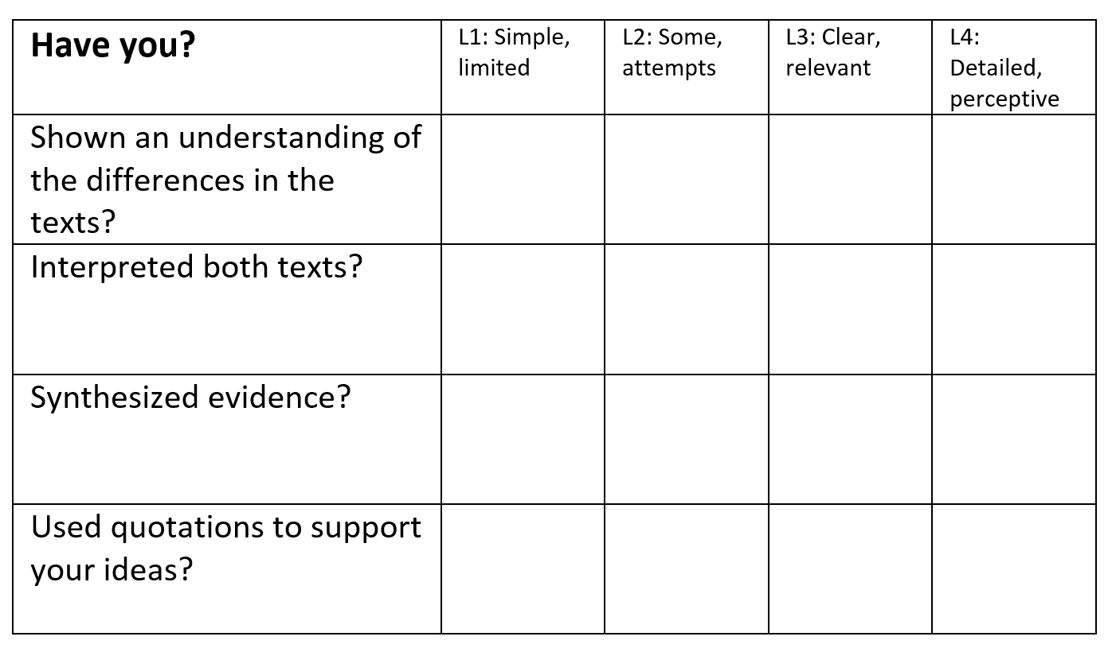
Learning Objective: Q2: select and synthesize evidence from different texts
LINK
Self-Assess

Slide 25
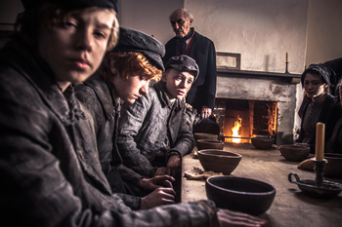
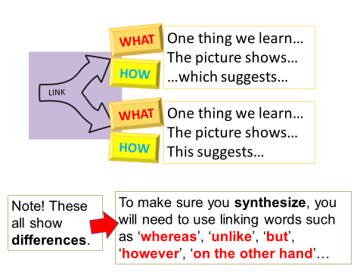
Learning Objective: Q2: select and synthesize evidence from different texts
Summarise the differences between these two dining rooms

Slide 26
Learning Objective: Q2: select and synthesize evidence from different texts
Look at his role: what are your expectations?
Look at where he’s eating: what are your expectations?
Source A
Jay Rayner, restaurant critic for the Guardian newspaper, eats at the flagship Michelin three-star restaurant of the George V Hotel in Paris. (2017)
Source B
In his book, Robert Blincoe's Memoir (1828) John Brown recounts Blincoe's first experience of eating food in the factory apprentice house.
Look at where he’s eating: what are your expectations?
Does this suggest that he’s there for pleasure?

Slide 27
Learning Objective: Q2: select and synthesize evidence from different texts
Q2: Write a summary of the differences in the eating places
Highlight information about…
The dining rooms
The people
The food
(Each of these can then be a focus for a QEYQEY comparative paragraph)

Slide 28
Learning Objective: Q2: select and synthesize evidence from different texts

Slide 29
Learning Objective: Q2: select and synthesize evidence from different texts
Self-Assess
Have you improved?

