Slide 1
Learning Objective To understand Q3: explain, comment on and analyse how writers use language…

Slide 2
Paper 2, Question 3 (AO2) 12 marks Looks something like this:
Learning Objective: Q3: explain, comment on and analyse how writers use language…
You now need to refer only to source B.
How does Henry use language to try to influence his father?
Worth 12 marks
Explain, comment on and analyse language and structure.

Slide 3
Learning Objective: Q3: explain, comment on and analyse how writers use language…
Level 4 Perceptive, Detailed 10-12 marks | Shows detailed and perceptive understanding of language: • Analyses the effects of the writer’s choices of language • Selects a judicious range of quotations • Uses a range of subject terminology appropriately
Level 3 Clear, relevant 7-9 marks | Shows clear understanding of language: • Clearly explains the effects of the writer’s choices of language • Selects relevant quotations • Uses a subject terminology accurately
Level 2 Some, attempts 4-6 marks | Shows some understanding of language: • Attempts to comment on the effect of language • Selects some relevant quotations • Uses some subject terminology, not always appropriately
Level 1 Simple, limited 1-3 marks | Shows simple awareness of language: • Offers simple comment on the effects of language • Simple references or textual details • Simple mention of subject terminology

Slide 4
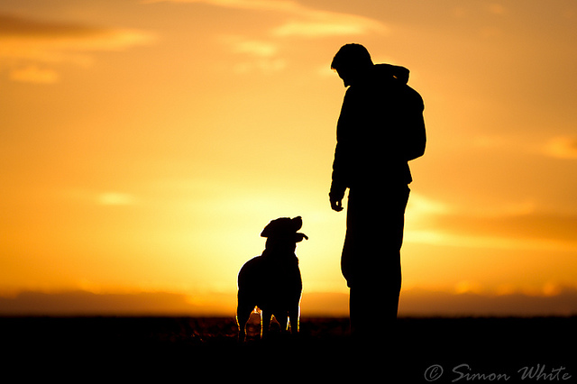
Learning Objective: Q3: explain, comment on and analyse how writers use language…
How does the writer use language to influence the jury’s view of the relationship between a dog and its owner?
George Graham Vest was a US lawyer. This speech was given in court while representing a man who sued another for the killing of his dog. During the trial, Vest ignored the testimony, and when his turn came to present a summation to the jury, he made the following speech and won the case.

Slide 5
Learning Objective: Q3: explain, comment on and analyse how writers use language…
Vest begins his speech by not talking about dogs at all. Instead, he lists all the ways that a man can be betrayed. He makes each example sound as awful as possible – his ‘best friend…in the world’ becomes ‘his enemy’ and when he describes the children ‘that he has reared with loving care’ we see a picture of family happiness. But then it says they are ‘ungrateful’ so that makes it seem like the happiness has been destroyed. In the next sentence, he uses the words ‘nearest and dearest’ to describe friends and family and he builds up this picture of ‘trust’ and ‘happiness’. Then the word ‘traitors’ is used, which sounds very harsh and violent. The next two sentences about money are short and use commas to create rhythm. In the example about reputation he uses the word ‘sacrificed’ which makes loss of reputation seem like a sort of death.
?

Slide 6
Learning Objective: Q3: explain, comment on and analyse how writers use language…
Vest begins his speech by not talking about dogs at all. Instead, he lists all the ways that a man can be betrayed. He makes each example sound as awful as possible – his ‘best friend…in the world’ becomes ‘his enemy’ and when he describes the children ‘that he has reared with loving care’ we see a picture of family happiness. But then it says they are ‘ungrateful’ so that makes it seem like the happiness has been destroyed. In the next sentence, he uses the words ‘nearest and dearest’ to describe friends and family and he builds up this picture of ‘trust’ and ‘happiness’. Then the word ‘traitors’ is used, which sounds very harsh and violent. The next two sentences about money are short and use commas to create rhythm. In the example about reputation he uses the word ‘sacrificed’ which makes loss of reputation seem like a sort of death.
x
x
x

Slide 7
Learning Objective: Q3: explain, comment on and analyse how writers use language…
Vest begins his speech by not talking about dogs at all. Instead, he lists all the ways that a man can be betrayed. He makes each example sound as awful as possible – his ‘best friend…in the world’ becomes ‘his enemy’ and when he describes the children ‘that he has reared with loving care’ we see a picture of family happiness. But then it says they are ‘ungrateful’ so that makes it seem like the happiness has been destroyed.
What’s the effect of this? What will the jury be waiting for?
This adds suspense because the jury is waiting for him to refer to ‘the dog’.
What kind of words are ‘friends’ and ‘enemies’? What is the relationship between these words?
The nouns ‘friend’ and ‘enemy’ are juxtaposed and in direct opposition to each other. This presents the idea that turning against the man in this way is cruel and irreversible.

Slide 8
Learning Objective: Q3: explain, comment on and analyse how writers use language…
In the next sentence, he uses the words ‘nearest and dearest’ to describe friends and family and he builds up this picture of ‘trust’ and ‘happiness’. Then the word ‘traitors’ is used, which sounds very harsh and violent. The next two sentences about money are short and use commas to create rhythm. In the example about reputation he uses the word ‘sacrificed’ which makes loss of reputation seem like a sort of death.
What kind of words are used in the quotations?
What is the effect of this rhythm?
How does this affect the jury?

Slide 9
Learning Objective: Q3: explain, comment on and analyse how writers use language…
?

Slide 10
Learning Objective: Q3: explain, comment on and analyse how writers use language…
x
x
x

Slide 11
Learning Objective: Q3: explain, comment on and analyse how writers use language…
Choose three other quotations from the text and do a layered analysis.
Use your notes to write three analytical paragraphs to answer this Q3.
[Remember to show off your
use of terminology!]
How does the writer use language to influence the jury’s view of the relationship between a dog and its owner?

Slide 12
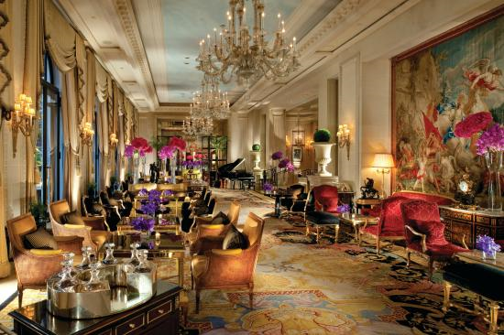
Learning Objective: Q3: explain, comment on and analyse how writers use language…
Q3: How does Jay Rayner use language to describe the food in Source B?
12 marks
The canapé we are instructed to eat first is a transparent ball on a spoon. It looks like a Barbie-sized silicone breast implant, and is a “spherification”, a gel globe using a technique perfected by Ferran Adriàat El Bulli about 20 years ago. This one pops in our mouth to release stale air with a tinge of ginger. My companion winces. “It’s like eating a condom that’s been left lying about in a dusty greengrocer’s,” she says.

