Slide 1
Learning Objective To understand Q4: compare writers’ ideas and perspectives

Slide 2
Paper 2, Question 4 (AO3) 16 marks Looks something like this:
Learning Objective: Q4: compare writers’ ideas and perspectives
For this question, you need to refer to the whole of source A together with source B.
Compare how the two writers convey their different attitudes to parenting and education.
In your answer, you should:
• compare their different attitudes
• compare the methods they use to convey their attitudes
• support your ideas with quotations from both texts.
Compare writers’ ideas/ perspectives and how they are conveyed to us.

Slide 3
Learning Objective: Q4: compare writers’ ideas and perspectives
Level 4 Perceptive, Detailed 13-16 marks | Shows a detailed understanding of the differences between the ideas and perspectives • Compares ideas and perspectives in a perceptive way • Analyses how methods are used to convey ideas and perspectives • Select a range of judicious quotations from both texts
Level 3 Clear, relevant 9-12 marks | Shows a clear understanding of the differences between ideas and perspectives • Compares ideas and perspectives in a clear and relevant way • Explains clearly how methods are used to convey ideas and perspectives • Selects relevant quotations to support from both texts
Level 2 Some, attempts 5-8 marks | Identifies some differences between the ideas and perspectives • Attempts to compare ideas and perspectives • Some comment on how methods are used to convey ideas and perspectives • Selects some quotations/references, not always supporting (from one or both texts)
Level 1 Simple, limited 1-4 marks | Simple awareness of different ideas and/or perspectives • Simple cross reference of ideas and/or perspectives • Simple identification of how differences are conveyed • Simple references or textual details from one or both texts

Slide 4
Learning Objective: Q4: compare writers’ ideas and perspectives
To answer this question successfully, you need to include four things:
Viewpoint: what is being said in the text
Perspective: how the writer’s context affects their ideas
Method: how the ideas are expressed
Quotations: to support your ideas

Slide 5
Learning Objective: Q4: compare writers’ ideas and perspectives
Statement linking the perspectives and attitudes in the texts
Q
E
T
W
R
Y
LINK
Dig into HOW the writers do this?
(They will do this differently)
E
T
W
R
Y

Slide 6
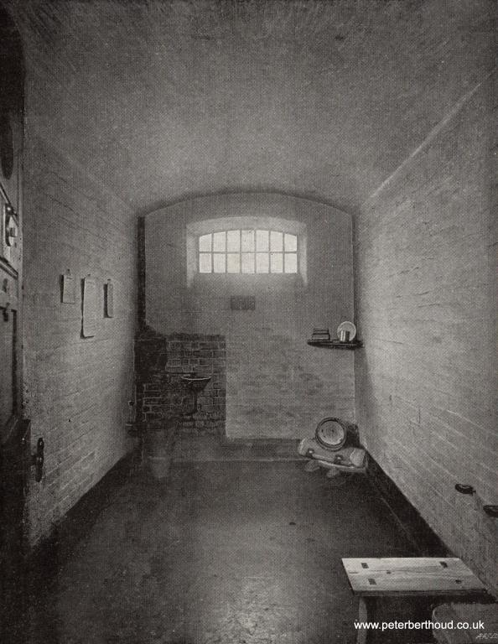
Learning Objective: Q4: compare writers’ ideas and perspectives
Let’s look at the prison texts again. Our question this time is:
Compare how the two writers present their views of the experience of prison.
Statement linking the perspectives and attitudes in the texts
Q
E
T
W
R
Y
LINK
Dig into HOW the writers do this?
(They will do this differently)
E
T
W
R
Y

Slide 7
Learning Objective: Q4: compare writers’ ideas and perspectives
Strong and stony as the prison seems to passers-by, it looks much stonier and stronger to the men who enter it. The multiplicity of heavy walls, of iron gates and doorways; of huge locks, of bolts, spikes and bars of every imaginable shape and size, make of the place a very nightmare dungeon. I followed the gruff under- warden, through some dark and chilly vaulted passages, now turning to the right, now to the left. We crossed a large hall, in the centre of which is a glass room for the use of prisoners when they are giving instructions to their lawyers.
Still following; I was led into another large recess or chamber, on one side of which was a huge boiler with a furnace glowing under it, and on another side a large stone bath. On the third wall there were a couple of round towels on a roller, with a wooden bench beneath them.
"Stop," cried the warden, "take your clothes off." I hesitated. "Take off your clothes, do you hear?" My clothes were soon laid on the bench, and a hot bath filled, and I went in. The officer had then his opportunity of taking up my garments one by one, searching their pockets and their linings, feeling them about and holding them against the light. My boots appeared to be especially suspicious. After he had put his hands into them, he thumped them violently on the stone floor; but there rolled nothing out.
Many people think that prison must be a terrifying place with lots of violent women locked behind bars. It isn’t. My arrival at Holloway was smooth, humane and expertly carried out, involving quick fingerprinting and the BOSS chair (Body Orifice Security Scanner), essentially a metal detector.
There was no strip search but there are rules. It was clear I had brought in far too many clothes. I was allowed to keep just 12 tops (shirts, T-shirts and jumpers) and six bottoms (trousers, tracksuit bottoms and pyjamas).
No toiletries were allowed but I was given an emergency bag with prison issue and I bought a ‘welcome’ bag for £2.99, which would be subtracted from the cash I brought in with me.
It contained a bottle of orange squash, biscuits, a bar of milk chocolate, deodorant, toothbrush and toothpaste, a comb and some tea bags and sugar. I had the choice of that or a smoker’s bag. But I could take in my books, all 18 of them and many given to me by my children, as well as my writing pads and a couple of pens. The welcome group and prison guards helped me and some other new inmates move our personal belongings, which had been transferred into transparent prison plastic bags, to landing A3, the reception landing, which ended up being my home for the next few days.
The lovely girl who had secured the food for me told me on the way that she had two more years to do but enjoyed doing the reception work because it kept her out of her cell until quite late in the evening.
That night was bitterly cold and I soon realised that the windows in Holloway cells do little to keep the chill out. At first I was shown a cell with no curtains and my helpers tried to fasten an orange blanket on to the railings, without much success. Fortunately there was another single cell available with curtains, this time near the guards’ office, but the TV was not working so there was another quick changeover.
Viewpoints:
First impressions
People’s assumptions about prisons
Impressions of other people

Slide 8
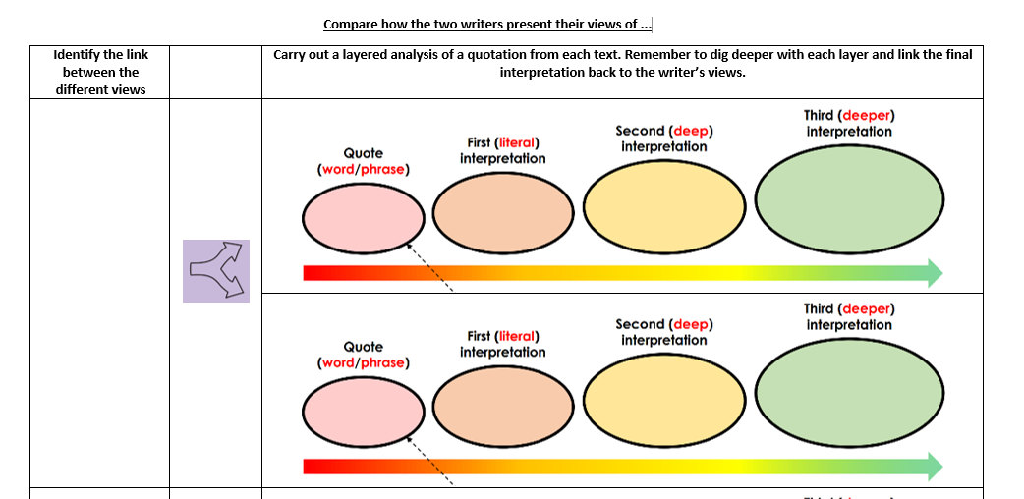
Learning Objective: Q4: compare writers’ ideas and perspectives
Both of the writers present and challenge people’s assumptions about prisons.
He agrees with their view, but uses the comparative adjectives “stronger” and “stonier” to show the reader that this hardness and brutality becomes much more severe and terrifying to an actual prisoner. This shows the reader that the experience of being an actual inmate is unimaginable.
“Strong and stony … to passers-by, it looks much stonier and stronger to the men who enter it.”
Adjectives “strong” and “stony” = how people see the prison.
This represents its hardness and brutality.
This simple, short sentence dismisses the impression clearly and dramatically.
This symbolises for the reader how fundamentally the prisoner disagrees before going on to explain prison life quite positively.
“Many people think that prison must be a terrifying place with lots of violent women locked behind bars.”
Adjectives “terrifying” and “violent” show the extremely negative perspective that people have of prisons, but she says that ‘It isn’t’.

Slide 9
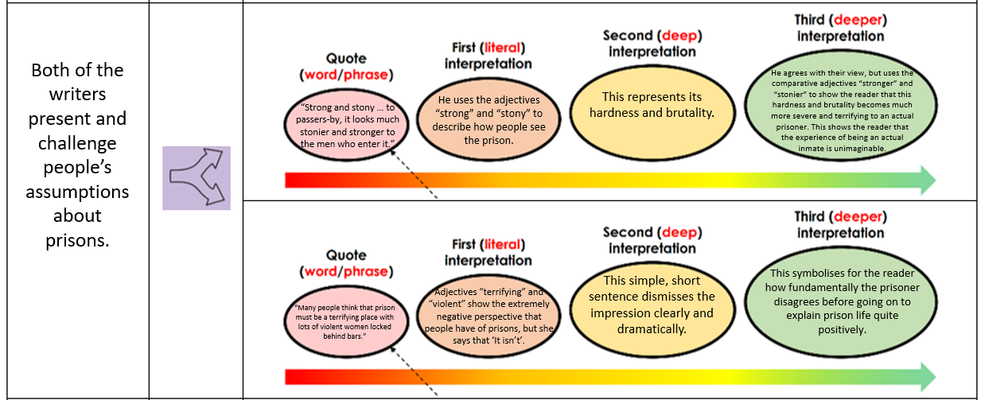
Learning Objective: Q4: compare writers’ ideas and perspectives
Both of the writers present and challenge people’s assumptions about prisons. The Newgate prisoner explains how, “Strong and stony as the prison seems to passers-by, it looks much stonier and stronger to the men who enter it.” He uses the adjectives “strong” and “stony” to describe how people see the prison. These adjectives are negative and imply its hardness and brutality. As a prisoner, he agrees with their view, but uses the comparative adjectives “stronger” and “stonier” to show the reader that this hardness and brutality becomes much more severe and terrifying to an actual prisoner. This shows the reader that the experience of being an actual inmate is unimaginable.
The Holloway prisoner also presents the idea that “Many people think that prison must be a terrifying place with lots of violent women locked behind bars.” The adjectives “terrifying” and “violent” show the extremely negative perspective that people have of prisons. However the writer then contradicts this perspective, disagreeing with this impression by saying simply, “It isn’t.” This simple, short sentence dismisses the impression clearly, dramatically and absolutely for the reader before the prisoner goes on to explain prison life quite positively.

Slide 10
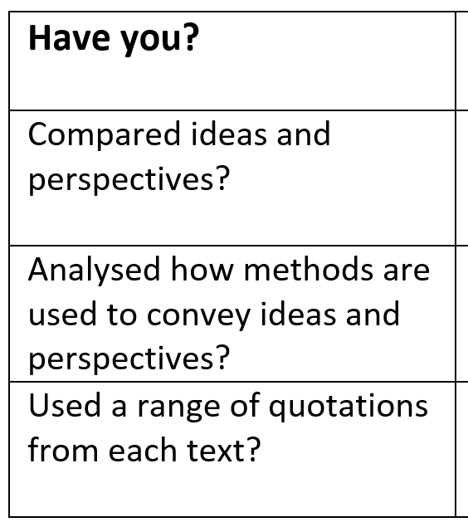
Learning Objective: Q4: compare writers’ ideas and perspectives
Compare how the two writers present their views of the experience of prison.
LINK
Your turn:
Use the other quotations to write another linked comparison paragraph

Slide 11
Learning Objective: Q4: compare writers’ ideas and perspectives
Q4: For this question, you need to refer to the whole of Source A, together with Source B.
Compare how the two writers convey their different attitudes towards their eating experiences.
In your answer, you could:
compare their different perspectives
compare the methods they use to convey their perspectives
support your ideas with references to both texts

Slide 12
Learning Objective: Q4: compare writers’ ideas and perspectives
What is the attitude towards the eating experience?
What techniques has he used to convey his viewpoint?
The dining room, deep in the hotel, is a broad space of high ceilings and coving, with thick carpets to muffle the screams. It is decorated in various shades of taupe, biscuit and sod you.
The young strangers were conducted into a spacious room, fitted up in the style of the dinner room in the St Pancras workhouse, with long, narrow tables, and wooden benches. Although the rooms seemed tolerably clean, there was a certain rank, oily smell, which Blincoe did not very much admire.

Slide 13
Learning Objective: Q4: compare writers’ ideas and perspectives
The room is impressive, but pretentious
Conveys negative view of the restaurant. It looks impressive, but the customers’ experience does not fit with the grand setting, making it superficial and pretentious, hiding the horror of the meal.
Both show their views of the dining rooms
high ceilings and coving, with thick carpets to muffle the screams
The room has
impressive, traditional architecture, but customers aren’t happy
Noun phrases imply grandeur, but shocking purpose of 3rd item in list: ‘muffle screams’ implies and exaggerates customers’ dissatisfaction
The room is basic and unpleasant
Conveys view that the dining room appears good enough, but this is only superficial. It reflects the workhouse’s attitude towards its workers.
The room appears clean enough, but the dirt is engrained
Adverb ‘tolerably’
implies that the cleanliness is good enough for those eating, but that this is superficial and masks unpleasantness
seemed tolerably clean, there was a certain rank, oily smell

Slide 14
Learning Objective: Q4: compare writers’ ideas and perspectives
What is the attitude towards the eating experience?
What techniques has he used to convey his viewpoint?
The canapé we are instructed to eat first is a transparent ball on a spoon. It looks like a Barbie-sized silicone breast implant, and is a “spherification”, a gel globe using a technique perfected by Ferran Adriàat El Bulli about 20 years ago. This one pops in our mouth to release stale air with a tinge of ginger. My companion winces. “It’s like eating a condom that’s been left lying about in a dusty greengrocer’s,” she says.
The supper set before them consisted of milk-porridge, of a very blue complexion! The bread was partly made of rye, very black, and so soft, they could scarcely swallow it, as it stuck like bird-lime to their teeth.

Slide 15
Learning Objective: Q4: compare writers’ ideas and perspectives
The food is…
Both show their views of the food
like a Barbie-sized silicone breast implant
The food is…
it stuck like bird-lime to their teeth

Slide 16
Learning Objective: Q4: compare writers’ ideas and perspectives
Dig in to words – what do they suggest about the food?
What does he think about the food?
What does this literally tell us?
The food is… disgusting and disappointing
Both show their views of the food
like a Barbie-sized silicone breast implant
The food is… disgusting but expected
it stuck like bird-lime to their teeth
like a Barbie-sized silicone breast implant
it stuck like bird-lime to their teeth

Slide 17
Learning Objective: Q4: compare writers’ ideas and perspectives
Both writers show their views of the food. Rayner thinks that the food is disgusting and disappointing. He writes that the first course is ‘like a Barbie-sized silicone breast implant’. This literally means…
The simile suggests…
This tells us that Rayner thinks…
On the other hand, Brown thinks that the food in the workhouse is disgusting but expected. He writes that the food ‘stuck like bird-lime to their teeth’.
This literally means…
The simile suggests…
This tells us that Brown thinks…

Slide 18
Learning Objective: Q4: compare writers’ ideas and perspectives
Q4: For this question, you need to refer to the whole of Source A, together with Source B.
Compare how the two writers convey their different attitudes towards their eating experiences.
In your answer, you could:
compare their different perspectives
compare the methods they use to convey their perspectives
support your ideas with references to both texts

Slide 19
Learning Objective: Q4: compare writers’ ideas and perspectives
Level 4 Perceptive, Detailed 13-16 marks | Shows a detailed understanding of the differences between the ideas and perspectives • Compares ideas and perspectives in a perceptive way • Analyses how methods are used to convey ideas and perspectives • Select a range of judicious quotations from both texts
Level 3 Clear, relevant 9-12 marks | Shows a clear understanding of the differences between ideas and perspectives • Compares ideas and perspectives in a clear and relevant way • Explains clearly how methods are used to convey ideas and perspectives • Selects relevant quotations to support from both texts
Level 2 Some, attempts 5-8 marks | Identifies some differences between the ideas and perspectives • Attempts to compare ideas and perspectives • Some comment on how methods are used to convey ideas and perspectives • Selects some quotations/references, not always supporting (from one or both texts)
Level 1 Simple, limited 1-4 marks | Simple awareness of different ideas and/or perspectives • Simple cross reference of ideas and/or perspectives • Simple identification of how differences are conveyed • Simple references or textual details from one or both texts

